Slide 1
Welcome

Slide 2
Good News!
Notes:
Let’s start the meeting on a positive note by sharing some good news. Reflect on something positive that happened and share it with the group. It could be a personal milestone, a professional accomplishment, or a simple joy that has brought a smile to your face.

Slide 3
Meeting Agenda
Company Updates
Marketing Updates
Wants & Needs
Real Estate Trends
Education Opportunities
Agent Development
Old Business
New Business
Adjourn
Notes:
NOTE: Edit the agenda as appropriate for your meeting.

Slide 4
Company Updates
Notes:
New company listings and buyer needs
Company Initiatives (company-specific updates or topics you deem appropriate)
“Parking Lot” items from previous meetings
Agent Sales Contest

Slide 5
Marketing Updates
Notes:
Company marketing initiatives
Company community service projects and events
Agent marketing opportunities that complement company/brand marketing

Slide 6
Wants & Needs

Slide 7
Notes:
Keeping up to date on real estate data trends and sharing relevant market insights with your clients and customers can set you apart in today’s competitive market. Let’s dive into the current dynamics shaping the national real estate landscape.

Slide 8
Real Estate Trends Local Market Report
Notes:
Total number of listings currently available per MLS
Number of pendings last month per MLS
Number of closed transactions last month per MLS

Slide 9
Real Estate Trends Company Production
Notes:
Production Updates, Listings, Under Contracts, Closings (various ways to share)
Previous month vs. the same period last year
Year To Date (YTD)
Year Over Year (YOY)
Market Share

Slide 10
Real Estate Trends Company Data
Notes:
Average DOM from List to Under Contract
Average DOM from Under Contract to Close
Average / Median List Price
Average / Median Sales Price
Company’s List Price to Sales Price Ratio

Slide 11
Education Opportunities

Slide 16
Guest Speaker
<INSERT SPEAKER NAME & COMPANY>
Notes:
NOTE: Delete if not using a guest speaker.

Slide 17
Old Business & New Business
Notes:
Updates and follow-up to the previous meeting
“Parking Lot” items

Slide 18
Next Meeting
INSERT Date & Time
INSERT Location
INSERT Next Meeting Highlight
Notes:
TIP: Consider adding a meeting teaser, such as the learning sprint topic, below the meeting location

Slide 19
Spark Your Business
National Watermelon Day
August 3, 2025
Drop by with a mouth-watering watermelon. Attach a clever tag and business cards.
Image Courtesy of Etsy Seller Systems and Solutions
Notes:
As we wrap up today’s sales meeting, let’s leave you with a fresh, actionable idea to ignite your business and keep your pipeline overflowing.
Staying top-of-mind with your clients doesn’t have to be routine—it can be memorable and fun. Here’s a creative twist: August 3rd is National Watermelon Day. Why not stand out by picking up several small watermelons from your local Farmers’ Market? Attach a clever tag—customized with your name and contact info—or slip a few business cards into a small envelope taped to each melon. Then, deliver these to past clients and key contacts in your sphere of influence during the last week of July.
This simple gesture is more than a sweet treat; it’s a conversation starter that gets you remembered. Consistent, thoughtful touches like this are the seeds of repeat and referral business—the highest return on your marketing investment.

Slide 20
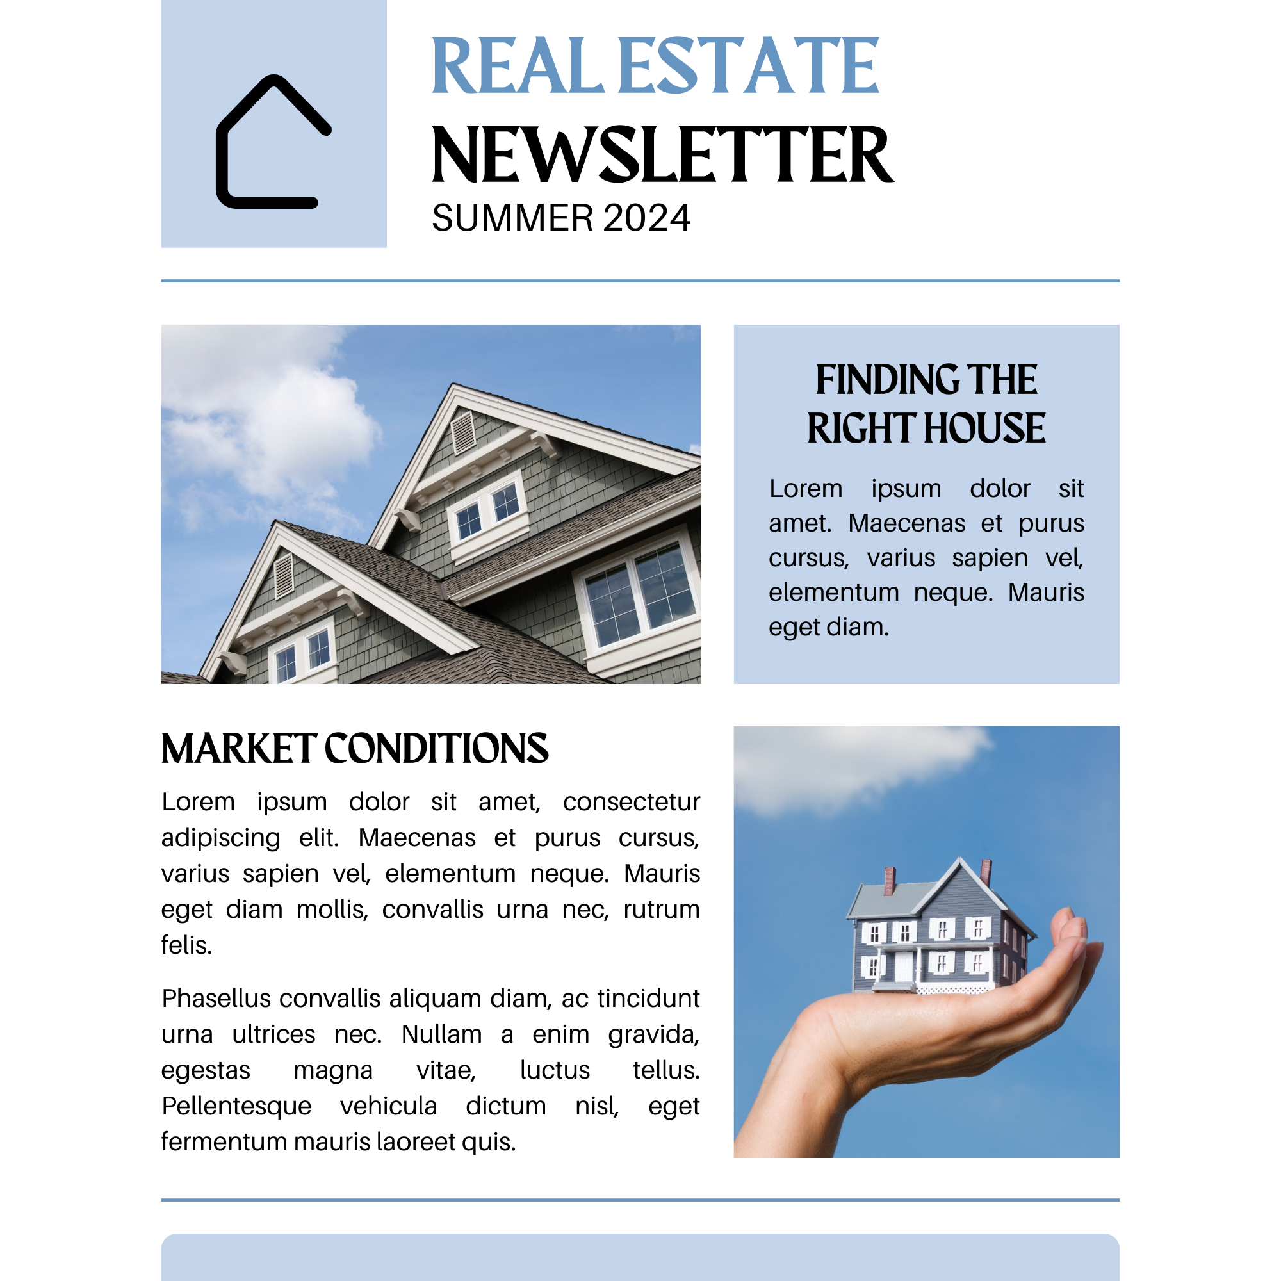
Spark Your Business
Newsletter
What’s Going On in Real Estate?
Create a newsletter focusing on important information for buyers and sellers.
Notes:
As we close today’s meeting, here’s one quick idea to keep your pipeline thriving:
Create a summer market newsletter! Feature seasonal market guidance, such as the best times to buy or sell, summer maintenance tips, and local market data, such as inventory levels and average days on market.
The best part of sending a newsletter is that it gets shared, extending your reach to friends, family, and neighbors. Use free templates from Canva, Google Docs, or Adobe to give it a sharp and professional look.
Take action this week—your next deal could start with your newsletter!

Slide 21
Spark Your Business
Social Media Posts
Summer Trends in Real Estate
Notes:
As we conclude today’s sales meeting, we want to leave you with one idea to help Spark Your Business and keep your pipeline full.
Create social media posts that focus on summer real estate trends. Post current trends, such as types of properties in demand, tips for preparing your home to sell in the late summer market, and the benefits of buying a home before the start of the school year. Add quality photos relevant to each post to stand out and draw attention. Many websites offer high-quality, free stock photos, such as Adobe Stock Images and Unsplash. Make sure you are engaging with any comments or likes since that may boost your SEO.

Slide 22
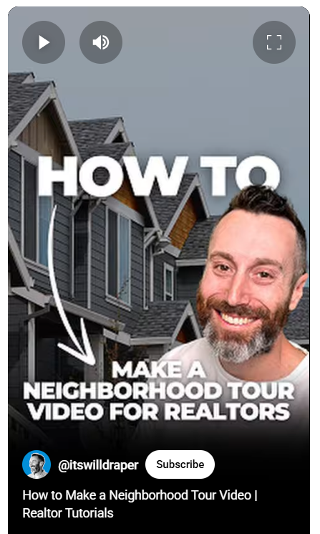
Spark Your
Business
Social Media
Virtual Neighborhood Tours
Notes:
As we conclude today’s sales meeting, we want to leave you with one idea to help Spark Your Business and keep your pipeline full.
Create engaging virtual tours of neighborhoods where you have listings or specialize. Highlight not just the homes for sale but also local amenities, schools, parks, and community events. Promote these tours through targeted social media advertising to attract potential buyers and sellers interested in those areas. Tour videos showcase your local market knowledge and position you as a valuable resource for anyone looking to buy or sell in those neighborhoods.

