Slide 1
Spark Your Business
Independence Day
^{July 4th}
Surprise past clients and SOI connections with a patriotic gift.
Image: Systems and Solutions (Etsy)
Notes:
As we conclude today’s sales meeting, we want to leave you with one idea to help Spark Your Business and keep your pipeline full.
Prepare small gift bags with sparklers, a small American flag, and glow sticks. Attach a clever tag like this one and include a couple of your business cards in the bag. Identify past clients and SOI connections who are nearby and drop them off during the last week of June. This will help you stay top-of-mind for repeat and referral business.

Slide 2
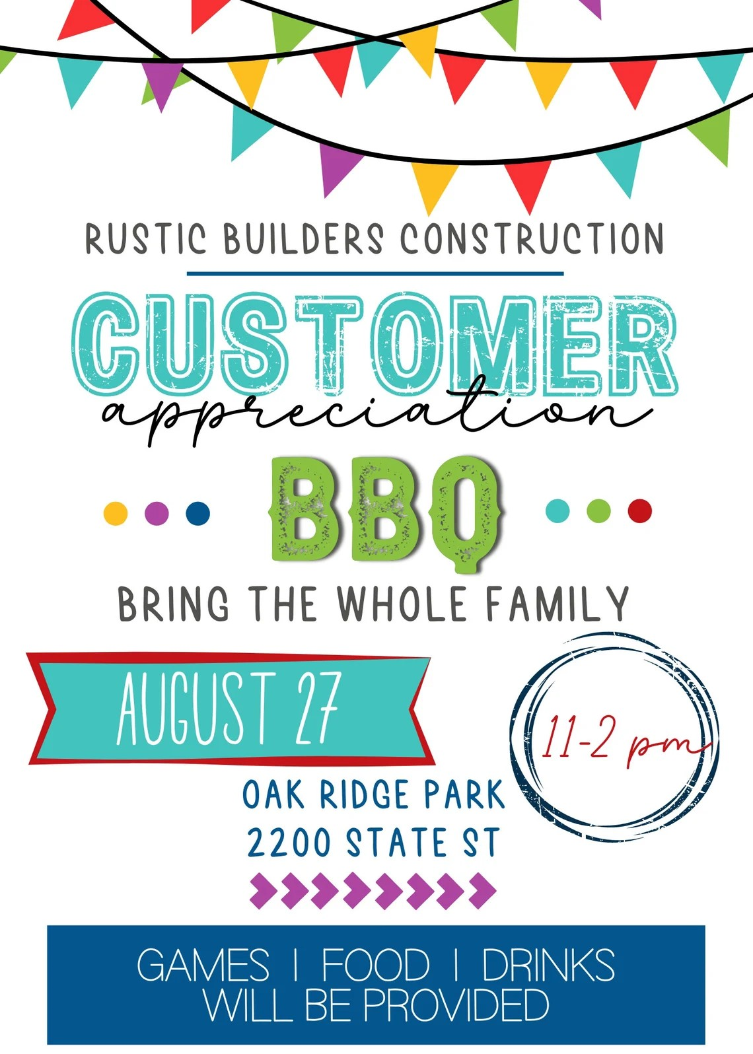
Spark Your Business
Customer Appreciation BBQ Event
Show your gratitude for your past clients.
Image: Nolasgoods (Etsy)
Notes:
As we wrap up today’s meeting, I want to leave you with one simple idea to help spark your business and keep your pipeline full: organize a summer-themed client appreciation event! Picture this—a casual get-together at a local park or backyard, complete with a barbecue, lawn games, and plenty of laughs. Send out personal invitations, maybe even a quick video message, to let your clients know how much you appreciate them. Add some branded summer swag—think sunglasses or water bottles—so your clients remember you long after the party’s over. This isn’t just about having fun (though that’s a big part of it!); it’s about deepening your relationships, building loyalty, and setting yourself up for more referrals. Happy clients don’t just come back—they bring their friends! So let’s make this summer the one where you grill up some gratitude and serve up a whole new batch of referrals.

Slide 3
Spark Your Business
Local Real Estate Market Trends
Demonstrate your expertise with a local real estate market update.
Notes:
As we conclude today’s sales meeting, we want to leave you with one idea to help Spark Your Business and keep your pipeline full.
Sharing local market trends with your database positions you as a knowledgeable and trusted real estate advisor. Whether you choose a brief email or a personalized letter, a quick update on recent sales activity, price changes, or inventory levels keeps your clients informed and engaged. This information helps homeowners and buyers make smarter decisions—whether they're considering selling, buying, or simply curious about their neighborhood's value. Regular, relevant communication like this demonstrates your expertise and keeps you top-of-mind for referrals and future business.

Slide 4
Spark Your
Business
Back-To-School Supplies Drive
Organize a community event to collect much-needed classroom supplies.
Notes:
As we conclude today’s sales meeting, we want to leave you with one idea to help Spark Your Business and keep your pipeline full.
Consider sponsoring a Back-to-School activity, such as providing backpacks filled with school supplies or classroom items teachers often request.
Plan to advertise during July and early August so you’ll have the items ready to be delivered at the beginning of the school year.
Leverage your social media accounts to promote the activity. Take pictures during the entire process to update and engage your connections.
Consider asking vendors you use to collaborate with you, such as a home inspector or mortgage broker.
It’s proven that people like to do business with businesses that give back to the community.

Slide 5
Spark Your
Business
Local Recreation
Newsletter
Highlight opportunities to get out and enjoy your community in July.
Notes:
As we conclude today’s sales meeting, we want to leave you with one idea to help Spark Your Business and keep your pipeline full.
Create a newsletter to be delivered electronically or by mail in July that focuses on exploring local recreational activities. The warm summer weather allows people to enjoy various outdoor activities, such as sports, festivals, concerts, and nature-based pursuits.
Many parks and public spaces host special events during the summer to encourage community engagements and physical activities. Include a few of your favorites, too. Add photos where possible to make the newsletter visually appealing. Programs like Canva, Google Docs, and Adobe offer free templates.
This type of marketing has a long shelf life, and recipients may share it with their family, friends, and neighbors.

Slide 6
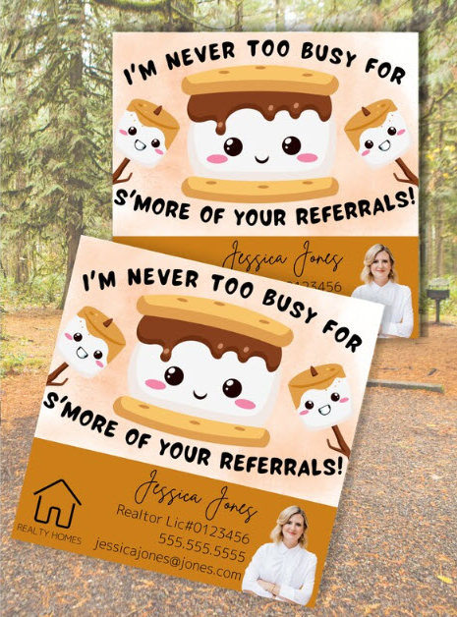
Spark Your Business
World Chocolate Day
July 7, 2024
I’m never too busy for s’more of your referrals!
Image courtesy of Systems and Solutions (Etsy) Discount code: SPARK25
Notes:
As we conclude today’s sales meeting, we want to leave you with one idea to help Spark Your Business and keep your pipeline full.
Fill a gift bag with a bag of marshmallows, a box of graham crackers, and chocolate bars. Attach a clever tag like this one. Drop by select past clients and SOI connections to reconnect in person and leave them with this delicious treat!

