Slide 1
Welcome

Slide 2
Good News!
Notes:
Let’s start the meeting on a positive note by sharing some good news. Reflect on something positive that happened and share it with the group. It could be a personal milestone, a professional accomplishment, or a simple joy that has brought a smile to your face.

Slide 3
Meeting Agenda
Company Updates
Marketing Updates
Wants & Needs
Real Estate Trends
Education Opportunities
Agent Development
Old Business
New Business
Adjourn
Notes:
NOTE: Edit the agenda as appropriate for your meeting.

Slide 4
Company Updates
Notes:
New company listings and buyer needs
Company Initiatives (company-specific updates or topics you deem appropriate)
“Parking Lot” items from previous meetings
Agent Sales Contest

Slide 5
Marketing Updates
Notes:
Company marketing initiatives
Company community service projects and events
Agent marketing opportunities that complement company/brand marketing

Slide 6
Wants & Needs

Slide 7
Notes:
Keeping up to date on real estate data trends and sharing relevant market insights with your clients and customers can set you apart in today’s competitive market. Let’s dive into the current dynamics shaping the national real estate landscape.

Slide 8
Real Estate Trends Local Market Report
Notes:
Total number of listings currently available per MLS
Number of pendings last month per MLS
Number of closed transactions last month per MLS

Slide 9
Real Estate Trends Company Production
Notes:
Production Updates, Listings, Under Contracts, Closings (various ways to share)
Previous month vs. the same period last year
Year To Date (YTD)
Year Over Year (YOY)
Market Share

Slide 10
Real Estate Trends Company Data
Notes:
Average DOM from List to Under Contract
Average DOM from Under Contract to Close
Average / Median List Price
Average / Median Sales Price
Company’s List Price to Sales Price Ratio

Slide 11
Education Opportunities

Slide 16
Guest Speaker
<INSERT SPEAKER NAME & COMPANY>
Notes:
NOTE: Delete if not using a guest speaker.

Slide 17
Old Business & New Business
Notes:
Updates and follow-up to the previous meeting
“Parking Lot” items

Slide 18
Next Meeting
INSERT Date & Time
INSERT Location
INSERT Next Meeting Highlight
Notes:
TIP: Consider adding a meeting teaser, such as the learning sprint topic, below the meeting location

Slide 19
Spark Your Business
Pop by with a gift card to a local ice cream shop.
Systems and Solutions | Etsy
Notes:
As we wrap up today's sales meeting, let's spark your business with a simple yet powerful idea. Identify a few past clients or key contacts and reconnect with a thoughtful gesture. With warmer days ahead, a gift card to a local ice cream shop is sure to hit the spot! Place it in an envelope with your business cards, add a clever tag, and schedule a pop-by visit. If they're not home, just tape it to their door with a smile. This small act can spark meaningful connections and keep your business top of mind – making someone's day a little sweeter!

Slide 20
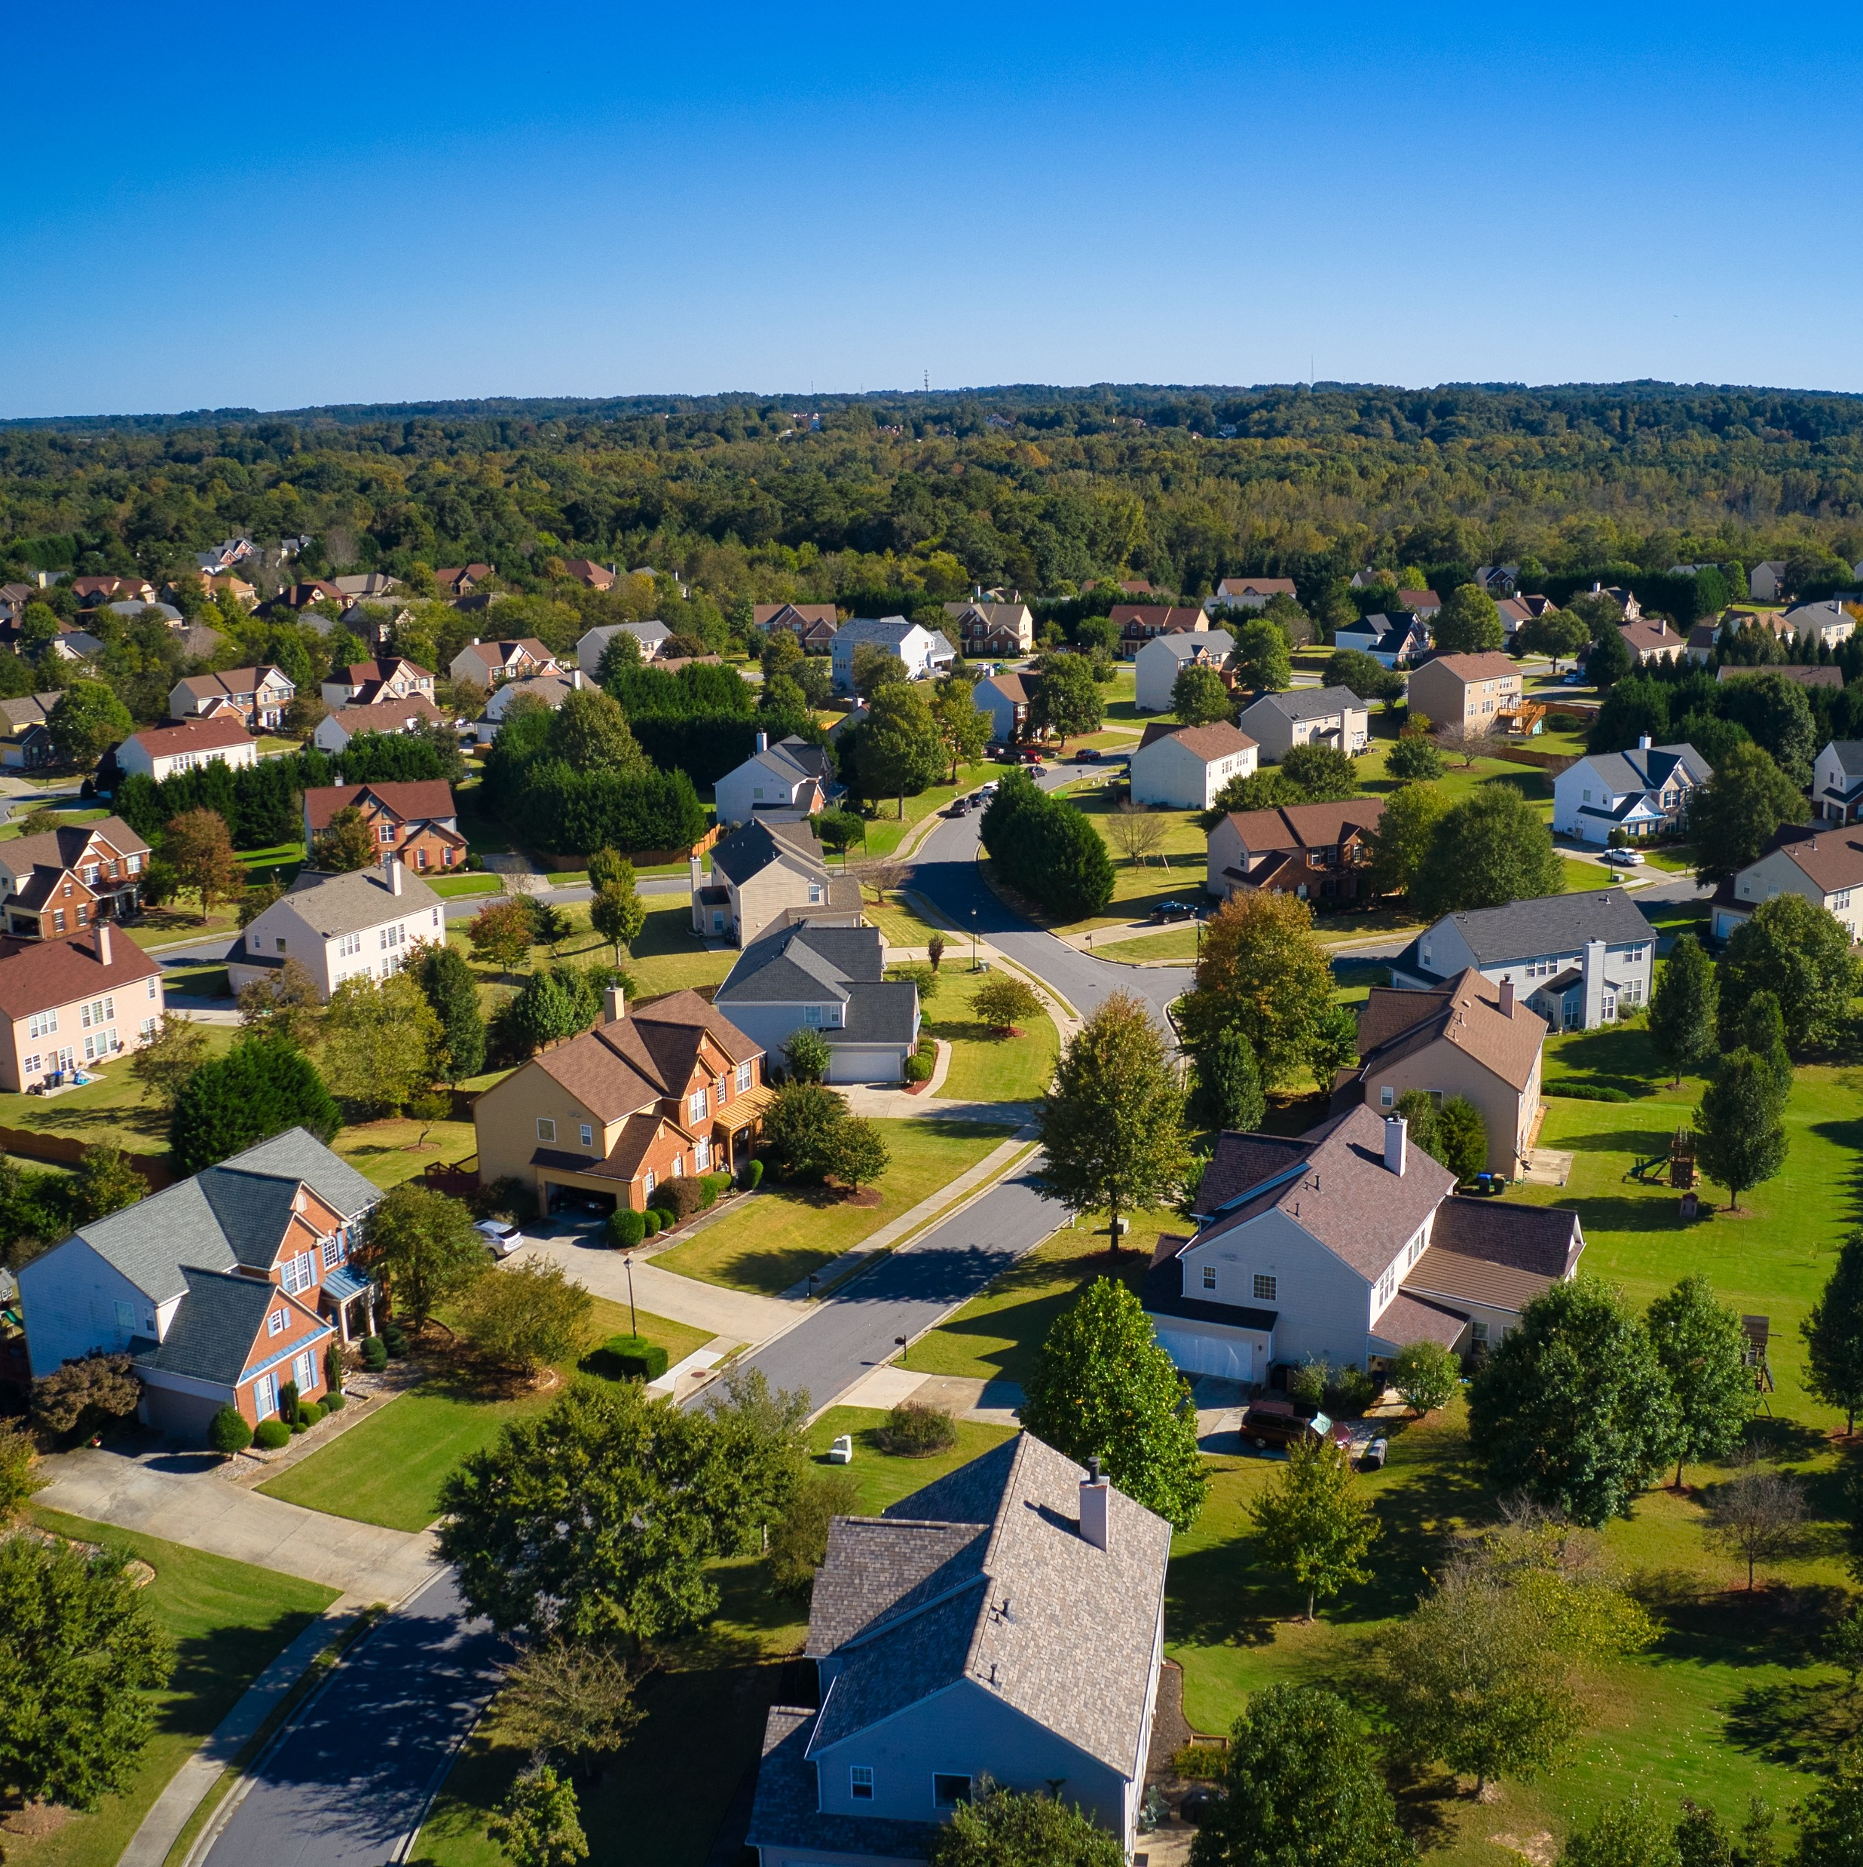
Spark Your Business
Neighborhood Market Reports
Reconnect with past clients
by mailing or emailing neighborhood market reports.
Notes:
As we wrap up today's sales meeting, here's an idea to boost your business: Create a neighborhood market report for past clients. In a brief letter, explain how the market is evolving and share updates about their neighborhood. Send it via mail or email, and always end by expressing your appreciation for referrals when they hear of someone interested in buying or selling locally. If mailing, include a few business cards to keep your contact information handy. This approach keeps your pipeline full and fosters ongoing relationships with past clients.

Slide 21
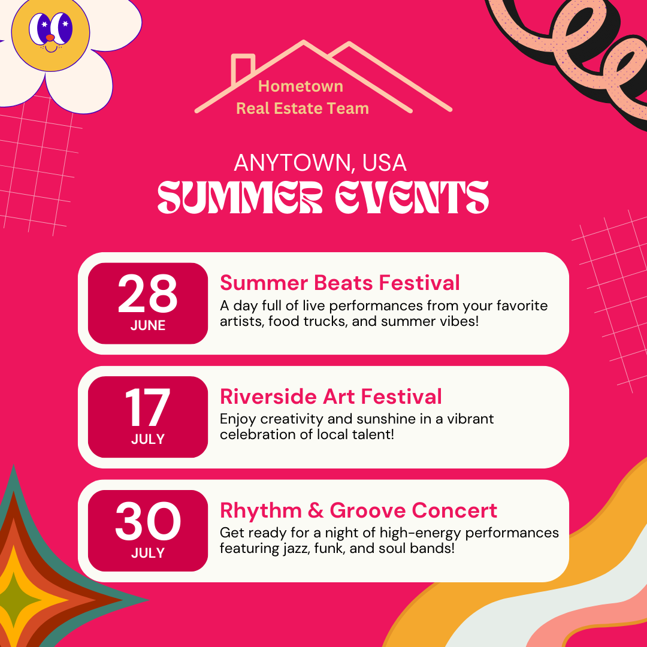
Spark Your Business
Summer Kickoff Social Media Campaign
Create a social media series featuring the best activities in your area.
Notes:
As we conclude today’s sales meeting, we want to give you one idea to help Spark Your Business and keep you top-of-mind with your social media followers. Create a social media series highlighting the Best Summer Activities in your area to engage your audience and keep them informed about local events. Think local sporting events, festivals, concerts, and farmers markets, to name a few.

Slide 22
Spark Your Business
Send a Text Message to Recent Buyers
Notes:
As we conclude today’s sales meeting, we want to leave you with one idea to help Spark Your Business and keep your pipeline full.
Stay top of mind with your recent buyers by sending a short text message.
Hi Past Buyer, hope you're enjoying the start of summer! I wanted to check in and see how you're loving your home. If you know anyone looking to buy or sell, I'd love to help them achieve their real estate goals. Your referrals mean the world to me! Let me know if you need any updates on the local market.
This personal touch offers value and encourages past clients to stay in touch, potentially leading to referrals.

