Slide 1
Welcome

Slide 2
Good News!
Notes:
Let’s start the meeting on a positive note by sharing some good news. Reflect on something positive that happened and share it with the group. It could be a personal milestone, a professional accomplishment, or a simple joy that has brought a smile to your face.

Slide 3
Meeting Agenda
Company Updates
Marketing Updates
Real Estate Wants & Needs
Education Opportunities
Practical Learning
Real Estate Trends
Old Business
New Business
Adjourn
Notes:
NOTE: Edit the agenda as appropriate for your meeting.

Slide 4
Company Updates
Notes:
New company listings and buyer needs
Company Initiatives (company-specific updates or topics you deem appropriate)
“Parking Lot” items from previous meetings
Agent Sales Contest

Slide 5
Marketing Updates
Notes:
Company marketing initiatives
Company community service projects and events
Agent marketing opportunities that complement company/brand marketing

Slide 6
Wants & Needs

Slide 7
Education Opportunities

Slide 12
Guest Speaker
<INSERT SPEAKER NAME & COMPANY>
Notes:
NOTE: Delete if not using a guest speaker.

Slide 13
Notes:
Keeping up to date on real estate data trends and sharing relevant market insights with your clients and customers can set you apart in today’s competitive market. Let’s dive into the current dynamics shaping the national real estate landscape.

Slide 14
Real Estate Trends Local Market Report
Notes:
Total number of listings currently available per MLS
Number of pendings last month per MLS
Number of closed transactions last month per MLS

Slide 15
Real Estate Trends Company Production
Notes:
Production Updates, Listings, Under Contracts, Closings (various ways to share)
Previous month vs. the same period last year
Year To Date (YTD)
Year Over Year (YOY)
Market Share

Slide 16
Real Estate Trends Company Data
Notes:
Average DOM from List to Under Contract
Average DOM from Under Contract to Close
Average / Median List Price
Average / Median Sales Price
Company’s List Price to Sales Price Ratio

Slide 17
Old Business & New Business
Notes:
Updates and follow-up to the previous meeting
“Parking Lot” items

Slide 18
Next Meeting
INSERT Date & Time
INSERT Location
INSERT Next Meeting Highlight
Notes:
TIP: Consider adding a meeting teaser, such as the learning sprint topic, below the meeting location

Slide 19
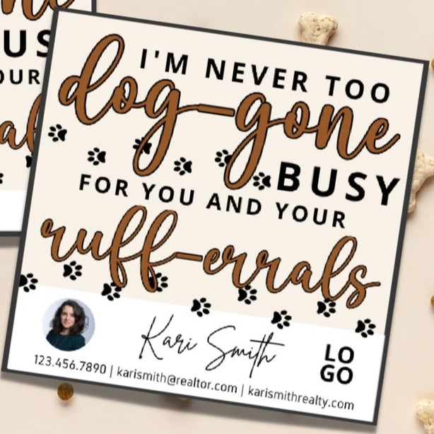
Spark Your
Business
March 10th
National Hug Your Dog Day
Surprise your dog-owner clients with treats for their fur-baby!
Image Courtesy of Etsy Seller
Planned Perfect Design
Notes:
As we wrap up today's sales meeting, here’s a tip to Spark Your Business and keep your pipeline active.
March 10th is National Hug Your Dog Day. Consider popping by a past client who owns a dog with a gift bag of dog treats. This thoughtful gesture shows you remember the client's love for their pet, creating a personal connection. Associating your brand with a fun occasion can leave a positive impression and encourage future referrals. The visit can also spark conversations about real estate needs, making it friendly and strategic. Overall, it fosters goodwill and reinforces your commitment to client relationships.

Slide 20
Spark Your
Business
St. Patrick’s Day
March 17th
Surprise past clients with lottery tickets!
Image Courtesy of Etsy Seller: Espresso Design Works
Notes:
As we wrap up today's sales meeting, here’s an idea to help Spark Your Business!
Sending instant lottery tickets to past clients for St. Patrick's Day is a fun way for you to stay top of mind. This thoughtful gesture shows appreciation and adds a festive touch while adding a personalized note can reinforce the agent-client relationship. Such creative gifts can spark conversations and encourage referrals, ensuring you are remembered when clients consider their real estate needs.

Slide 21
Spark Your
Business
March 21st
National Flower Day
Let people know you appreciate their referrals!
Image Courtesy of Etsy Seller
System and Solutions
Notes:
As we wrap up today’s sales meeting, here’s a tip to Spark Your Business.
Delivering a flowering plant on National Flower Day is more than just a kind gesture; it is a strategic marketing move that helps you maintain client relationships, enhance brand visibility, and encourage referrals. By leveraging this opportunity thoughtfully, you can cultivate lasting connections that benefit your business in both the short and long term.

Slide 22
Spark Your
Business
State of the Market Update
Stay top of mind with past clients and demonstrate your market knowledge.
Image Courtesy of Etsy Seller: Real Estate Simplicity
Notes:
As we wrap up today's sales meeting, here’s one idea to Spark Your Business and keep your pipeline full.
Sending a spring market update can really boost your credibility. It shows clients you know about local trends, inventory, and pricing strategies, which builds trust. Regular updates keep you top-of-mind and encourage clients to engage. Plus, being transparent about market conditions establishes you as a reliable advisor, enhancing your overall reputation in the industry.

