Slide 1
Welcome

Slide 2
Good News!
Notes:
Let’s start the meeting on a positive note by sharing some good news. Reflect on something positive that happened and share it with the group. It could be a personal milestone, a professional accomplishment, or a simple joy that has brought a smile to your face.

Slide 3
Meeting Agenda
Company Updates
Marketing Updates
Real Estate Wants & Needs
Education Opportunities
Practical Learning
Real Estate Trends
Old Business
New Business
Adjourn
Notes:
NOTE: Edit the agenda as appropriate for your meeting.

Slide 4
Company Updates
Notes:
New company listings and buyer needs
Company Initiatives (company-specific updates or topics you deem appropriate)
“Parking Lot” items from previous meetings
Agent Sales Contest

Slide 5
Marketing Updates
Notes:
Company marketing initiatives
Company community service projects and events
Agent marketing opportunities that complement company/brand marketing

Slide 6
Wants & Needs

Slide 7
Education Opportunities

Slide 12
Guest Speaker
<INSERT SPEAKER NAME & COMPANY>
Notes:
NOTE: Delete if not using a guest speaker.

Slide 13
Notes:
Keeping up to date on real estate data trends and sharing relevant market insights with your clients and customers can set you apart in today’s competitive market. Let’s dive into the current dynamics shaping the national real estate landscape.

Slide 14
Real Estate Trends Local Market Report
Notes:
Total number of listings currently available per MLS
Number of pendings last month per MLS
Number of closed transactions last month per MLS

Slide 15
Real Estate Trends Company Production
Notes:
Production Updates, Listings, Under Contracts, Closings (various ways to share)
Previous month vs. the same period last year
Year To Date (YTD)
Year Over Year (YOY)
Market Share

Slide 16
Real Estate Trends Company Data
Notes:
Average DOM from List to Under Contract
Average DOM from Under Contract to Close
Average / Median List Price
Average / Median Sales Price
Company’s List Price to Sales Price Ratio

Slide 17
Old Business & New Business
Notes:
Updates and follow-up to the previous meeting
“Parking Lot” items

Slide 18
Next Meeting
INSERT Date & Time
INSERT Location
INSERT Next Meeting Highlight
Notes:
TIP: Consider adding a meeting teaser, such as the learning sprint topic, below the meeting location

Slide 19
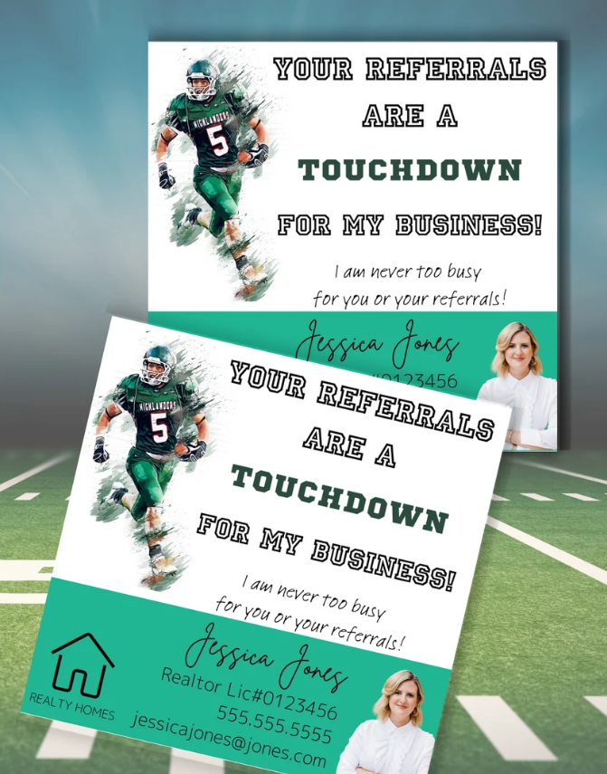
Spark Your Business
Super Bowl Sunday
February 9th
Connect with select clients by dropping off game day snacks!
Image courtesy of Etsy Seller Systems & Solutions
Notes:
As we conclude today’s sales meeting, we want to leave you with one idea to help Spark Your Business and keep your pipeline full.
Leveraging a Super Bowl Sunday pop-by can help you connect with clients and reinforce relationships. Create themed gifts, such as snack baskets or football-themed items, which can be delivered before the game. Include a note, such as "Enjoy the game! I'd greatly appreciate your referral if you know anyone looking to buy or sell a home!" This keeps you top-of-mind and adds a personal touch that clients appreciate. Additionally, consider hosting a small viewing party or gathering for clients, allowing for networking opportunities and fostering community spirit.

Slide 20
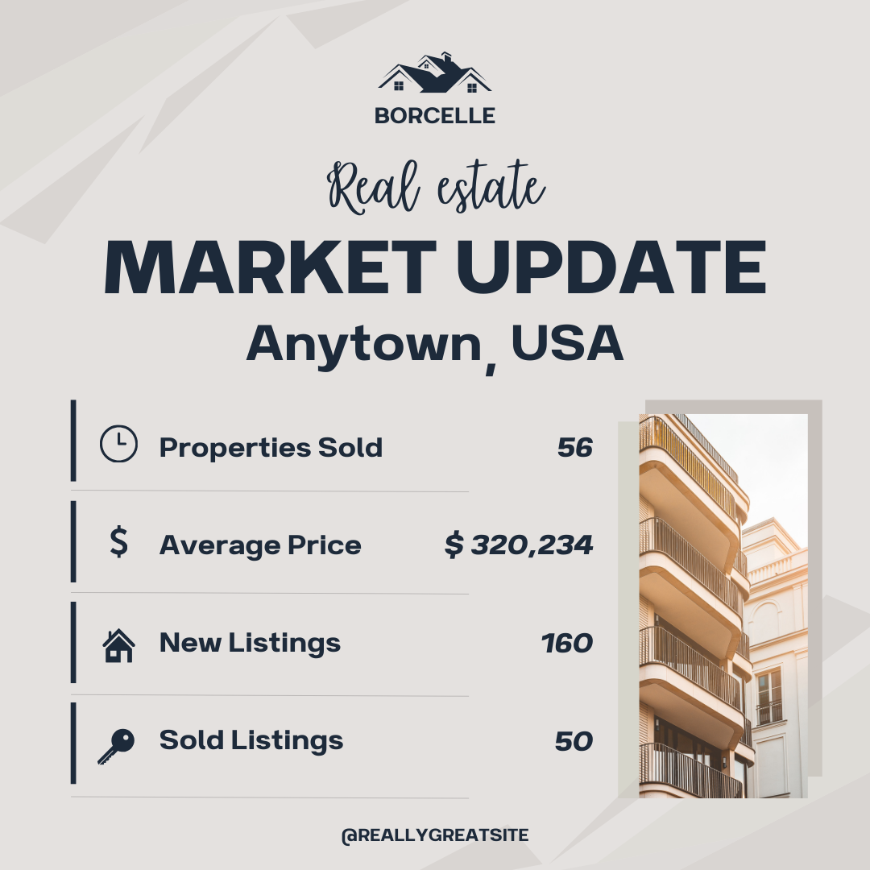
Spark Your Business
Market Update
Establish yourself as the market expert!
Notes:
As we finish up today, here's one impactful tip to help drive your business forward and maintain a steady pipeline.
Sending real estate market updates to past clients and your sphere of influence allows you to establish yourself as the market expert, keeps you top-of-mind, builds trust and credibility, encourages referrals, and increases engagement. Consider also sending this update to your dormant leads. Someone who wasn't ready to sell or buy previously might take action after seeing how the market has shifted in their favor.

Slide 21
Spark Your Business
Valentine’s Day
February 14th
Thank your past clients and SOI who have sent you referrals.
Image courtesy of Etsy Seller Systems & Solutions
Notes:
Before we close today's sales meeting, we want to leave you with one powerful idea to fuel your business growth and keep your pipeline flowing.
Thanking past clients and your SOI with a small Valentine’s Day gift strengthens relationships, keeps you top of mind, and builds goodwill. It’s a thoughtful way to stand out, showcase your personal touch, and create opportunities for referrals or conversations about real estate. The key is to ensure the gift is thoughtful, relevant, and personalized, if possible. For example, heart-shaped cookies, a small plant, or a handwritten note expressing gratitude for their trust can all leave a lasting impression.

Slide 22
Spark Your Business
February Newsletter
Stay top of mind with past clients by providing useful information.
Image courtesy of Etsy Seller RookieREAgent
Notes:
As we end today’s session, we want to equip you with one practical tip to spark your success and fill your pipeline.
For a February newsletter aimed at past clients, cover various topics demonstrating your expertise and providing valuable insights. Here are some suggested topics: Housing Market Trends, Home Maintenance Tips on preparing homes for spring, Financing Insights including current mortgage rates and any local financing options, Community Events, or Home Buying/Selling Strategies for the spring market.
When done well, a monthly newsletter is more than just a communication tool--it's a marketing asset that helps you grow your network, foster loyalty, and generate leads over time.

