Slide 1
Welcome

Slide 2
Good News!
Notes:
Let’s start the meeting on a positive note by sharing some good news. Reflect on something positive that happened and share it with the group. It could be a personal milestone, a professional accomplishment, or a simple joy that has brought a smile to your face.

Slide 3
Meeting Agenda
Company Updates
Marketing Updates
Real Estate Wants & Needs
Education Opportunities
Practical Learning
Real Estate Trends
Old Business
New Business
Adjourn
Notes:
NOTE: Edit the agenda as appropriate for your meeting.

Slide 4
Company Updates
Notes:
New company listings and buyer needs
Company Initiatives (company-specific updates or topics you deem appropriate)
“Parking Lot” items from previous meetings
Agent Sales Contest

Slide 5
Marketing Updates
Notes:
Company marketing initiatives
Company community service projects and events
Agent marketing opportunities that complement company/brand marketing

Slide 6
Wants & Needs

Slide 7
Education Opportunities

Slide 12
Guest Speaker
<INSERT SPEAKER NAME & COMPANY>
Notes:
NOTE: Delete if not using a guest speaker.

Slide 13
Notes:
Keeping up to date on real estate data trends and sharing relevant market insights with your clients and customers can set you apart in today’s competitive market. Let’s dive into the current dynamics shaping the national real estate landscape.

Slide 14
Real Estate Trends Local Market Report
Notes:
Total number of listings currently available per MLS
Number of pendings last month per MLS
Number of closed transactions last month per MLS

Slide 15
Real Estate Trends Company Production
Notes:
Production Updates, Listings, Under Contracts, Closings (various ways to share)
Previous month vs. the same period last year
Year To Date (YTD)
Year Over Year (YOY)
Market Share

Slide 16
Real Estate Trends Company Data
Notes:
Average DOM from List to Under Contract
Average DOM from Under Contract to Close
Average / Median List Price
Average / Median Sales Price
Company’s List Price to Sales Price Ratio

Slide 17
Old Business & New Business
Notes:
Updates and follow-up to the previous meeting
“Parking Lot” items

Slide 18
Next Meeting
INSERT Date & Time
INSERT Location
INSERT Next Meeting Highlight
Notes:
TIP: Consider adding a meeting teaser, such as the learning sprint topic, below the meeting location

Slide 19
Spark Your
Business
Show your 2024 clients that they are clients for life by helping them prepare for tax time.
In early January, mail them a copy of their closing statement.
Notes:
As we wrap up today's sales meeting, here’s a tip to *Spark Your Business* and keep your pipeline active.
Clients remember their experience working with you. Don’t assume they'll remember where to find their closing statements for tax season next year. Start a habit of filing copies of each client's closing statement. In January, send each client a letter of thanks with their statement and a couple of your business cards. Mention that your business thrives on referrals from satisfied clients.
Staying top of mind is essential, especially when people know multiple real estate professionals.

Slide 20
Spark Your Business
Open House Treats
Thanks for popping by!
Image Courtesy of Etsy Seller RookieREAgent
Notes:
As we wrap up today's sales meeting, here’s an idea to help Spark Your Business! Prepare a branded takeaway for your next open house to keep you top-of-mind with visitors. For example, January 19th is National Popcorn Day – why not make small popcorn gift bags with your business card and a clever tag? Place them by the sign-in sheet. This fun and memorable touch offers a snack and keeps your name in front of visitors long after they leave, making it easier for them to reconnect with you when they're ready to move forward.

Slide 21
Spark Your
Business
January 23rd
National Pie Day
Let people know you appreciate their referrals!
Image Courtesy of Etsy Seller
RookieREAgent
Notes:
As we wrap up today’s sales meeting, here’s a tip to Spark Your Business: show appreciation to past clients or SOI members who’ve referred you this year. With National Pie Day on January 23rd, drop by with a pie and a tag from Etsy seller RookieREAgent to thank them—don’t forget a couple of business cards! Staying top of mind builds lasting relationships and a steady stream of referrals.

Slide 22
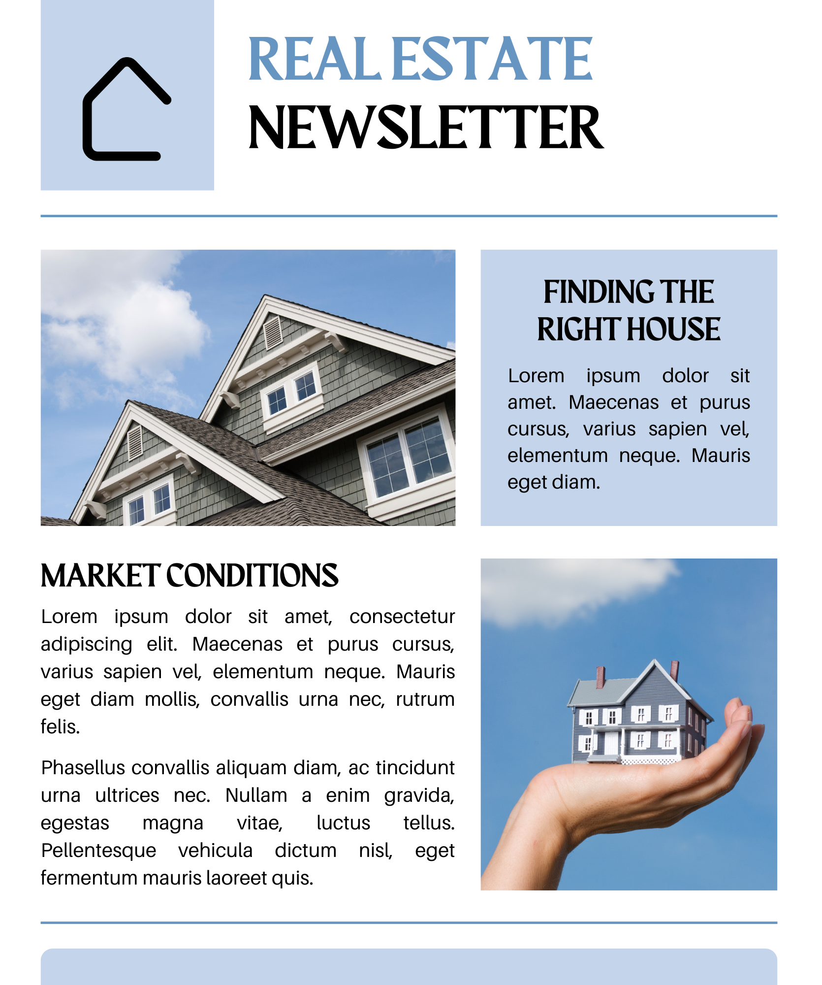
Spark Your
Business
First Quarter Newsletter
Create a homeowner newsletter covering topics such as market trends, home maintenance, and local events.
Notes:
To close today’s meeting, here’s one idea to Spark Your Business: Gather 3-4 articles for a Q1 newsletter, covering topics like market trends, winter home maintenance, local events, and homeowner tax breaks. Aim to send it by late January to stay top of mind with clients and boost referrals.

Slide 23
Spark Your Business
Random Acts of Kindness
Notes:
As we wrap up today's sales meeting, here’s one idea to Spark Your Business and keep your pipeline full:
As we close out 2024 and look ahead to 2025, consider embracing random acts of kindness in your community. Simple gestures like buying coffee for someone in line, leaving a cheerful note on a car, or volunteering for a local nonprofit can foster goodwill, strengthen relationships, and boost your reputation. Kindness creates positive ripple effects, enhancing your network and positioning you as a valued community member. By making kindness a part of your brand, you’ll build trust and drive long-term success in the coming year.

