Slide 1
Welcome

Slide 2
Good News!
Notes:
Let’s start the meeting on a positive note by sharing some good news. Reflect on something positive that happened and share it with the group. It could be a personal milestone, a professional accomplishment, or a simple joy that has brought a smile to your face.

Slide 3
Meeting Agenda
Company Updates
Marketing Updates
Real Estate Wants & Needs
Education Opportunities
Practical Learning
Real Estate Trends
Old Business
New Business
Adjourn
Notes:
NOTE: Edit the agenda as appropriate for your meeting.

Slide 4
Company Updates
Notes:
New company listings and buyer needs
Company Initiatives (company-specific updates or topics you deem appropriate)
“Parking Lot” items from previous meetings
Agent Sales Contest

Slide 5
Marketing Updates
Notes:
Company marketing initiatives
Company community service projects and events
Agent marketing opportunities that complement company/brand marketing

Slide 6
Wants & Needs

Slide 7
Education Opportunities

Slide 13
Guest Speaker
<INSERT SPEAKER NAME & COMPANY>
Notes:
NOTE: Delete if not using a guest speaker.

Slide 14
Notes:
Keeping up to date on real estate data trends and sharing relevant market insights with your clients and customers can set you apart in today’s competitive market. Let’s dive into the current dynamics shaping the national real estate landscape.

Slide 15
Real Estate Trends Local Market Report
Notes:
Total number of listings currently available per MLS
Number of pendings last month per MLS
Number of closed transactions last month per MLS

Slide 16
Real Estate Trends Company Production
Notes:
Production Updates, Listings, Under Contracts, Closings (various ways to share)
Previous month vs. the same period last year
Year To Date (YTD)
Year Over Year (YOY)
Market Share

Slide 17
Real Estate Trends Company Data
Notes:
Average DOM from List to Under Contract
Average DOM from Under Contract to Close
Average / Median List Price
Average / Median Sales Price
Company’s List Price to Sales Price Ratio

Slide 18
Old Business & New Business
Notes:
Updates and follow-up to the previous meeting
“Parking Lot” items

Slide 19
Next Meeting
INSERT Date & Time
INSERT Location
INSERT Next Meeting Highlight
Notes:
TIP: Consider adding a meeting teaser, such as the learning sprint topic, below the meeting location

Slide 20
Spark Your Business
Late Fall Newsletter
mail or email
Keep in touch with past and current clients with a newsletter.
Notes:
As we wrap up today's sales meeting, let’s leave you with one idea to help Spark Your Business and keep your pipeline full.
Send your real estate newsletter at the beginning of November to get ahead of the holiday mail rush. Include valuable content such as tips on winter home maintenance, insights on winter market trends, and ways to improve energy efficiency for the colder months. Be sure to include a solid Call To Action (CTA), such as: "Know someone looking to buy or sell? I can offer them exceptional service." Remember to prominently display your contact information, including your cell phone and email, so potential clients can easily reach you.

Slide 21
Spark Your Business
Veterans Day
November 11th
Give back to your community by organizing a donation drive.
Notes:
As we wrap up today's sales meeting, we want to give you one idea to help Spark Your Business and keep your pipeline full.
Show your appreciation for local veterans by organizing a donation drive. Start by reaching out to your local Veterans Office to find out which items are most needed this time of year. Then, set up a donation collection point at your office. Spread the word by promoting the drive to your past clients and sphere of influence through email and social media. Let them know how they can contribute, whether it’s by donating, sharing the message on their own social channels, helping with collections, or delivering items to the designated agency. Be sure to post regular updates on social media with photos of the drive in action, and don’t forget to send thank-you notes to everyone who contributed or helped make the event a success!

Slide 22
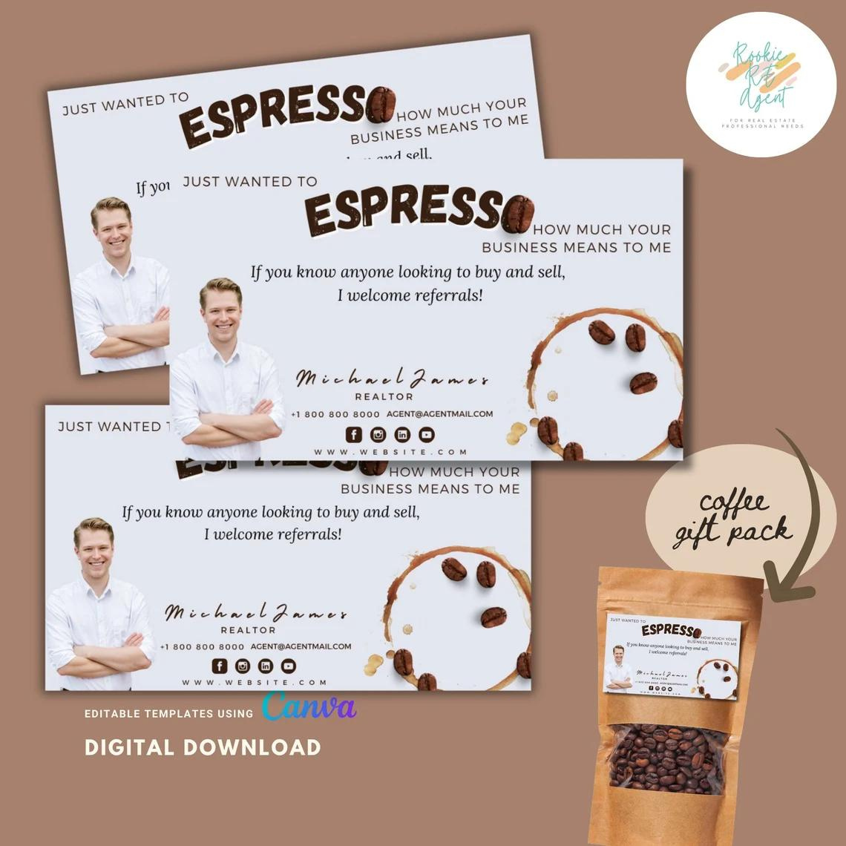
Spark Your Business
National Espresso Day
November 23rd
Delight past clients and SOI with espresso-related gift bags!
Image courtesy of Etsy Seller: RookieREAgent
Notes:
As we wrap up today's sales meeting, let’s leave you with one idea to help Spark Your Business and keep your pipeline full.
I like this clever tag: Just wanted to espresso how much your business means to me! Delight your espresso-loving clients with small, curated gift bags to celebrate National Espresso Day. Consider including items like an espresso shot glass, handheld milk frother, coffee stencils, a tamping mat, or even a coffee-scented candle. Add a clever tag (like this one from RookieREAgent), tuck in a few of your business cards, and personally drop off the gifts. This simple yet thoughtful gesture helps keep you top of mind, which is key to building strong relationships and growing your repeat and referral business.

Slide 23
Spark Your Business
Holiday Pie Giveaway
Client Appreciation Event
Show past clients some love with Thanksgiving pies.
Image courtesy of Etsy Seller: RookieREAgent
Notes:
As we wrap up today's sales meeting, we want to give you one idea to help Spark Your Business and keep your pipeline full.
A holiday pie giveaway is a thoughtful way to stay connected with past clients and show appreciation. I know of several top-producing agents who do this every year with excellent results. Whether you make or purchase the pies, plan a specific day and time for clients to stop by your office to pick them up. Add a clever tag to each pie for a personal touch, like the one shown by RookieREAgent. Start promoting the event in early November and send reminders as the date approaches—people tend to get busy during the holiday season. This simple yet meaningful gesture keeps you top-of-mind with clients and helps nurture lasting relationships beyond the initial deal.

Slide 24
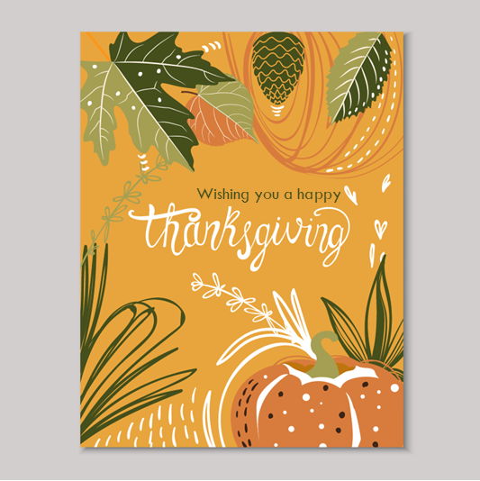
Spark Your Business
Thanksgiving
Greeting Cards
Stand out by sending a greeting for a holiday with fewer exchanged cards.
Notes:
As we wrap up today's sales meeting, let’s leave you with one idea to help Spark Your Business and keep your pipeline full.
Send past clients a thoughtful card at Thanksgiving, a holiday on which people typically don’t exchange cards, making yours stand out. Use the opportunity to express your gratitude, thanking clients for their past business and referrals. Include a couple of your business cards in the envelope to keep your contact information handy. Start preparing your cards in late October, so they're ready to mail out two weeks before Thanksgiving, ensuring they arrive in time for the holiday. This personal touch can leave a lasting impression and strengthen client relationships.

