Slide 1
Welcome

Slide 2
Good News!
Notes:
Let’s start the meeting on a positive note by sharing some good news. Reflect on something positive that happened and share it with the group. It could be a personal milestone, a professional accomplishment, or a simple joy that has brought a smile to your face.

Slide 3
Meeting Agenda
Company Updates
Marketing Updates
Real Estate Wants & Needs
Education Opportunities
Practical Learning
Real Estate Trends
Old Business
New Business
Adjourn
Notes:
NOTE: Edit the agenda as appropriate for your meeting.

Slide 4
Company Updates
Notes:
New company listings and buyer needs
Company Initiatives (company-specific updates or topics you deem appropriate)
“Parking Lot” items from previous meetings
Agent Sales Contest

Slide 5
Marketing Updates
Notes:
Company marketing initiatives
Company community service projects and events
Agent marketing opportunities that complement company/brand marketing

Slide 6
Wants & Needs

Slide 7
Education Opportunities

Slide 12
Guest Speaker
<INSERT SPEAKER NAME & COMPANY>
Notes:
NOTE: Delete if not using a guest speaker.

Slide 13
National Real Estate Data Trends
Notes:
Keeping up to date on real estate data trends and sharing relevant market insights with your clients and customers can set you apart in today’s competitive market. Let’s dive into the current dynamics shaping the national real estate landscape.

Slide 14
30-Year Fixed Mortgage Rates
6.86%
June 2024
6.78% July 2024
Source: Macrotrends.net
Notes:
The 30-year fixed rate continues to hover at 6.78%.
It’s important to inform your buyers about the current 30-year fixed mortgage rates, which have recently decreased to their lowest level in over a year. This can significantly enhance their purchasing power and encourage them to consider making a move. Additionally, sharing this information can help existing homeowners explore refinancing opportunities, potentially leading to substantial savings.

Slide 15
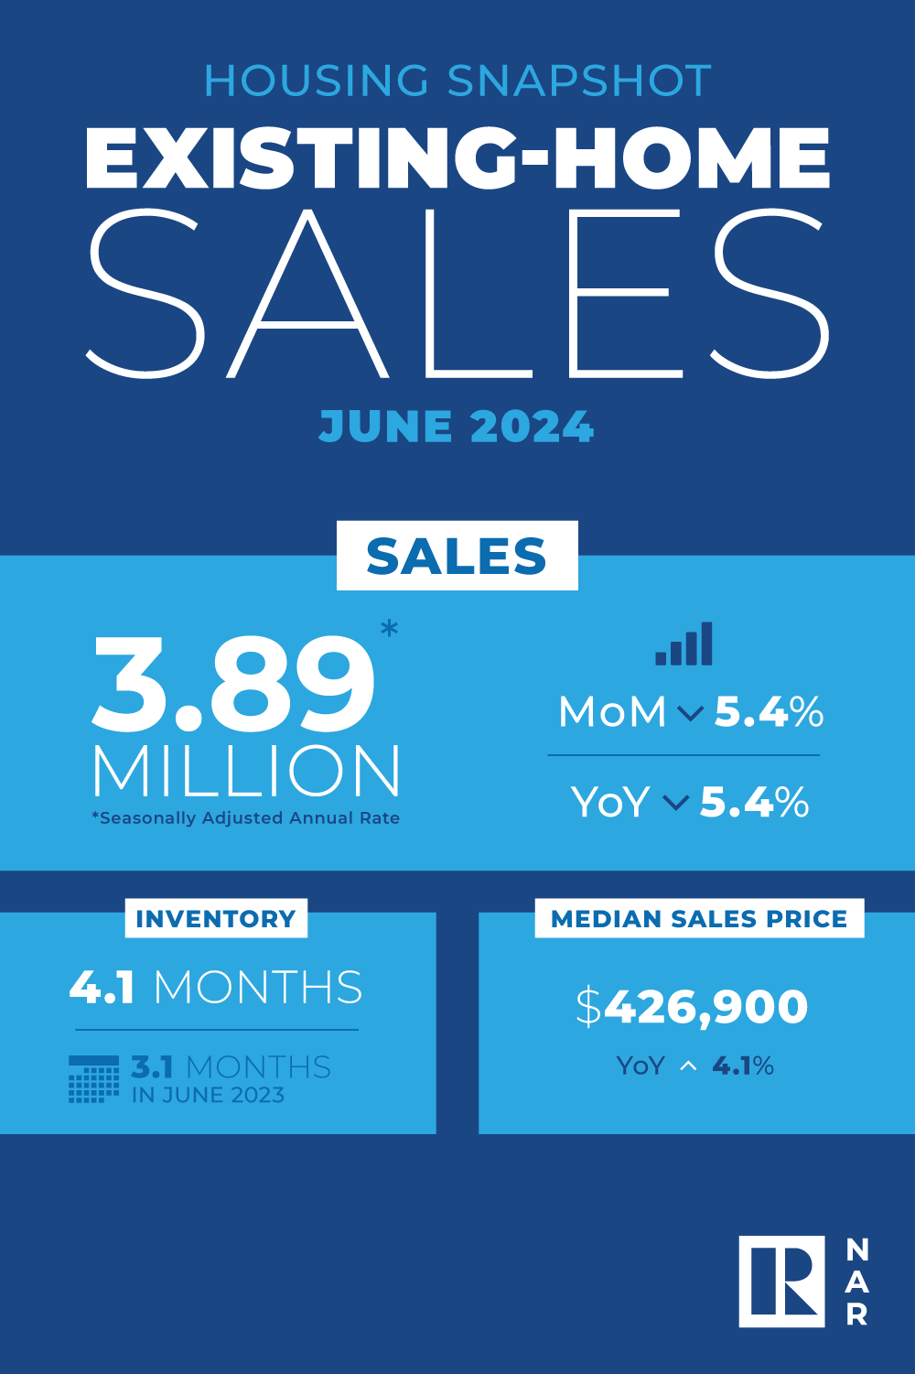
Existing-Home SALES
4.1
Months of Inventory
June 2024
Copyright ©2024 “Existing Home Sales.” NATIONAL ASSOCIATION OF REALTORS®. All rights reserved. Reprinted with permission. August 2024..nar.realtor/
Notes:
June brought a median sales price of $426,900 and a 4.1 months absorption rate of inventory nationally.
Regularly update yourself with the latest market trends and data, including absorption rates and comparable sales in your area. Be prepared to share this information with clients, ensuring they understand the information and its implications, such as whether it’s a buyers’ or sellers’ market. Preparing a similar report for your local market will also help establish you as the local expert.

Slide 16
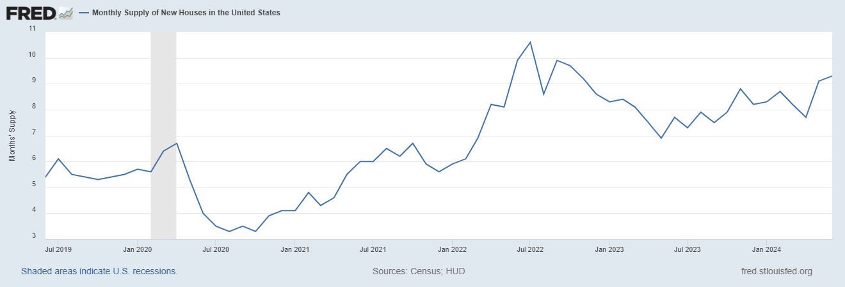
Monthly Supply of New Houses
9.3
June 2024
U.S. Census Bureau and U.S. Department of Housing and Urban Development, Monthly Supply of New Houses in the United States [MSACSR], retrieved from FRED, Federal Reserve Bank of St. Louis; https://fred.stlouisfed.org/series/MSACSR.
Notes:
The current monthly supply of new houses in the United States stands at 9.3 months, indicating a significant increase from 7.7 months a year ago, which suggests a growing inventory relative to sales. This higher supply can lead to less upward pressure on home prices, as buyers have more options available, potentially stabilizing the market for both buyers and sellers.

Slide 17
Real Estate Trends Local Market Report
Notes:
Total number of listings currently available per MLS
Number of pendings last month per MLS
Number of closed transactions last month per MLS

Slide 18
Real Estate Trends Company Production
Notes:
Production Updates, Listings, Under Contracts, Closings (various ways to share)
Previous month vs. the same period last year
Year To Date (YTD)
Year Over Year (YOY)
Market Share

Slide 19
Real Estate Trends Company Data
Notes:
Average DOM from List to Under Contract
Average DOM from Under Contract to Close
Average / Median List Price
Average / Median Sales Price
Company’s List Price to Sales Price Ratio

Slide 20
Old Business & New Business
Notes:
Updates and follow-up to the previous meeting
“Parking Lot” items

Slide 21
Next Meeting
INSERT Date & Time
INSERT Location
INSERT Next Meeting Highlight
Notes:
TIP: Consider adding a meeting teaser, such as the learning sprint topic, below the meeting location

Slide 22
Spark Your Business
World Homeless Day
October 10th
Coordinate donations with local organizations that support vulnerable populations.
Notes:
As we wrap up today's sales meeting, we want to leave you with one idea to help Spark Your Business and keep your pipeline full.
Giving back to your community is rewarding and impactful. One way to contribute is by preparing care packages for local organizations supporting vulnerable populations. Here's an idea from a top Midwest agent:
Fill tube socks with trial-size items like shampoo, conditioner, soap, moisturizer, sunscreen, deodorant, toothbrush/toothpaste, and other personal hygiene products. Let your database know you're putting together a donation, inviting them to contribute or help assemble. People love doing business with those who give back to their community.

Slide 23
Spark Your Business
National Apple Day
October 21st
Surprise your SOI with fresh picked apples from a local orchard.
Image: Systems and Solutions (Etsy)
Notes:
As we conclude today’s sales meeting, we want to leave you with one idea to help Spark Your Business and keep your pipeline full.
Surprise your past clients by dropping off a bag of freshly picked apples from a local orchard. Attach a clever tag like this one and include a couple of your business cards. This strategy is meant to recognize and thank clients for their referrals, building trust and appreciation. Consistent engagement fosters a loyal network that supports your business growth.

Slide 24
Spark Your Business
National Checklist Day
October 30th
Mail past clients a packet of fall home maintenance checklists.
Image: RookieREAgent (Etsy)
Notes:
As we wrap up today’s sales meeting, we want to leave you with one actionable idea to spark your business and keep your pipeline full.
This fall, as part of your commitment to helping your past clients maintain their properties, consider sending them a comprehensive checklist of seasonal maintenance tasks. This simple gesture can help keep their homes in top shape. Be sure to include a short, personalized note and a couple of your business cards.
For professional-looking checklists, check out resources like RookieREAgent on Etsy.

Slide 25
Spark Your Business
Daylight Saving Time Ends
November 3rd
^{Email your database a reminder}
^{to turn back their clocks.}
Notes:
As we conclude today’s sales meeting, we want to leave you with one idea to help Spark Your Business and keep your pipeline full.
Email your database a reminder a few days ahead that Daylight Saving Time ends on Sunday, November 3rd. Engaging with past clients through a variety of communication methods will help you maintain strong relationships, foster referrals, and ensure you remain the go-to resource for future real estate needs.

