Slide 1
Welcome

Slide 2
Good News!
Notes:
Let’s start the meeting on a positive note by sharing some good news. Reflect on something positive that happened and share it with the group. It could be a personal milestone, a professional accomplishment, or a simple joy that has brought a smile to your face.

Slide 3
Meeting Agenda
Company Updates
Marketing Updates
Real Estate Wants & Needs
Education Opportunities
Practical Learning
Real Estate Trends
Old Business
New Business
Adjourn
Notes:
NOTE: Edit the agenda as appropriate for your meeting.

Slide 4
Company Updates
Notes:
New company listings and buyer needs
Company Initiatives (company-specific updates or topics you deem appropriate)
“Parking Lot” items from previous meetings
Agent Sales Contest

Slide 5
Marketing Updates
Notes:
Company marketing initiatives
Company community service projects and events
Agent marketing opportunities that complement company/brand marketing

Slide 6
Wants & Needs

Slide 7
Education Opportunities

Slide 12
Guest Speaker
<INSERT SPEAKER NAME & COMPANY>
Notes:
NOTE: Delete if not using a guest speaker.

Slide 14
30-Year Fixed Mortgage Rates
6.86%
June 2024
6.77% July 2024
Source: Macrotrends.net
Notes:
The 30-year fixed rate continues to decrease, now at 6.77%.
With lower inflation readings, there’s potential for mortgage rates to fall further. There’s more inventory on the market nationally, including listings with price cuts, which is encouraging for prospective buyers and can contribute to lower rates.

Slide 15
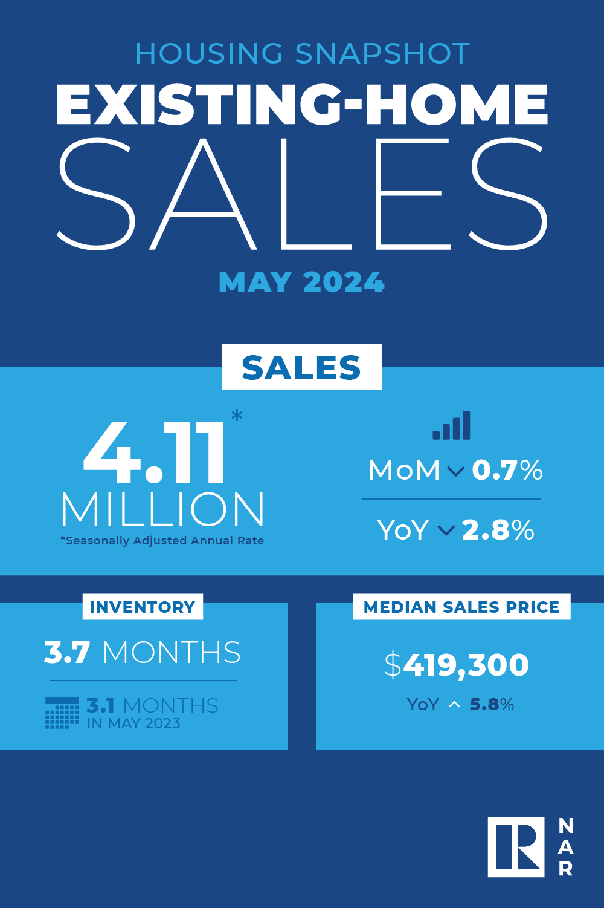
Existing-Home SALES
3.7
Months of Inventory
May 2024
Copyright ©2024 “Existing Home Sales.” NATIONAL ASSOCIATION OF REALTORS®. All rights reserved. Reprinted with permission. August 2024..nar.realtor/
Notes:
May brought a median sales price of $419,300 and a 3.7 months absorption rate of inventory nationally.
Regularly update yourself with the latest market trends and data, including absorption rates and comparable sales in your area. Be prepared to share this information with clients, ensuring they understand the information and its implications, such as whether it’s a buyers or sellers market. Preparing a similar report for your local market will help establish you as the local expert.

Slide 16
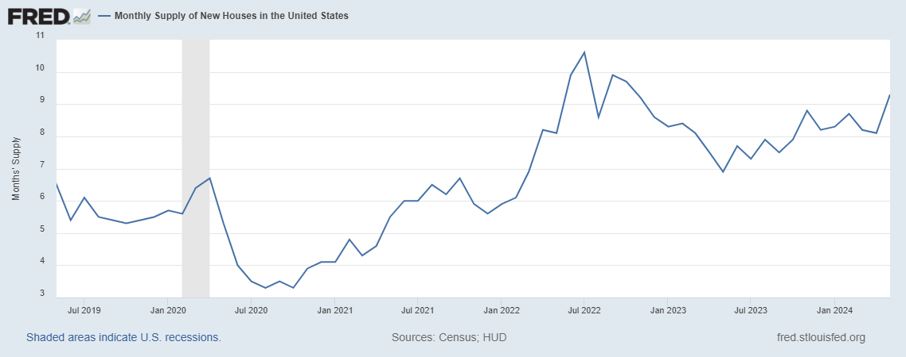
Monthly Supply of New Houses
9.3
May 2024
U.S. Census Bureau and U.S. Department of Housing and Urban Development, Monthly Supply of New Houses in the United States [MSACSR], retrieved from FRED, Federal Reserve Bank of St. Louis; https://fred.stlouisfed.org/series/MSACSR.
Notes:
The monthly absorption rate of new construction homes edged up to 9.3 months of inventory in May.
The new house supply metric provides information about home building activity and future housing availability. This information can help you anticipate market changes and advise clients on timing for buying or selling.

Slide 17
Real Estate Trends Local Market Report
Notes:
Total number of listings currently available per MLS
Number of pendings last month per MLS
Number of closed transactions last month per MLS

Slide 18
Real Estate Trends Company Production
Notes:
Production Updates, Listings, Under Contracts, Closings (various ways to share)
Previous month vs. the same period last year
Year To Date (YTD)
Year Over Year (YOY)
Market Share

Slide 19
Real Estate Trends Company Data
Notes:
Average DOM from List to Under Contract
Average DOM from Under Contract to Close
Average / Median List Price
Average / Median Sales Price
Company’s List Price to Sales Price Ratio

Slide 20
Old Business & New Business
Notes:
Updates and follow-up to the previous meeting
“Parking Lot” items

Slide 21
Next Meeting
INSERT Date & Time
INSERT Location
INSERT Next Meeting Highlight
Notes:
TIP: Consider adding a meeting teaser, such as the learning sprint topic, below the meeting location

Slide 22
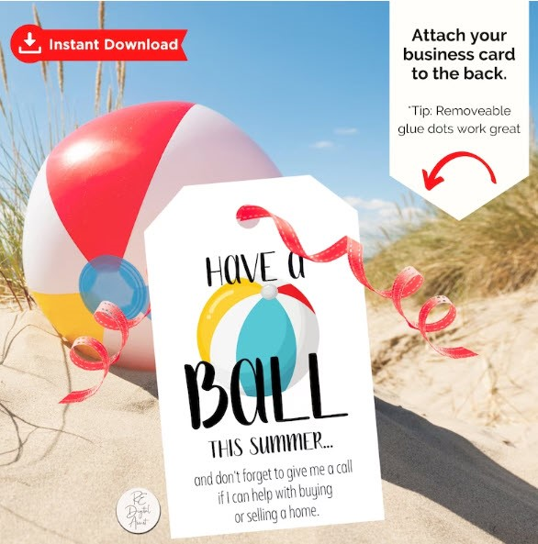
Spark Your Business
National Beach Day
August 30th
Create gift bags with inflatable balls, sunglasses, and beach toys.
Image credit: REdigitalassist
Notes:
As we conclude today’s sales meeting, we want to leave you with one idea to help Spark Your Business and keep your pipeline full.
Summer is wrapping up quickly – August 30th is National Beach Day! Select a small number of past clients and SOI members and prepare a small gift bag with fun items from the dollar store, like an inflatable beach ball, sunglasses, and a plastic pail and shovel. Attach a clever tag like the one featured here, throw in a couple of business cards, and schedule a day to pop by. Be prepared to discuss market conditions, along with relevant real estate trends. If they’re not home, leave the bag where they’ll see it and send them a short text: Quick heads up: the real estate market is still HOT. Want to chat about what this means for you? Let’s catch up soon.

Slide 23
Spark Your Business
National Food Bank Day
September 1st
Organize food drive for your local food bank.
Notes:
As we conclude today’s sales meeting, we want to leave you with one idea to help Spark Your Business and keep your pipeline full.
Reach out to your local food bank to find out how you can help for National Food Bank Day. Leverage your social media platforms to request donations. Send a series of emails to your past clients and Sphere of Influence. Remember to thank donors with personalized notes or emails.
People like to do business with businesses that give back to the community!

Slide 24
Spark Your Business
National Cheese Pizza Day
September 5th
Surprise your SOI with a pizza kit
^{or pizzeria gift card!}
Image credit: mMadeDesignCo.
Notes:
As we conclude today’s sales meeting, we want to leave you with one idea to help Spark Your Business and keep your pipeline full.
Select a few people in your power sphere who have sent you referrals. Prepare a small gift bag with all the ingredients to make a delicious cheese pizza or a gift card to a great local pizzeria. Let them know you appreciate their referrals. Make sure to give them 2-3 business cards to pass along. Staying top of mind will help you continue receiving referral business.

Slide 25
Spark Your
Business
End of Summer Newsletter
Mail or email a newsletter focusing on market updates, seasonal advice, home maintenance, and local market conditions.
Notes:
As we conclude today’s sales meeting, we want to leave you with one idea to help Spark Your Business and keep your pipeline full.
Now’s a good time to prepare an end-of-summer newsletter. Send to your entire database—topics. Topics to consider include: Market Updates, Seasonal Advice, Home Maintenance, and local market conditions. Have a call to action, such as “Discover Your Dream Home Today!” and include a link to your latest listings. If your CRM software provides information on who opened your newsletter, or, even better, who clicked on links within the newsletter, consider sending a personalized follow-up email asking if they have any questions about the market.

