Slide 1
Welcome
Notes:
Introduction of new agents and staff, guest speaker welcome
Agent/staff recognition (birthdays, production achievements, etc.)
General & community service announcements

Slide 2
Good News!
Notes:
Let’s start the meeting on a positive note by sharing some good news. Reflect on something positive that happened and share it with the group. It could be a personal milestone, a professional accomplishment, or a simple joy that has brought a smile to your face.

Slide 3
Meeting Agenda
Company Updates
Marketing Updates
Real Estate Wants & Needs
Education Opportunities
Practical Learning
Real Estate Trends
Old Business
New Business
Adjourn
Notes:
NOTE: Edit the agenda as appropriate for your meeting.

Slide 4
Company Updates
Notes:
New company listings and buyer needs
Company Initiatives (company-specific updates or topics you deem appropriate)
“Parking Lot” items from previous meetings
Agent Sales Contest

Slide 5
Marketing Updates
Notes:
Company marketing initiatives
Company community service projects and events
Agent marketing opportunities that complement company/brand marketing

Slide 6
Wants & Needs

Slide 7
Education Opportunities

Slide 12
Guest Speaker
<INSERT SPEAKER NAME & COMPANY>
Notes:
NOTE: Delete if not using a guest speaker.

Slide 13
30-Year Fixed Mortgage Rates
6.79%
March 2024
7.17% April 2024
Source: Macrotrends.net
Notes:
TALKING POINTS
The 30-year fixed rate increased slightly to 7.17% at the end of April.
WHY IS THIS IMPORTANT?
Despite expectations that mortgage rates would start declining in 2024 as the Fed implemented rate cuts, rates surged instead. This was partly because of hotter-than-expected inflation readings and a strong labor market.
While higher mortgage rates make homebuying more expensive for consumers, the Fed views raising rates as necessary to cool demand and bring inflation back to its 2% target.

Slide 14
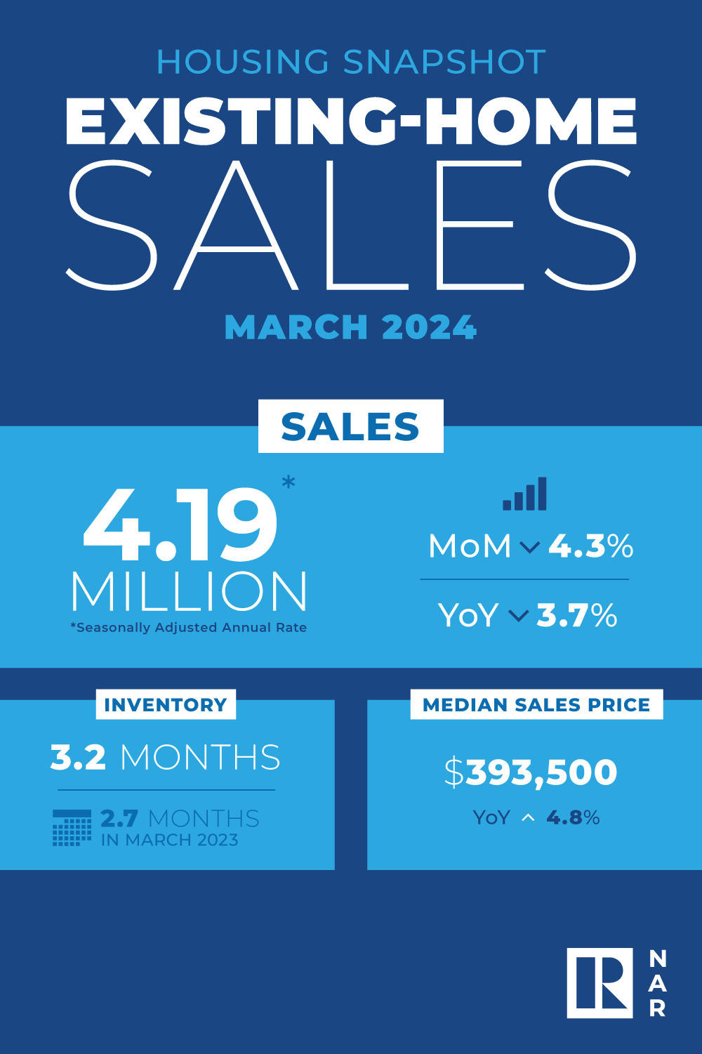
Existing-Home SALES
- 4.3%
March 2024
Copyright ©2024 “Existing Home Sales.” NATIONAL ASSOCIATION OF REALTORS®. All rights reserved. Reprinted with permission. March 2024..nar.realtor/
Notes:
TALKING POINTS
Existing-home sales declined by 4.3% in March, while the median sales price rose 4.8% year-over-year to $393,500, marking nine consecutive months of YOY price gains.
WHY IS THIS IMPORTANT?
Keep your clients up-to-date on the absorption rate in your market. Nationally, the inventory of unsold existing homes grew 4.7% from just one month ago, equaling 3.2 months’ supply at the current monthly sales pace.

Slide 15
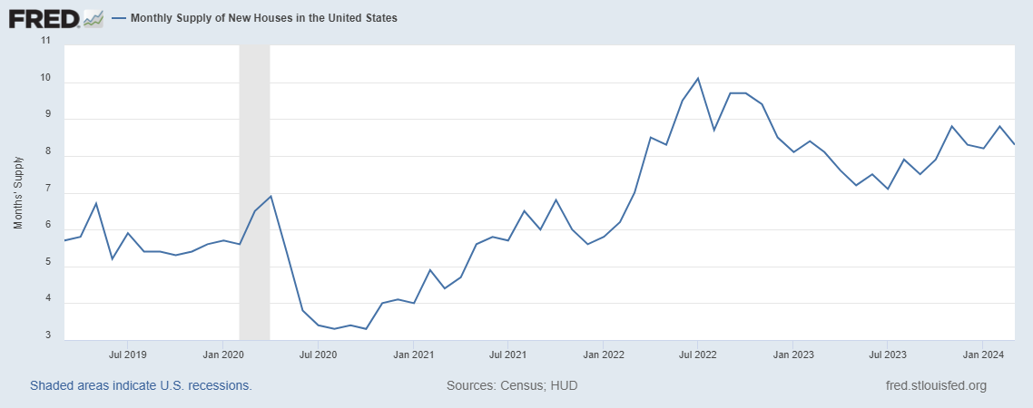
Monthly Supply of New Houses
8.3
March 2024
U.S. Census Bureau and U.S. Department of Housing and Urban Development, Monthly Supply of New Houses in the United States [MSACSR], retrieved from FRED, Federal Reserve Bank of St. Louis; https://fred.stlouisfed.org/series/MSACSR.
Notes:
TALKING POINTS
The monthly absorption rate of new construction homes again decreased slightly to 8.3 months of inventory in March.
WHY IS THIS IMPORTANT?
New construction homes appeal to buyers struggling to find an existing home that matches their wants and needs. Many buyers dislike the thought of being in a bidding war, and new construction offers less drama.
When working with sellers, include information about new subdivisions competing for the same buyer pool.

Slide 16
Real Estate Trends Local Market Report
Notes:
Total number of listings currently available per MLS
Number of pendings last month per MLS
Number of closed transactions last month per MLS

Slide 17
Real Estate Trends Company Production
Notes:
Production Updates, Listings, Under Contracts, Closings (various ways to share)
Previous month vs. the same period last year
Year To Date (YTD)
Year Over Year (YOY)
Market Share

Slide 18
Real Estate Trends Company Data
Notes:
Average DOM from List to Under Contract
Average DOM from Under Contract to Close
Average / Median List Price
Average / Median Sales Price
Company’s List Price to Sales Price Ratio

Slide 19
Old Business & New Business
Notes:
Updates and follow-up to the previous meeting
“Parking Lot” items

Slide 20
Next Meeting
INSERT Date & Time
INSERT Location
INSERT Next Meeting Highlight
Notes:
TIP: Consider adding a meeting teaser, such as the learning sprint topic, below the meeting location

Slide 21
Spark Your Business
Happy 4th of July!
^{POP BY}
Image courtesy of Systems and Solutions (Etsy) Discount code: SPARK25
Notes:
As we conclude today’s sales meeting, we want to leave you with one idea to help Spark Your Business and keep your pipeline full.
Prepare small gift bags with sparklers, a small American flag, and glow sticks. Attach a clever tag like this one and include a couple of your business cards in the bag. Identify past clients and SOI connections who are nearby and drop them off during the last week of June. This will help you stay top-of-mind for repeat and referral business.

Slide 22
Spark Your Business
World Chocolate Day
July 7, 2024
I’m never too busy for s’more of your referrals!
Image courtesy of Systems and Solutions (Etsy) Discount code: SPARK25
Notes:
As we conclude today’s sales meeting, we want to leave you with one idea to help Spark Your Business and keep your pipeline full.
Fill a gift bag with a bag of marshmallows, a box of graham crackers, and chocolate bars. Attach a clever tag like this one. Drop by select past clients and SOI connections to reconnect in person and leave them with this delicious treat!

Slide 23
Spark Your
Business
Local Recreation
Newsletter
Highlight opportunities to get out and enjoy your community in July.
Notes:
As we conclude today’s sales meeting, we want to leave you with one idea to help Spark Your Business and keep your pipeline full.
Create a newsletter to be delivered electronically or by mail in July that focuses on exploring local recreational activities. The warm summer weather allows people to enjoy various outdoor activities, such as sports, festivals, concerts, and nature-based pursuits.
Many parks and public spaces host special events during the summer to encourage community engagements and physical activities. Include a few of your favorites, too. Add photos where possible to make the newsletter visually appealing. Programs like Canva, Google Docs, and Adobe offer free templates.
This type of marketing has a long shelf life, and recipients may share it with their family, friends, and neighbors.

Slide 24
Spark Your
Business
Back-To-School Supplies Drive
Organize a community event to collect much-needed classroom supplies.
Notes:
As we conclude today’s sales meeting, we want to leave you with one idea to help Spark Your Business and keep your pipeline full.
Consider sponsoring a Back-to-School activity, such as providing backpacks filled with school supplies or classroom items teachers often request.
Plan to advertise during July and early August so you’ll have the items ready to be delivered at the beginning of the school year.
Leverage your social media accounts to promote the activity. Take pictures during the entire process to update and engage your connections.
Consider asking vendors you use to collaborate with you, such as a home inspector or mortgage broker.
It’s proven that people like to do business with businesses that give back to the community.

