Slide 1
Welcome
Notes:
Introduction of new agents and staff, guest speaker welcome
Agent/staff recognition (birthdays, production achievements, etc.)
Good news sharing
General & community service announcements

Slide 2
Good News!
Notes:
Let’s start the meeting on a positive note by sharing some good news. Reflect on something positive that happened and share it with the group. It could be a personal milestone, a professional accomplishment, or a simple joy that has brought a smile to your face.

Slide 3
Meeting Agenda
Company Updates
Marketing Updates
Real Estate Wants & Needs
Education Opportunities
Practical Learning
Real Estate Trends
Old Business
New Business
Adjourn
Notes:
NOTE: Edit the agenda as appropriate for your meeting.

Slide 4
Company Updates
Notes:
New company listings and buyer needs
Company Initiatives (company-specific updates or topics you deem appropriate)
“Parking Lot” items from previous meetings
Agent Sales Contest

Slide 5
Marketing Updates
Notes:
Company marketing initiatives
Company community service projects and events
Agent marketing opportunities that complement company/brand marketing

Slide 6
Wants & Needs

Slide 7
Education Opportunities

Slide 13
Guest Speaker
<INSERT SPEAKER NAME & COMPANY>
Notes:
NOTE: Delete if not using a guest speaker.

Slide 14
30-Year Fixed Mortgage Rates
6.94%
February 2024
6.79% March 2024
Source: Macrotrends.net
Notes:
TALKING POINTS
The 30-year fixed-rate decreased slightly from 6.95% to 6.79% at the end of March.
WHY IS THIS IMPORTANT?
Several experts are predicting a decline in mortgage rates over the course of 2024. Projections indicate that 30-year rates could stabilize at anywhere between 6.1% to 6.4% by year end. As a result, we may see slightly expanded buyer pools emerging later in the year.

Slide 15
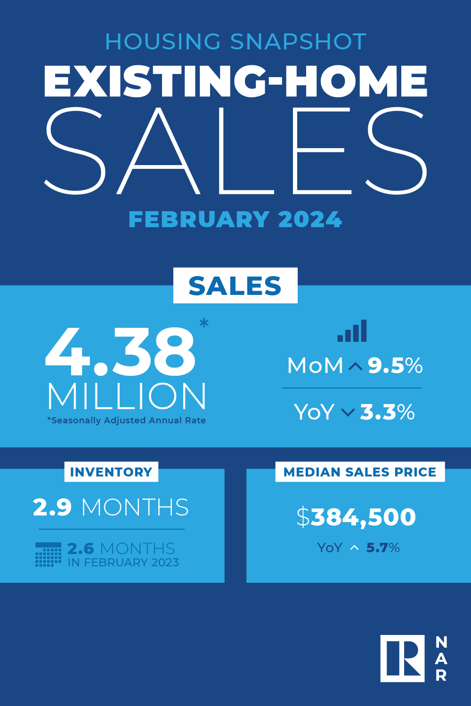
Existing-Home SALES
9.5%
February 2024
Copyright ©2023 “Existing Home Sales.” NATIONAL ASSOCIATION OF REALTORS®. All rights reserved. Reprinted with permission. February 2024..nar.realtor/
Notes:
TALKING POINTS
Existing home sales surged by 9.5% in February, the most significant jump in a year, driven by low mortgage rates and strong demand.
Median sales prices rose 5.7% year-over-year to $384,500, marking eight consecutive months of increases.
Despite a slight dip in supply, with a national absorption rate of 2.9 months, prices remain good due to limited inventory.
WHY IS THIS IMPORTANT?
This underscores the market’s resilience, with prices expected to continue rising in 2024.

Slide 16
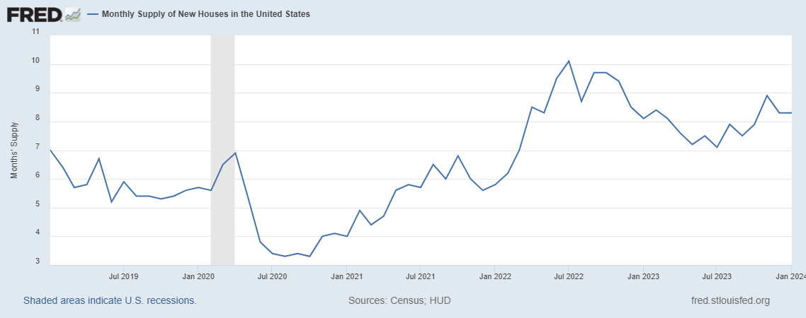
Monthly Supply of New Houses
8.4
February 2024
U.S. Census Bureau and U.S. Department of Housing and Urban Development, Monthly Supply of New Houses in the United States [MSACSR], retrieved from FRED, Federal Reserve Bank of St. Louis; https://fred.stlouisfed.org/series/MSACSR.
Notes:
TALKING POINTS
The monthly absorption rate of new construction homes again increased slightly to 8.4 months of inventory in February.
WHY IS THIS IMPORTANT?
New construction may be appealing to buyers who are struggling to find an existing home that matches their wants and needs. However, new homes can have several disadvantages:
Cost: In February 2024, the median price of a newly built home was $400,500, $16,000 more than the median sales price of existing homes.
Timeline: Getting into a new home can take 3-9 months.
Quality: some say new construction homes have low-built quality that can lead to expensive issues later.
Advise buyers to research builders and have an independent home inspection before closing. In Michigan, a new construction buyer who didn’t use an inspector couldn’t figure out why one room in their home was always cold. Turned out the room lacked insulation in the ceiling – underscoring the importance of thorough inspections.

Slide 17
Real Estate Trends Local Market Report
Notes:
Total number of listings currently available per MLS
Number of pendings last month per MLS
Number of closed transactions last month per MLS

Slide 18
Real Estate Trends Company Production
Notes:
Production Updates, Listings, Under Contracts, Closings (various ways to share)
Previous month vs. the same period last year
Year To Date (YTD)
Year Over Year (YOY)
Market Share

Slide 19
Real Estate Trends Company Data
Notes:
Average DOM from List to Under Contract
Average DOM from Under Contract to Close
Average / Median List Price
Average / Median Sales Price
Company’s List Price to Sales Price Ratio

Slide 20
Old Business & New Business
Notes:
Updates and follow-up to the previous meeting
“Parking Lot” items

Slide 21
Next Meeting
INSERT Date & Time
INSERT Location
INSERT Next Meeting Highlight
Notes:
TIP: Consider adding a meeting teaser, such as the learning sprint topic, below the meeting location

Slide 22
Spark Your Business
Pop by with a gift card to the local ice cream shop.
Systems and Solutions | Etsy
Notes:
As we conclude today’s sales meeting, we want to leave you with one idea to help Spark Your Business and keep your pipeline full. Identify several past clients or members of your sphere of influence whom you want to connect with in June. With warm days ahead, a gift card to a local ice cream shop will hit the spot! Place in an envelope, include 2 or 3 of your business cards, and attach a clever tag like the one shown. Schedule your pop-bys – if they’re not home, you can tape it to their door.

Slide 23
Spark Your Business
Neighborhood Market Reports
Reconnect with past clients by mailing or emailing neighborhood market reports.
Notes:
As we conclude today’s sales meeting, we want to give you one idea to help Spark Your Business and keep your pipeline full.
Homeowners are always curious about the value of their homes, especially during a Seller’s market. Select a few of your past clients and prepare a neighborhood market report. In a short letter, explain that the market is constantly changing, and you want to inform them about what’s happening in their neighborhood. Either mail or email it to them. Always close your communication by letting them know you’d appreciate referrals when they learn of someone looking to buy or sell in the area. If mailing, be sure to include a couple of your business cards.

Slide 24
Spark Your Business
Name Your Poison Day
June 8th
Invite a past client to meet up to share their “poison” of choice with you!
Notes:
As we conclude today’s sales meeting, we want to give you one idea to help Spark Your Business and keep your pipeline full.
On June 8th we celebrate National Name Your Poison Day – either food or drink! This saying is traced back to 1864 when the latest fashion was to ask someone to “nominate your poison.” Invite a couple of past clients or SOI to join you at a favorite local shop to catch up. Before you part ways, let them know you appreciate them referring new business to you. Make sure to give each of them 2-3 business cards to pass along.

Slide 25
Spark Your Business
National Sunglasses Day
^{June 27th}
Surprise past clients with fun sunglasses.
Systems and Solutions | Etsy
Notes:
As we conclude today’s sales meeting, we want to give you one idea to help Spark Your Business and keep your pipeline full.
June 27th is National Sunglasses Day. Surprise a few select past clients and your SOI with a gift bag of fun sunglasses from the Dollar Store. Attach a clever tag, such as this one, and drop in 2-3 of your business cards for the recipients to pass along as they refer you to their friends, family, and co-workers.

Slide 26
Spark Your Business
Birthdays &
Anniversaries
Mail cards to your SOI on special dates.
Notes:
As we conclude today’s sales meeting, we want to leave you with one idea to help Spark Your Business and keep your pipeline full.
As part of your plan to stay top-of-mind with past clients and your sphere of influence, it’s nice to send Birthday or Anniversary cards. When we get busy, it’s easy to put this marketing touch on the backburner. During June, consider buying birthday cards in bulk and prepare them for mailing. You can do a month at a time or more. Store them where you won’t forget to mail at least one week prior to their special date.
If you’ve been staying in contact regularly, just signing your full name should be sufficient. If you’ve been remiss, instead of a birthday or wedding anniversary card, consider sending a First Anniversary in Your New Home card and include your business card.
It’s a good idea to place a reminder on your calendar to mail the prepared cards.

