Slide 1
Welcome

Slide 2
Good News!
Notes:
Let’s start the meeting on a positive note by sharing some good news. Reflect on something positive that happened and share it with the group. It could be a personal milestone, a professional accomplishment, or a simple joy that has brought a smile to your face.

Slide 3
Meeting Agenda
Company Updates
Marketing Updates
Real Estate Wants & Needs
Education Opportunities
Practical Learning
Real Estate Trends
Old Business
New Business
Adjourn
Notes:
NOTE: Edit the agenda as appropriate for your meeting.

Slide 4
Company Updates
Notes:
New company listings and buyer needs
Company Initiatives (company-specific updates or topics you deem appropriate)
“Parking Lot” items from previous meetings
Agent Sales Contest

Slide 5
Marketing Updates
Notes:
Company marketing initiatives
Company community service projects and events
Agent marketing opportunities that complement company/brand marketing

Slide 6
Wants & Needs

Slide 7
Education Opportunities

Slide 13
Guest Speaker
<INSERT SPEAKER NAME & COMPANY>
Notes:
NOTE: Delete if not using a guest speaker.

Slide 14
30-Year Fixed Mortgage Rates
6.69%
January 2024
6.94% February 2024
Source: Macrotrends.net
Notes:
TALKING POINTS
The 30-year fixed rate increased slightly from 6.69% to 6.94% at the end of February.
One reason may be the large gap between the Consumer Price Index (which measures what we pay for food items, autos, and rent for example) vs. the Personal Consumption Expenditures (which measures what we pay for goods and services).
WHY IS THIS IMPORTANT?
As mortgage rates rise, the effect on real estate investing can be positive. If you’re working with clients looking to buy investment properties, now is a good time to buy because rental demand may increase as more people opt to rent while waiting for interest rate to fall.

Slide 15
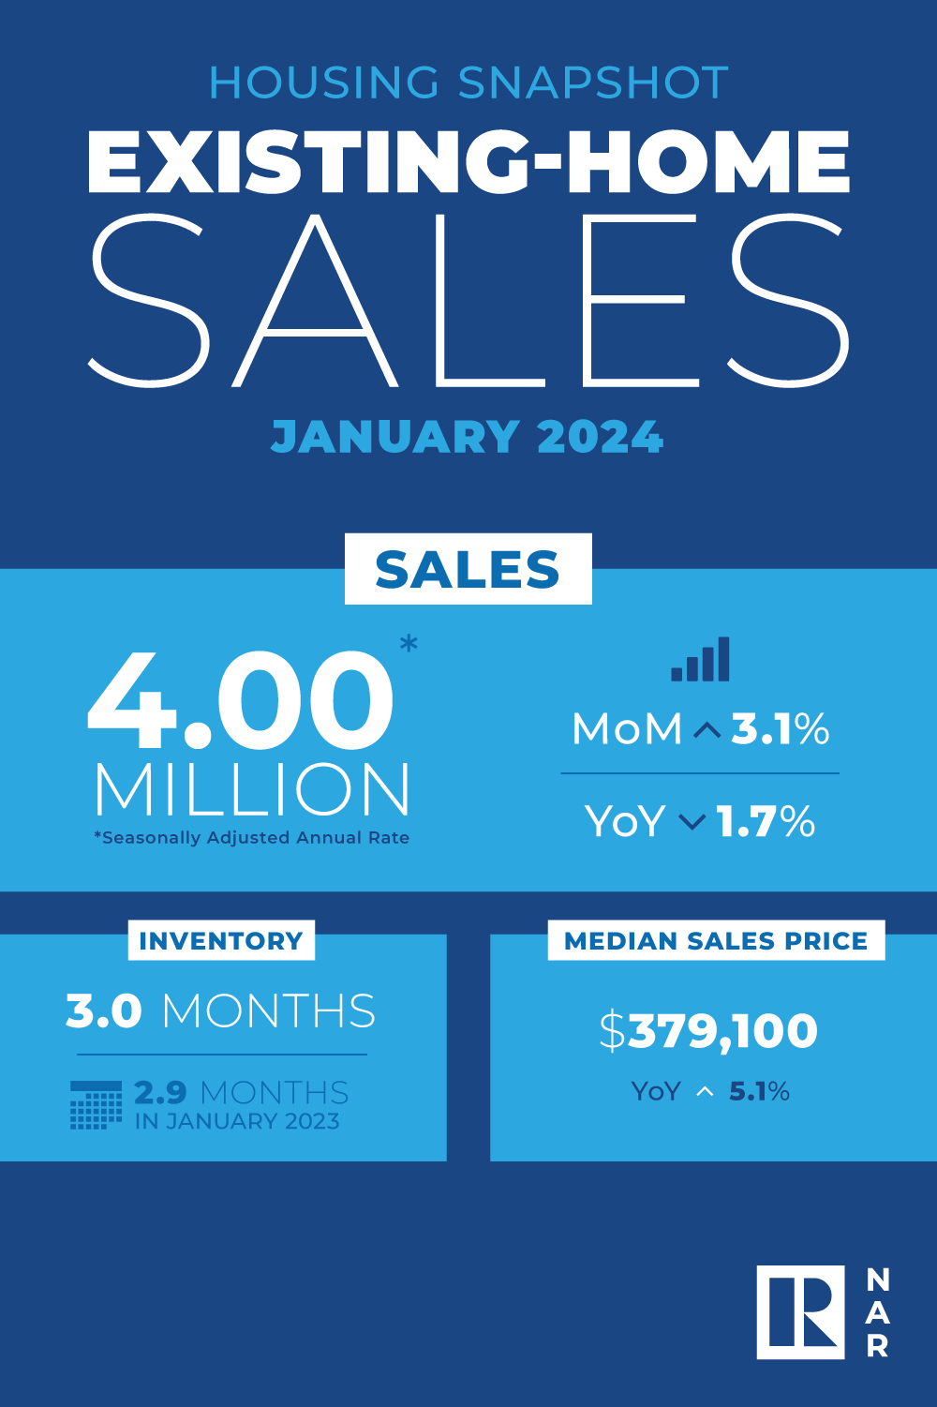
Existing-Home SALES
3.1%
January 2024
Copyright ©2023 “Existing Home Sales.” NATIONAL ASSOCIATION OF REALTORS®. All rights reserved. Reprinted with permission. February 2024..nar.realtor/
Notes:
TALKING POINTS
Existing-home sales increased 3.1% in January.
The median sales price fell slightly to $379,100 month-over-month, but is strong when compared year-over-year where it is up 5.1%.
The national absorption rate is trending slightly down at 3 months versus 3.2 months in December..
WHY IS THIS IMPORTANT?
Even with the 30-year fixed rate slightly increasing, home sale prices have remained steady nationally. It is still a great time to sell in most areas of the US. Buyers should be aware that mid-priced homes are still receiving multiple offers and be prepared to offer highest and best.

Slide 16
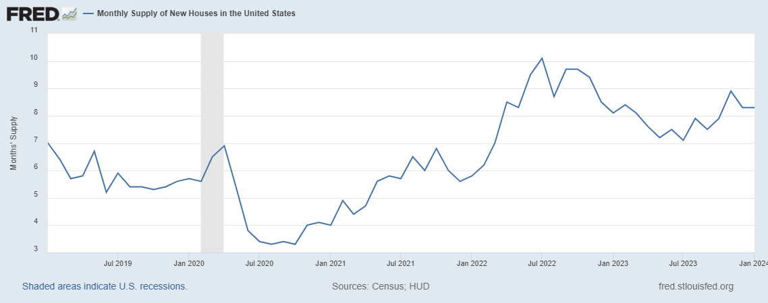
Monthly Supply of New Houses
8.3
January 2024
U.S. Census Bureau and U.S. Department of Housing and Urban Development, Monthly Supply of New Houses in the United States [MSACSR], retrieved from FRED, Federal Reserve Bank of St. Louis; https://fred.stlouisfed.org/series/MSACSR.
Notes:
TALKING POINTS
The monthly absorption rate of new construction homes increased slightly to 8.3 months of inventory in January.
WHY IS THIS IMPORTANT?
With new construction homes lingering on the market longer than existing homes and single-family housing construction starts predicted to increase this year, this could be a good year for your buyers looking to buy new construction.

Slide 17
Real Estate Trends Local Market Report
Notes:
Total number of listings currently available per MLS
Number of pendings last month per MLS
Number of closed transactions last month per MLS

Slide 18
Real Estate Trends Company Production
Notes:
Production Updates, Listings, Under Contracts, Closings (various ways to share)
Previous month vs. the same period last year
Year To Date (YTD)
Year Over Year (YOY)
Market Share

Slide 19
Real Estate Trends Company Data
Notes:
Average DOM from List to Under Contract
Average DOM from Under Contract to Close
Average / Median List Price
Average / Median Sales Price
Company’s List Price to Sales Price Ratio

Slide 20
Old Business & New Business
Notes:
Updates and follow-up to the previous meeting
“Parking Lot” items

Slide 21
Next Meeting
INSERT Date & Time
INSERT Location
INSERT Next Meeting Highlight
Notes:
TIP: Consider adding a meeting teaser, such as the learning sprint topic, below the meeting location

Slide 22
Spark Your Business
National Lemonade Day
May 5th
Prepare a small gift bag with lemonade mix and fresh lemons.
Image Credit: BigTopCreations / Etsy
Notes:
As we conclude today’s sales meeting, we want to give you one idea to help Spark Your Business and keep your pipeline full.
May 5th is National Lemonade Day. Leverage this day by scheduling a pop-by to a few select past clients and members of your sphere of influence. In a small gift bag, include lemonade mix and fresh lemons. Be sure to attach a clever tag like the one shown and include a couple of your business cards. If the recipient is home, be prepared to share relevant data about the market.

Slide 23
Spark Your Business
Spring
Newsletter
Create a Spring Newsletter to email to your database.
Notes:
As we conclude today’s sales meeting, we want to give you one idea to help Spark Your Business and keep your pipeline full.
Spring is a great time to connect with your database using a newsletter. Articles should focus on spring maintenance, a relevant national trend and its impact on the local market, and upcoming summer events. Sharing this information with your clients will help them stay informed about what's happening in the local market and keep you top-of-mind for potential repeat and referral business. Always conclude your communication with a call to action, such as, "If you need more information about our market, please feel free to contact me. And, if you know someone who is looking to buy or sell real estate, I would appreciate your referral."

Slide 24
Spark Your Business
Real Estate Niche Announcement
Inform your database of your specialized niche.
Notes:
At the end of today's sales meeting, we offer you a valuable tip to help you boost your business and maintain a steady stream of clients. People tend to choose a professional they perceive as an expert. By specializing in a specific real estate niche, you can tell your existing clients what additional value you can provide for those interested in buying or selling properties. In your letter, mention your area of specialization, the reason behind your passion, and how your knowledge and expertise will benefit buyers and sellers. Moreover, seek opportunities to share this information with potential clients likely to be interested in that niche. For instance, if you specialize in waterfront residential properties, you can mail the letter to all homeowners in local lake subdivisions.

Slide 25
Spark Your
Business
International Tea Day
May 21st
Surprise contacts with assorted teas, a branded mug, and a few honey spoons!
Image Credit: Front Porch Portraits
Notes:
As we conclude today’s sales meeting, we want to leave you with one idea to help Spark Your Business and keep your pipeline full. May 21st is International Tea Day. Consider doing a pop-by to a few select past clients and sphere of influence contacts. Put together a small gift bag with an assortment of tea, maybe a travel mug branded with your logo, and honey spoons. Attach a clever tag and slide in 2 or 3 of your business cards.

Slide 26
Memorial Day Marketing Ideas
Hand Out Flags at a Local Parade
Kick-Off to Summer Branded Events Calendar
Farmers’ Markets
Firework Displays
Festivals
Arts & Crafts Shows
Sidewalk Sales
Concerts
Notes:
As we conclude today’s sales meeting, we want to leave you with one idea to help Spark Your Business and keep your pipeline full.
Many community members enjoy a good parade, and Memorial Day is just around the corner, on May 27th. You may want to consider several marketing ideas. One successful Michigan agent would line the local parade route with small US flags year after year while wearing a polo shirt with his logo. To this day people still talk about Scott Griffith and his flags. You could create a simple summer calendar of community events like farmers’ markets, firework displays, and arts & crafts festivals. Brand the calendar with your logo and contact information and mail or email to your SOI and past clients. The calendar will provide shelf-life for this marketing promotion.

