Slide 1
Welcome

Slide 2
Good News!
Notes:
Let’s start the meeting on a positive note by sharing some good news. Reflect on something positive that happened and share it with the group. It could be a personal milestone, a professional accomplishment, or a simple joy that has brought a smile to your face.

Slide 3
Meeting Agenda
Company Updates
Marketing Updates
Real Estate Wants & Needs
Education Opportunities
Practical Learning
Real Estate Trends
Old Business
New Business
Adjourn
Notes:
NOTE: Edit the agenda as appropriate for your meeting.

Slide 4
Company Updates
Notes:
New company listings and buyer needs
Company Initiatives (company-specific updates or topics you deem appropriate)
“Parking Lot” items from previous meetings
Agent Sales Contest

Slide 5
Marketing Updates
Notes:
Company marketing initiatives
Company community service projects and events
Agent marketing opportunities that complement company/brand marketing

Slide 6
Wants & Needs

Slide 7
Education Opportunities

Slide 8
Embedded videos are for PowerPoint only.
Videos will NOT play in Google Slides or Keynote.
Notes:
Hide this slide if you do not wish to play this video.
Embedded videos are for PowerPoint only. Videos will NOT play in Google Slides or Keynote.

Slide 9
Embedded videos are for PowerPoint only.
Videos will NOT play in Google Slides or Keynote.
Notes:
Hide this slide if you do not wish to play this video.
Embedded videos are for PowerPoint only. Videos will NOT play in Google Slides or Keynote.

Slide 10
Embedded videos are for PowerPoint only.
Videos will NOT play in Google Slides or Keynote.
Notes:
Hide this slide if you do not wish to play this video.
Embedded videos are for PowerPoint only. Videos will NOT play in Google Slides or Keynote.

Slide 11
Embedded videos are for PowerPoint only.
Videos will NOT play in Google Slides or Keynote.
Notes:
Hide this slide if you do not wish to play this video.
Embedded videos are for PowerPoint only. Videos will NOT play in Google Slides or Keynote.

Slide 12
Guest Speaker
<INSERT SPEAKER NAME & COMPANY>
Notes:
NOTE: Delete if not using a guest speaker.

Slide 13
30-Year Fixed Mortgage Rates
6.61%
December 2023
6.69% January 2024
Source: Macrotrends.net
Notes:
TALKING POINTS
At their January 2024 meeting, the Federal Reserve held interest rates steady at 5.25%-5.5%. A strong economy, low unemployment, and inflation near 2%, have some experts predicting a rate decrease of around 1% at the March 20th meeting.
WHY IS THIS IMPORTANT?
Early spring markets may still have slim pickings when it comes to existing homes for sale, and your buyers may want to delay putting in offers while they wait on a rate drop.
Be prepared to advise your buyers that if the perfect home comes on the market now, they may want to grab it. Lower rates will create more buyer competition which typically drives up prices.

Slide 14
Existing-Home SALES
-1.0%
December 2023
Copyright ©2023 “Existing Home Sales.” NATIONAL ASSOCIATION OF REALTORS®. All rights reserved. Reprinted with permission. February 2024..nar.realtor/
Notes:
TALKING POINTS
Existing-home sales fell slightly in December, slumping 6.2% from the previous year.
The median sales price is $382,600 – the sixth consecutive month of YOY price increases.
WHY IS THIS IMPORTANT?
With existing-home prices still increasing, you may suggest your buyers consider new construction. New home builds are staying on the market several months longer than existing homes.
When you work with sellers, nationally, days on market have been increasing from 25 days in November to 29 days in December. Know the days on market for your local area and advise your sellers that every showing is important for a quick sale.

Slide 15
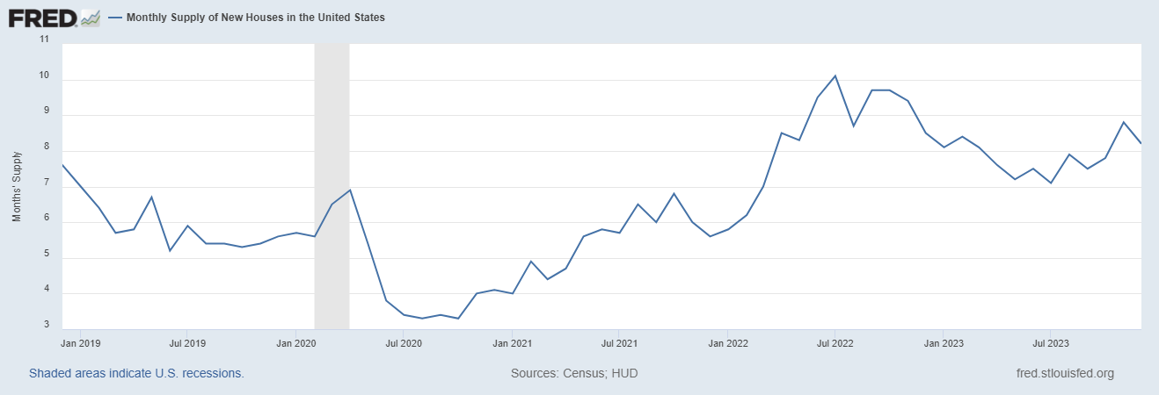
Monthly Supply of New Houses
8.2
December 2023
U.S. Census Bureau and U.S. Department of Housing and Urban Development, Monthly Supply of New Houses in the United States [MSACSR], retrieved from FRED, Federal Reserve Bank of St. Louis; https://fred.stlouisfed.org/series/MSACSR.
Notes:
TALKING POINTS
The monthly absorption rate of new construction homes decreased by one month to 8.2 months of inventory in December.
WHY IS THIS IMPORTANT?
With new construction homes lingering on the market longer than existing homes and single-family housing construction starts predicted to increase in 2024, this could be a good year for your buyers looking to buy new construction.

Slide 16
Real Estate Trends Local Market Report
Notes:
Total number of listings currently available per MLS
Number of pendings last month per MLS
Number of closed transactions last month per MLS

Slide 17
Real Estate Trends Company Production
Notes:
Production Updates, Listings, Under Contracts, Closings (various ways to share)
Previous month vs. the same period last year
Year To Date (YTD)
Year Over Year (YOY)
Market Share

Slide 18
Real Estate Trends Company Data
Notes:
Average DOM from List to Under Contract
Average DOM from Under Contract to Close
Average / Median List Price
Average / Median Sales Price
Company’s List Price to Sales Price Ratio

Slide 19
Old Business & New Business
Notes:
Updates and follow-up to the previous meeting
“Parking Lot” items

Slide 20
Next Meeting
INSERT Date & Time
INSERT Location
INSERT Next Meeting Highlight
Notes:
TIP: Consider adding a meeting teaser, such as the learning sprint topic, below the meeting location

Slide 21
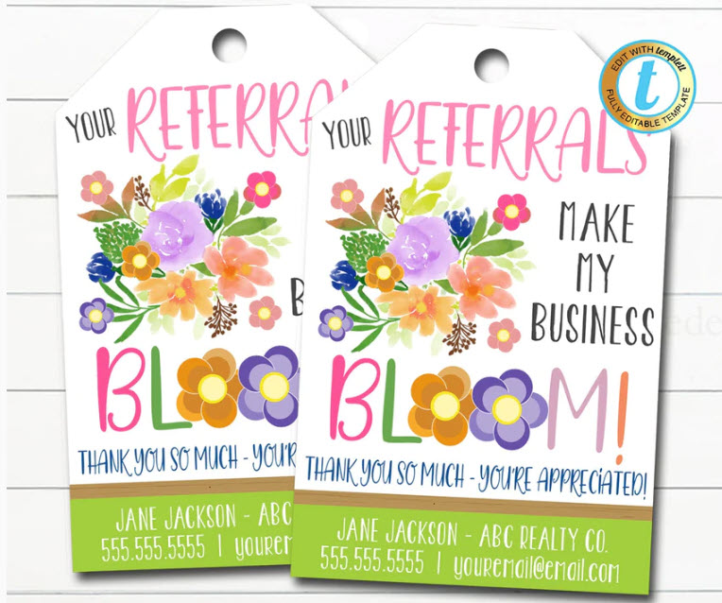
Spark Your Business
National Plant a Flower Day
March 12th
Prepare a small gift bag with flowers, seeds, gardening tools, or accessories.
Image Credit: Tidy Lady
Notes:
As we conclude today’s sales meeting, we want to leave you with one idea to help Spark Your Business and keep your pipeline full.
March 12th is National Plant a Flower Day. Leverage this day by scheduling a pop-by to a few select past clients and members of your Sphere of Influence.
In a small gift bag, include items such as flower seeds (forget-me-nots and sunflowers are always a huge hit), gardening gloves, plastic plant tags, or pruners. Slip in a couple of business cards and schedule a day to drop off the bags. If the recipient is home, share relevant data about the market and ask them if they know of anyone looking to buy or sell real estate.

Slide 22
Spark Your
Business
St. Patrick’s Day
March 17th
Surprise your SOI with lottery tickets!
Image Credit: Front Porch Portraits
Notes:
As we conclude today’s sales meeting, we want to leave you with one idea to help Spark Your Business and keep your pipeline full.
Select a few past clients and people in your sphere of influence and do an impromptu pop-by.
March 17th is St. Patrick’s Day. Prepare a small gift bag containing assorted scratch-off lottery tickets. Add a couple of your business cards and a clever tag, such as Wishing you a lotto luck! Staying top of mind will help you win repeat and referral business.

Slide 23
Spark Your
Business
First Day of Spring
March 20th
Surprise past clients with a flower or vegetable seeds.
Image Credit: Front Porch Portraits
Notes:
As we conclude today’s sales meeting, we want to leave you with one idea to help Spark Your Business and keep your pipeline full.
The first day of spring is March 20th. A fun way to stay top-of-mind with past clients would be to surprise them with vegetable or flower seeds. If they have small children, a springy toy, like a Slinky, might be fun, too!
Be sure to attach a clever tag like the one shown and a couple of your business cards.

Slide 24
Spark Your Business
Local Market Update
Show off your expertise by keeping your past clients and SOI apprised of local real estate happenings.
Notes:
As we conclude today’s sales meeting, we want to leave you with one idea to help Spark Your Business and keep your pipeline full.
Communities are constantly changing and evolving. Now would be an excellent time to reach out to your database contacts and share with them what’s happening in your local market.
Include new companies, stores, or restaurants that have recently moved into the area and information about new construction subdivisions and projects.
You might tie in with national trends like the number of new construction starts and inventory availability.
Sharing this with your clients will help keep them up-to-date on what’s taking place in the local market. And always close your communication with a call to action, such as, “Please call me if you would like additional information on our market. And if you know of someone looking to buy or sell real estate, I would appreciate the referral.”

