Slide 1
Welcome

Slide 2
Good News!
Notes:
Let’s start the meeting on a positive note by sharing some good news. Reflect on something positive that happened and share it with the group. It could be a personal milestone, a professional accomplishment, or a simple joy that has brought a smile to your face.

Slide 3
Meeting Agenda
Company Updates
Marketing Updates
Real Estate Wants & Needs
Education Opportunities
Practical Learning
Real Estate Trends
Old Business
New Business
Adjourn
Notes:
NOTE: Edit the agenda as appropriate for your meeting.

Slide 4
Company Updates
Notes:
New company listings and buyer needs
Company Initiatives (company-specific updates or topics you deem appropriate)
“Parking Lot” items from previous meetings
Agent Sales Contest

Slide 5
Marketing Updates
Notes:
Company marketing initiatives
Company community service projects and events
Agent marketing opportunities that complement company/brand marketing

Slide 6
Wants & Needs

Slide 7
Education Opportunities

Slide 8
Embedded videos are for PowerPoint only.
Videos will NOT play in Google Slides or Keynote.
Notes:
Hide this slide if you do not wish to play this video.
Embedded videos are for PowerPoint only. Videos will NOT play in Google Slides or Keynote.

Slide 9
Embedded videos are for PowerPoint only.
Videos will NOT play in Google Slides or Keynote.
Notes:
Hide this slide if you do not wish to play this video.
Embedded videos are for PowerPoint only. Videos will NOT play in Google Slides or Keynote.

Slide 10
Embedded videos are for PowerPoint only.
Videos will NOT play in Google Slides or Keynote.
Notes:
Hide this slide if you do not wish to play this video.
Embedded videos are for PowerPoint only. Videos will NOT play in Google Slides or Keynote.

Slide 11
Embedded videos are for PowerPoint only.
Videos will NOT play in Google Slides or Keynote.

Slide 12
Embedded videos are for PowerPoint only.
Videos will NOT play in Google Slides or Keynote.
Notes:
Hide this slide if you do not wish to play this video.
Embedded videos are for PowerPoint only. Videos will NOT play in Google Slides or Keynote.

Slide 13
Guest Speaker
<INSERT SPEAKER NAME & COMPANY>
Notes:
NOTE: Delete if not using a guest speaker.

Slide 14
30-Year Fixed Mortgage Rates
7.22%
November 2023
6.61%
December 2023
Source: Macrotrends.net
Notes:
TALKING POINTS
The good news is that the 30-year fixed rate has finally dipped below 7% to 6.61% in December.
WHY IS THIS IMPORTANT?
The drop in rates could open up opportunities for more buyers to snag their dream homes instead of just settling for what they could afford. If you’ve got cautious buyers on your hands, it might be a good idea to suggest they reach out to their mortgage rep now. And with inflation hanging low, there’s a chance the Federal Reserve might stick with the current rates or even tweak them down a bit.

Slide 15
Existing-Home SALES
+0.8%
November 2023
Copyright ©2023 “Existing Home Sales.” NATIONAL ASSOCIATION OF REALTORS®. All rights reserved. Reprinted with permission. January 2024..nar.realtor/
Notes:
TALKING POINTS
In November, existing home sales made a modest gain of just under 1% monthly, and year-over-year sales fell 7.3%.
The Median Sales Price increased 4% from a year ago.
WHY IS THIS IMPORTANT?
House prices just keep on climbing. The only thing that can really put a damper on the rise in prices is if there’s a significant increase in the supply.

Slide 16
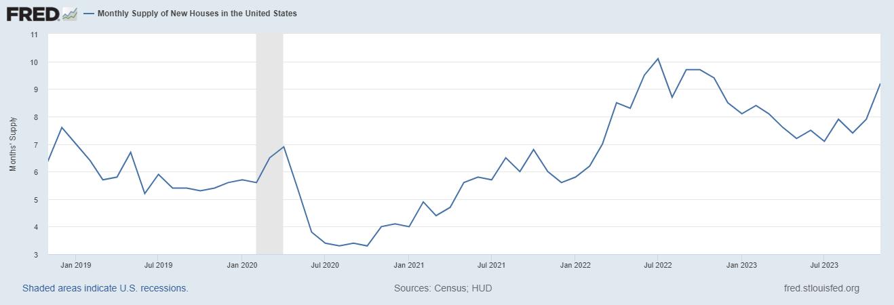
Monthly Supply of New Houses
9.2
November 2023
U.S. Census Bureau and U.S. Department of Housing and Urban Development, Monthly Supply of New Houses in the United States [MSACSR], retrieved from FRED, Federal Reserve Bank of St. Louis; https://fred.stlouisfed.org/series/MSACSR.
Notes:
TALKING POINTS
The monthly absorption rate of new construction homes increased from 7.8 to 9.2 months of inventory!
WHY IS THIS IMPORTANT?
With new construction homes lingering on the market longer and single-family housing construction starts predicted to increase in 2024, this could be a good year for your buyers looking to negotiate asking prices and/or building upgrades.

Slide 17
Real Estate Trends Local Market Report
Notes:
Total number of listings currently available per MLS
Number of pendings last month per MLS
Number of closed transactions last month per MLS

Slide 18
Real Estate Trends Company Production
Notes:
Production Updates, Listings, Under Contracts, Closings (various ways to share)
Previous month vs. the same period last year
Year To Date (YTD)
Year Over Year (YOY)
Market Share

Slide 19
Real Estate Trends Company Data
Notes:
Average DOM from List to Under Contract
Average DOM from Under Contract to Close
Average / Median List Price
Average / Median Sales Price
Company’s List Price to Sales Price Ratio

Slide 20
Old Business & New Business
Notes:
Updates and follow-up to the previous meeting
“Parking Lot” items

Slide 21
Next Meeting
INSERT Date & Time
INSERT Location
INSERT Next Meeting Highlight
Notes:
TIP: Consider adding a meeting teaser, such as the learning sprint topic, below the meeting location

Slide 22
Spark Your Business
Thomas Edison’s Birthday
February 11th
Prepare a small gift bag with LED night lights or energy-saving light bulbs.
Notes:
As we conclude today’s sales meeting, we want to leave you with one idea to help Spark Your Business and keep your pipeline full.
February 11th is Thomas Edison’s birthday. Leverage this day by scheduling a pop by to a few select past clients and members of your Sphere of Influence. In a small gift bag include items such as LED night lights, energy-saving light bulbs, or plastic light bulbs you buy at the local craft store that you can fill with candy. Attach a clever gift tag, such as Your Referrals LIGHT up my day! Slip in a couple of business cards and schedule a day to drop off the bags. If the recipient is home, share relevant data about the market and let them know that if they know of anyone looking to buy or sell real estate that you would appreciate their referral.

Slide 23
Spark Your Business
Valentine’s Day
February 14th
Surprise your SOI with assorted chocolates.
Notes:
As we conclude today’s sales meeting, we want to leave you with one idea to help Spark Your Business and keep your pipeline full.
Select a few past clients and people in your sphere of influence and do an impromptu pop-by. February 14th is Valentine’s Day. Prepare a small gift bag containing assorted chocolates. Add a couple of your business cards and a clever tag, such as You are the Heart of our business. Staying top of mind will help you win repeat and referral business.

Slide 24
Spark Your
Business
National Banana Bread Day
February 23rd
Surprise past clients with a loaf of banana bread.
Image Credit: MadeDesignCo
Notes:
As we conclude today’s sales meeting, we want to leave you with one idea to help Spark Your Business and keep your pipeline full.
National Banana Bread Day is February 23rd. A fun way to stay top-of-mind with past clients would be to surprise them with a loaf of banana bread. Be sure to attach a clever tag like the one shown and your business card.

Slide 25
Spark Your Business
Market Trends Mailing
Show off your real estate expertise by keeping your past clients and SOI apprised on local real estate trends.
Notes:
As we conclude today’s sales meeting, we want to leave you with one idea to help Spark Your Business and keep your pipeline full.
Many companies are shifting to electronic communications with their clients. This means the empty mailbox may get your marketing material noticed by sending information that homeowners will want to hold onto, which means that your contact information will be available when needed. An excellent report to prepare and send is the Absorption Rate. This report provides valuable insights into the pace at which properties are selling and aids in pricing strategies. Sharing this with your clients will help guide them on what’s happening in the local market.

Slide 26
Spark Your
Business
Spring Forward
Daylight Saving Time
March 10th
Send email reminders to everyone in your database.
Notes:
As we conclude today’s sales meeting, we want to leave you with one idea to help Spark Your Business and keep your pipeline full.
March 10th will start Daylight Saving Time. Consider sending an email to everyone in your database. A clever line to use in the email is, “Hey, if you’re considering buying or selling a home, let’s chat about making the most of that extra hour of daylight in finding your dream home or showcasing your property’s best features!”
If you don’t already have an email signature, now’s a good time to create a professional one with your brand. And if you do have one, verify that it still accurately reflects your brand.

