Slide 1
Welcome

Slide 2
Good News!
Notes:
Let’s start the meeting on a positive note by sharing some good news. Reflect on something positive that happened and share it with the group. It could be a personal milestone, a professional accomplishment, or a simple joy that has brought a smile to your face.

Slide 3
Meeting Agenda
Company Updates
Marketing Updates
Real Estate Wants & Needs
Education Opportunities
Practical Learning
Real Estate Trends
Old Business
New Business
Adjourn
Notes:
NOTE: Edit the agenda as appropriate for your meeting.

Slide 4
Company Updates
Notes:
New company listings and buyer needs
Company Initiatives (company-specific updates or topics you deem appropriate)
“Parking Lot” items from previous meetings
Agent Sales Contest

Slide 5
Marketing Updates
Notes:
Company marketing initiatives
Company community service projects and events
Agent marketing opportunities that complement company/brand marketing

Slide 6
Wants & Needs

Slide 7
Education Opportunities

Slide 8
Embedded videos are for PowerPoint only.
Videos will NOT play in Google Slides or Keynote.
Notes:
Hide this slide if you do not wish to play this video.
Embedded videos are for PowerPoint only. Videos will NOT play in Google Slides or Keynote.

Slide 9
Embedded videos are for PowerPoint only.
Videos will NOT play in Google Slides or Keynote.
Notes:
Hide this slide if you do not wish to play this video.
Embedded videos are for PowerPoint only. Videos will NOT play in Google Slides or Keynote.

Slide 10
Embedded videos are for PowerPoint only.
Videos will NOT play in Google Slides or Keynote.
Notes:
Hide this slide if you do not wish to play this video.
Embedded videos are for PowerPoint only. Videos will NOT play in Google Slides or Keynote.

Slide 11
Embedded videos are for PowerPoint only.
Videos will NOT play in Google Slides or Keynote.

Slide 12
FULL LENGTH VIDEO (for the first time you do this activity)
Embedded videos are for PowerPoint only.
Videos will NOT play in Google Slides or Keynote.
Notes:
FULL LENGTH VERSION of Monthly Goal Setting for the first time you introduce the activity.
Hide this slide if you do not wish to play this video.
Embedded videos are for PowerPoint only. Videos will NOT play in Google Slides or Keynote.

Slide 13
SHORT VIDEO (you have done the activity in the past and only need a quick activity introduction)
Embedded videos are for PowerPoint only.
Videos will NOT play in Google Slides or Keynote.
Notes:
SHORT VERSION of Monthly Goal Setting when you have done the activity in the past and want a quick introduction to the activity.
Hide this slide if you do not wish to play this video.
Embedded videos are for PowerPoint only. Videos will NOT play in Google Slides or Keynote.

Slide 14
Guest Speaker
<INSERT SPEAKER NAME & COMPANY>
Notes:
NOTE: Delete if not using a guest speaker.

Slide 15
30-Year Fixed Mortgage Rates
7.79%
October 2023
7.22%
November 2023
Source: Macrotrends.net
Notes:
TALKING POINTS
Good news is that the 30-year fixed edged slightly down during November to 7.22%.
WHY IS THIS IMPORTANT?
No one has a crystal ball; however, 30-year fixed rates are now the lowest they’ve been in four months. Most experts attribute this to slowing inflation rates. If you’re working with buyers, make sure they are staying in constant touch with the lender so they can optimize their mortgage rate.

Slide 16
Existing-Home SALES
-4.1%
October 2023
Copyright ©2023 “Existing Home Sales.” NATIONAL ASSOCIATION OF REALTORS®. All rights reserved. Reprinted with permission. December 2023..nar.realtor/
Notes:
TALKING POINTS
In October 2023, existing home sales fell by a little over 4% month over month and sales slumped 14.6% from one year ago.
The Median Sales price also fell month-over-month from $394,300 in September
WHY IS THIS IMPORTANT?
Prepare your sellers for the fact that homes may linger on the market slightly longer than last month. The national absorption rate increased from 3.3 months of inventory to 3.4 months. Please give them ideas to help their home stand out from their competition, positioning it for a quicker sale. This can be accomplished in many ways – decluttering the home, sprucing up or staging the interior, and offering incentives are a few ideas.

Slide 17
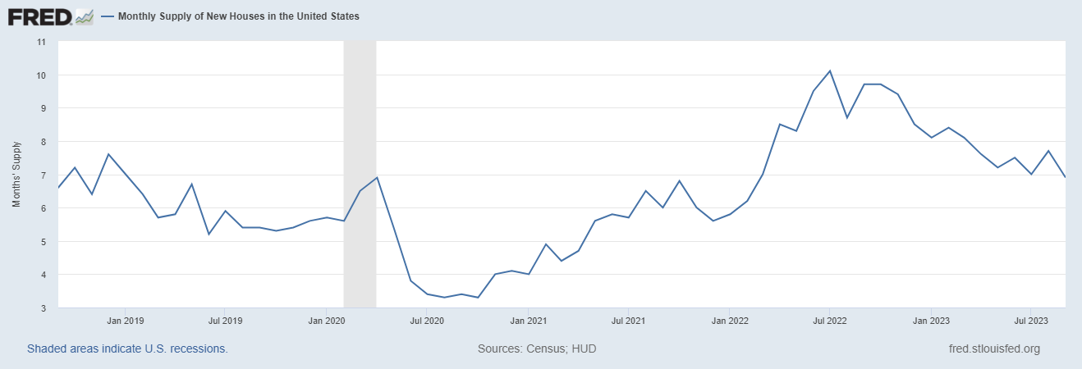
Monthly Supply of New Houses
7.8
October 2023
U.S. Census Bureau and U.S. Department of Housing and Urban Development, Monthly Supply of New Houses in the United States [MSACSR], retrieved from FRED, Federal Reserve Bank of St. Louis; https://fred.stlouisfed.org/series/MSACSR.
Notes:
TALKING POINTS
The monthly absorption rate of new construction homes increased by just over one month to almost eight months of inventory nationally.
WHY IS THIS IMPORTANT?
With new home sales slowing, if you have been working with a buyer who hasn’t found an existing home they like, you’d be wise to scope out a few new construction subdivisions in their price range. You’ll want to stop by the builder’s model ASAP to inquire if they will work with a real estate agent – ask about their protocol regarding the buyer’s first visit, what the compensation percentage is, and what the compensation is based on (usually the base price). Then, advise your buyer client, clearly letting them know that if they want your expert guidance, they need to follow the builder’s protocol. Better yet, schedule time with the buyer to take them to see the model homes. Make sure to get everything in writing.

Slide 18
Real Estate Trends Local Market Report
Notes:
Total number of listings currently available per MLS
Number of pendings last month per MLS
Number of closed transactions last month per MLS

Slide 19
Real Estate Trends Company Production
Notes:
Production Updates, Listings, Under Contracts, Closings (various ways to share)
Previous month vs. the same period last year
Year To Date (YTD)
Year Over Year (YOY)
Market Share

Slide 20
Real Estate Trends Company Data
Notes:
Average DOM from List to Under Contract
Average DOM from Under Contract to Close
Average / Median List Price
Average / Median Sales Price
Company’s List Price to Sales Price Ratio

Slide 21
Old Business & New Business
Notes:
Updates and follow-up to the previous meeting
“Parking Lot” items

Slide 22
Next Meeting
INSERT Date & Time
INSERT Location
INSERT Next Meeting Highlight
Notes:
TIP: Consider adding a meeting teaser, such as the learning sprint topic, below the meeting location

Slide 23
Spark Your Business
Open House Giveaway
Give away individual bags of popped corn at your next open house. Attach a clever tag and your business card.

Slide 24
Spark Your Business
National Peanut Butter Day
January 24th
Surprise your SOI with peanut butter cookies.
Notes:
Select the “Spark Your Business” slide(s) you wish to share and hide the rest.

Slide 25
Spark Your Business
Super Bowl LVII
February 11th
Surprise your SOI a football themed gift bag.
Notes:
Select the “Spark Your Business” slide(s) you wish to share and hide the rest.

Slide 26
Spark Your
Business
January
National Blood Donor Month
Host or participate in a community blood drive.
Notes:
Select the “Spark Your Business” slide(s) you wish to share and hide the rest.

Slide 27
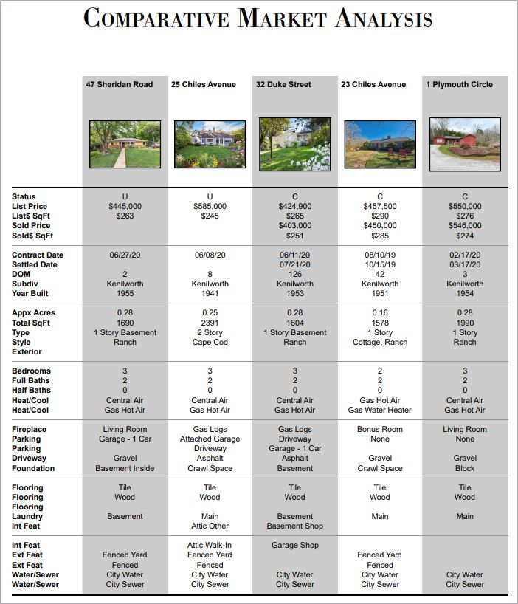
Spark Your
Business
Comparative Market Analysis
Select a few clients who have been in their homes for around ten years. Mail or email them an updated CMA and ask if they’re considering moving in the next year.
Notes:
Select the “Spark Your Business” slide(s) you wish to share and hide the rest.

