Slide 1
November Financial Strategies

Slide 2
Welcome

Slide 3
Meeting Agenda
Company Updates
Marketing Updates
Education Opportunities
Practical Learning
Real Estate Trends
Old Business
New Business
Adjourn
Notes:
NOTE: Edit the agenda as appropriate for your meeting.

Slide 4
Company Updates
Notes:
New company listings and buyer needs
Company Initiatives (company-specific updates or topics you deem appropriate)
“Parking Lot” items from previous meetings
Agent Sales Contest

Slide 5
Marketing Updates
Notes:
Company marketing initiatives
Company community service projects and events
Agent marketing opportunities that complement company/brand marketing

Slide 6
Education Opportunities

Slide 7
Embedded videos are for PowerPoint only.
Videos will NOT play in Google Slides or Keynote.
Notes:
Hide this slide if you do not wish to play this video.
Embedded videos are for PowerPoint only. Videos will NOT play in Google Slides or Keynote.

Slide 8
Embedded videos are for PowerPoint only.
Videos will NOT play in Google Slides or Keynote.
Notes:
Hide this slide if you do not wish to play this video.
Embedded videos are for PowerPoint only. Videos will NOT play in Google Slides or Keynote.

Slide 9
Embedded videos are for PowerPoint only.
Videos will NOT play in Google Slides or Keynote.
Notes:
Hide this slide if you do not wish to play this video.
Embedded videos are for PowerPoint only. Videos will NOT play in Google Slides or Keynote.

Slide 10
Embedded videos are for PowerPoint only.
Videos will NOT play in Google Slides or Keynote.

Slide 11
FULL LENGTH VIDEO (for the first time you do this activity)
Embedded videos are for PowerPoint only.
Videos will NOT play in Google Slides or Keynote.
Notes:
FULL LENGTH VERSION of Monthly Goal Setting for the first time you introduce the activity.
Hide this slide if you do not wish to play this video.
Embedded videos are for PowerPoint only. Videos will NOT play in Google Slides or Keynote.

Slide 12
SHORT VIDEO (you have done the activity in the past and only need a quick activity introduction)
Embedded videos are for PowerPoint only.
Videos will NOT play in Google Slides or Keynote.
Notes:
SHORT VERSION of Monthly Goal Setting when you have done the activity in the past and want a quick introduction to the activity.
Hide this slide if you do not wish to play this video.
Embedded videos are for PowerPoint only. Videos will NOT play in Google Slides or Keynote.

Slide 13
Guest Speaker
<INSERT SPEAKER NAME & COMPANY>
Notes:
NOTE: Delete if not using a guest speaker.

Slide 14
30-Year Fixed Mortgage Rates
7.18%
August 2023
7.31%
September 2023
Source: Macrotrends.net
Notes:
TALKING POINTS
While cash sales are excellent, according to Freddie Mac, nearly 90% of home buyers choose a 30-year fixed-rate mortgage, mainly for its affordability and flexibility.
WHY IS THIS IMPORTANT?
If your buyer chooses a 30-year mortgage, ask them to check with their mortgage representative about the pros and cons of paying off their mortgage early. They should also ask their lender what costs are entailed with refinancing and how to know if it’s a good financial move for them.
If you’re working with a seller, brainstorm a few creative ideas to entice a buyer who will be mortgaging the purchase to choose the seller’s property, such as down payment assistance or offering to pay a certain number of months of an HOA fee.

Slide 15
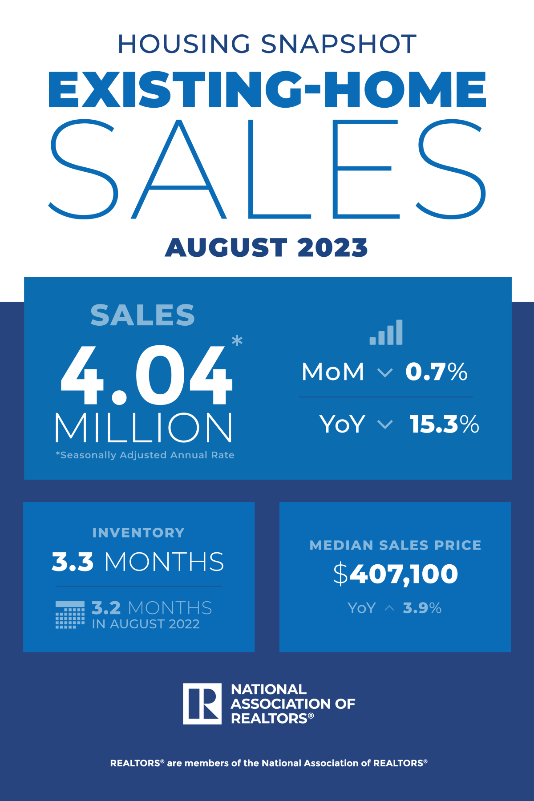
Existing-Home SALES
-0.7%
August 2023
Copyright ©2023 “Existing Home Sales.” NATIONAL ASSOCIATION OF REALTORS®. All rights reserved. Reprinted with permission. August 2023..nar.realtor/
Notes:
TALKING POINTS
August 2023 brought just over 4 million in sales, a median sales price of $407,000, up 3.9% YOY, and 3.3 months of inventory (Absorption Rate) – an increase of a few days from August of 2022.
WHY IS THIS IMPORTANT?
When talking with sellers this month, let them know that the median sales price increased only by 3.9% from a year ago. Most markets are no longer seeing double-digit appreciation YOY.
If you’re preparing your market’s Absorption Rate monthly, look back at last year’s data to compare to the national trend and share this information with your clients.
Prepare your sellers that homes may linger on the market a little longer than they were last month. Provide them with ideas that will help their home stand out from their competition, thereby positioning their home for a quicker sale.
This is good information to include in your listing presentation to help set the correct expectations for sellers.
According to NAR, “Existing home sales improved in the Midwest, were unchanged in the Northeast, and slipped in the South and West.” All four regions saw sales declines in YOY statistics.

Slide 16
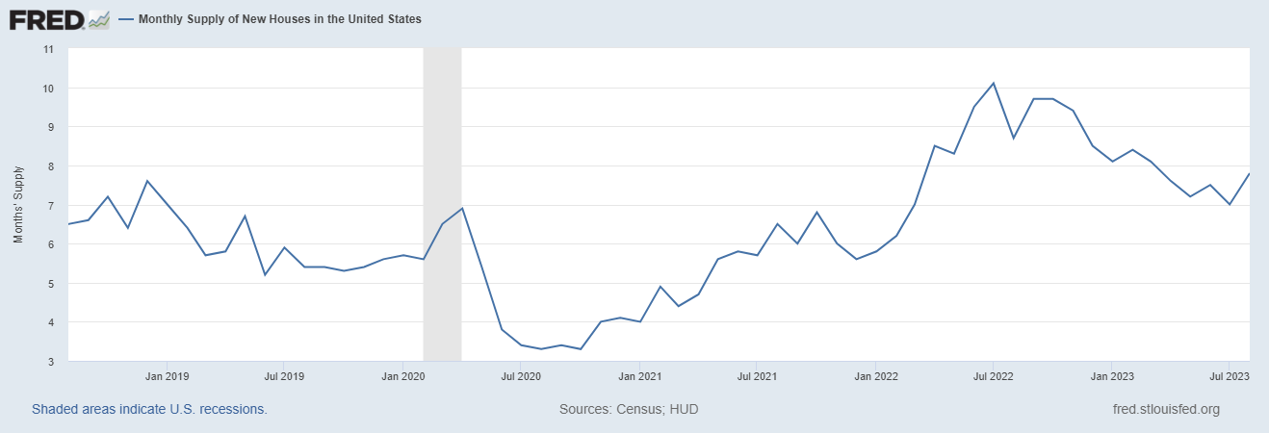
Monthly Supply of New Houses
7.8
August 2023
U.S. Census Bureau and U.S. Department of Housing and Urban Development, Monthly Supply of New Houses in the United States [MSACSR], retrieved from FRED, Federal Reserve Bank of St. Louis; https://fred.stlouisfed.org/series/MSACSR.
Notes:
TALKING POINTS
The monthly absorption rate of new construction homes is increasing slightly, meaning that it is taking longer to sell.
The National Association of Home Builders estimates that “…at least 1.5 million housing units are needed to meet demand and bring the housing market into balance.”
WHY IS THIS IMPORTANT?
If your buyers are considering buying new construction, make sure you are recommending a private home inspection vs. the builder’s inspector. Homes are going up quickly to take advantage of existing homes’ low inventory, and sub-contractors aren’t held accountable as they should. Even local County building departments have been known to let sub-par work slide during the inspection.
Builders, like existing home sellers, still have the upper hand in hot markets, so getting builders to throw in extras at no charge will be challenging.

Slide 17
Real Estate Trends Local Market Report
Notes:
Total number of listings currently available per MLS
Number of pendings last month per MLS
Number of closed transactions last month per MLS

Slide 18
Real Estate Trends Company Production
Notes:
Production Updates, Listings, Under Contracts, Closings (various ways to share)
Previous month vs. the same period last year
Year To Date (YTD)
Year Over Year (YOY)
Market Share

Slide 19
Real Estate Trends Company Data
Notes:
Average DOM from List to Under Contract
Average DOM from Under Contract to Close
Average / Median List Price
Average / Median Sales Price
Company’s List Price to Sales Price Ratio

Slide 20
Old Business & New Business
Notes:
Updates and follow-up to the previous meeting
“Parking Lot” items

Slide 21
Next Meeting
INSERT Date & Time
INSERT Location
INSERT Next Meeting Highlight
Notes:
TIP: Consider adding a meeting teaser, such as the learning sprint topic, below the meeting location

Slide 22
Spark Your Business
National Sundae Day
November 11th
Give your SOI gift cards to the local ice cream shop.
Notes:
Select the “Spark Your Business” slide(s) you wish to share and hide the rest.

Slide 23
Spark Your Business
Football Season
Surprise your SOI with football themed gift bags.
Notes:
Select the “Spark Your Business” slide(s) you wish to share and hide the rest.

Slide 24
Spark Your Business
Encourage your SOI to slow down this holiday season. Consider a postcard mailing or email with self-care suggestions, or pop by with simple self-care gifts.
Notes:
Select the “Spark Your Business” slide(s) you wish to share and hide the rest.

Slide 25
Spark Your Business
Happy New Year
Card Mailing
Wish your SOI a happy and prosperous new year!
Notes:
Select the “Spark Your Business” slide(s) you wish to share and hide the rest.

