Slide 1
October Business Planning

Slide 2
Welcome

Slide 3
Meeting Agenda
Company Updates
Marketing Updates
Education Opportunities
Practical Learning
Real Estate Trends
Old Business
New Business
Adjourn
Notes:
NOTE: Edit the agenda as appropriate for your meeting.

Slide 4
Company Updates
Notes:
New company listings and buyer needs
Company Initiatives (company-specific updates or topics you deem appropriate)
“Parking Lot” items from previous meetings
Agent Sales Contest

Slide 5
Marketing Updates
Notes:
Company marketing initiatives
Company community service projects and events
Agent marketing opportunities that complement company/brand marketing

Slide 6
Education Opportunities

Slide 7
Practical Learning
Click the link to the video you wish to play.
PowerPoint users may also use the embedded videos on the following slides.
Creating a Business Plan – Part 1
https://sparkandlogic.com/videos/create-your-business-plan-part-1/
Creating a Business Plan – Part 2
https://sparkandlogic.com/videos/create-your-business-plan-part-2/
Creating a Business Plan – Part 3
https://sparkandlogic.com/videos/create-your-business-plan-part-3/
Monthly Goal Setting
Full length: https://sparkandlogic.com/videos/monthly-goal-setting/
Short version: https://sparkandlogic.com/videos/monthly-goal-setting-short-version/
Notes:
Learning Sprint Video Instructions
PowerPoint
Option 1: Use this slide to click on the link to the video you wish to play. You must be logged into your Spark & Logic account to play the video.
Option 2: Use one of the following slides to play the embedded video.
Hide or delete the slides you do not wish to use
Google Slides or Keynote
Option 1: Use this slide to click on the link to the video you wish to play
Embedded videos will not play in Google Slides or Keynote.
Hide or delete the slides you do not wish to use

Slide 8
Embedded videos are for PowerPoint only.
Videos will NOT play in Google Slides or Keynote.
Notes:
Hide this slide if you do not wish to play this video.
Embedded videos are for PowerPoint only. Videos will NOT play in Google Slides or Keynote.

Slide 9
Embedded videos are for PowerPoint only.
Videos will NOT play in Google Slides or Keynote.
Notes:
Hide this slide if you do not wish to play this video.
Embedded videos are for PowerPoint only. Videos will NOT play in Google Slides or Keynote.

Slide 10
Embedded videos are for PowerPoint only.
Videos will NOT play in Google Slides or Keynote.
Notes:
Hide this slide if you do not wish to play this video.
Embedded videos are for PowerPoint only. Videos will NOT play in Google Slides or Keynote.

Slide 11
FULL LENGTH VIDEO (for the first time you do this activity)
Embedded videos are for PowerPoint only.
Videos will NOT play in Google Slides or Keynote.
Notes:
FULL LENGTH VERSION of Monthly Goal Setting for the first time you introduce the activity.
Hide this slide if you do not wish to play this video.
Embedded videos are for PowerPoint only. Videos will NOT play in Google Slides or Keynote.

Slide 12
SHORT VIDEO (you have done the activity in the past and only need a quick activity introduction)
Embedded videos are for PowerPoint only.
Videos will NOT play in Google Slides or Keynote.
Notes:
SHORT VERSION of Monthly Goal Setting when you have done the activity in the past and want a quick introduction to the activity.
Hide this slide if you do not wish to play this video.
Embedded videos are for PowerPoint only. Videos will NOT play in Google Slides or Keynote.

Slide 13
Guest Speaker
<INSERT SPEAKER NAME & COMPANY>
Notes:
NOTE: Delete if not using a guest speaker.

Slide 14
30-Year Fixed Mortgage Rates
6.81%
July 2023
7.18%
August 2023
Source: Macrotrends.net
Notes:
TALKING POINTS
Inflation remains uncomfortably high. Chair Jerome Powell indicated that additional 2023 rate increases are possible if inflation hasn’t dropped enough by the next meeting, October 31.
WHY IS THIS IMPORTANT?
High-interest rates have pushed the average interest and principal payment for new borrowers using a 30-year mortgage to $2,306. Compared to two years ago, 5% of new borrowers paid over $3,000/month; today, it’s almost 25%!
As a Buyer’s Agent, you’ll want to connect with respected and knowledgeable mortgage reps and recommend 2-3 of them to your buyers. Buyers must shop for the best mortgage terms and conditions.
It’s essential to let your buyers know that real estate typically outperforms other assets regarding value appreciation.
A high-interest rate environment can be a great time to buy an investment property if you know what you are doing. The market may spook other investors and landlords, and your investors can come in and find hidden gems.

Slide 15
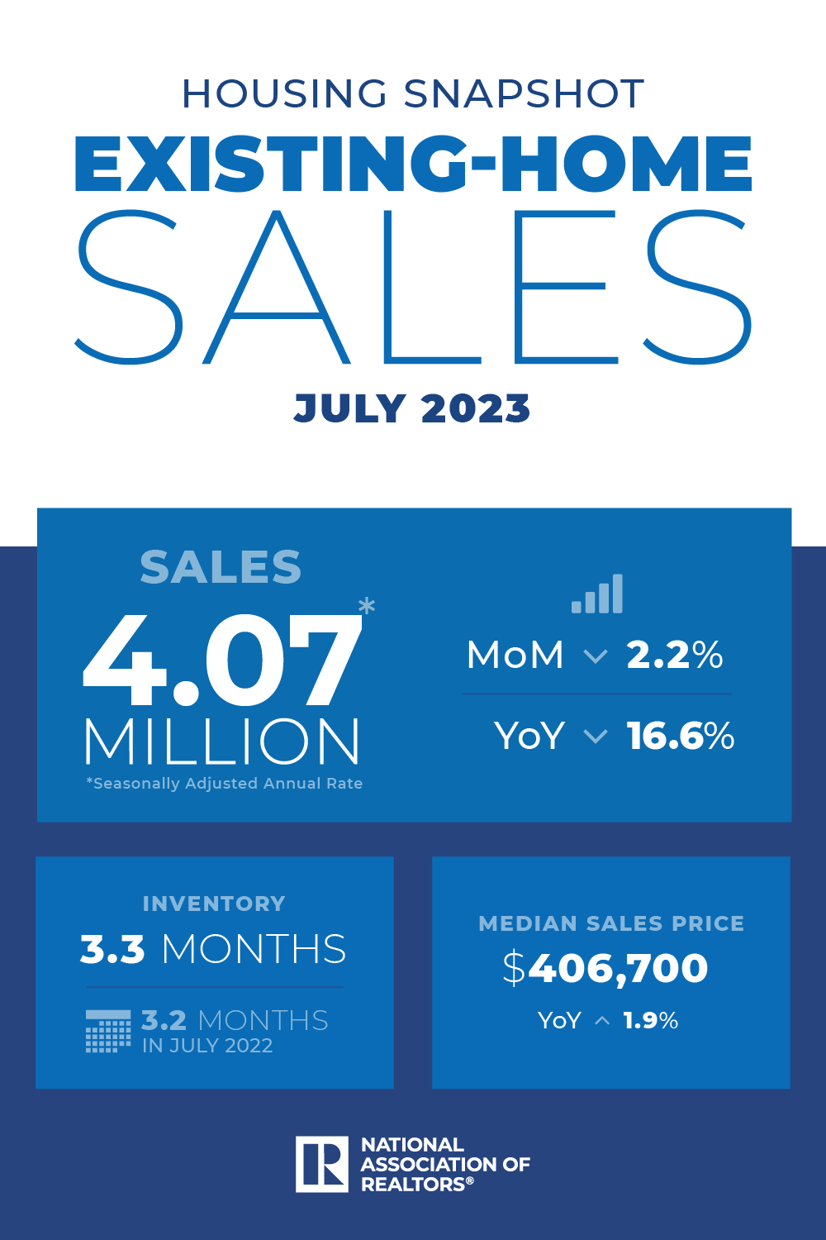
Existing-Home SALES
-2.2%
July 2023
Copyright ©2023 “Existing Home Sales.” NATIONAL ASSOCIATION OF REALTORS®. All rights reserved. Reprinted with permission. July 2023..nar.realtor/
Notes:
TALKING POINTS
Existing home sales fell 2.2% in July.
The median existing-home sales price rose in July by 1.9% from one year ago to $406,8700. This is the fourth time the monthly median sales price has exceeded $400,000.
The national absorption rate for existing homes is 3.3 months, continuing its upward swing.
WHY IS THIS IMPORTANT?
This is good information to include in your listing presentation to help set the correct expectations for sellers.
Higher interest rates are slowing the pace of sales.
If you’re working with renters, be aware that they face affordability challenges.

Slide 16
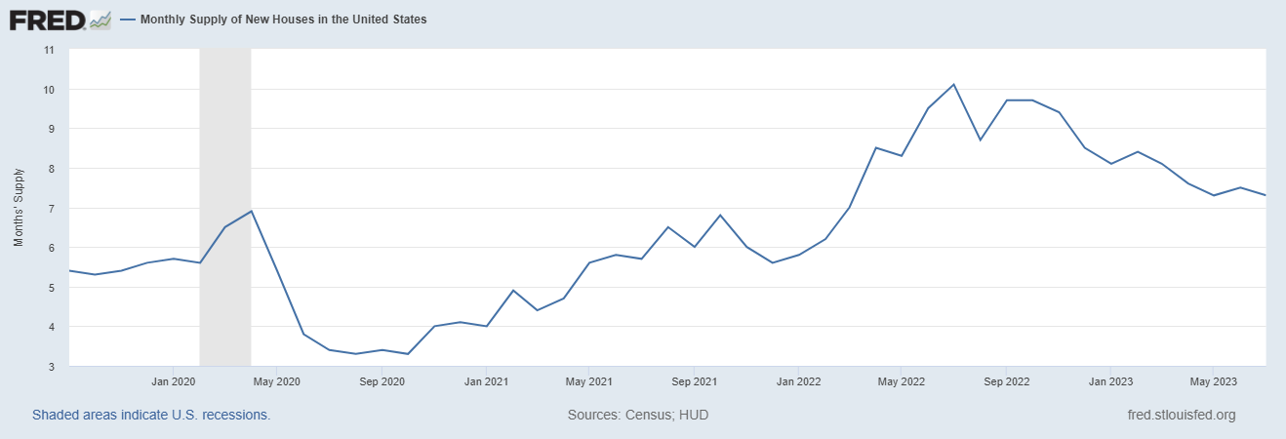
Monthly Supply of New Houses
7.3
July 2023
U.S. Census Bureau and U.S. Department of Housing and Urban Development, Monthly Supply of New Houses in the United States [MSACSR], retrieved from FRED, Federal Reserve Bank of St. Louis; https://fred.stlouisfed.org/series/MSACSR.
Notes:
TALKING POINTS
The monthly absorption rate of new construction homes is increasing slightly.
The National Association of Home Builders estimates that “…at least 1.5 million housing units are needed to meet demand and bring the housing market into balance.”
Why is this important?
If your buyers are considering buying new construction, make sure you are recommending a private home inspection vs. the builder’s inspector. Homes are going up quickly to take advantage of existing homes’ low inventory, and sub-contractors aren’t held accountable as they should. Even local County building departments have been known to let sub-par work slide during the inspection.
Builders, like existing home sellers, still have the upper hand in hot markets, so getting builders to throw in extras at no charge will be challenging.

Slide 17
Real Estate Trends Local Market Report
Notes:
Total number of listings currently available per MLS
Number of pendings last month per MLS
Number of closed transactions last month per MLS

Slide 18
Real Estate Trends Company Production
Notes:
Production Updates, Listings, Under Contracts, Closings (various ways to share)
Previous month vs. the same period last year
Year To Date (YTD)
Year Over Year (YOY)
Market Share

Slide 19
Real Estate Trends Company Data
Notes:
Average DOM from List to Under Contract
Average DOM from Under Contract to Close
Average / Median List Price
Average / Median Sales Price
Company’s List Price to Sales Price Ratio

Slide 20
Old Business & New Business
Notes:
Updates and follow-up to the previous meeting
“Parking Lot” items

Slide 21
Next Meeting
INSERT Date & Time
INSERT Location
INSERT Next Meeting Highlight
Notes:
TIP: Consider adding a meeting teaser, such as the learning sprint topic, below the meeting location

Slide 22
Spark Your Business
Sweetest Day
October 21st
Create gift bags with an assortment of candy.
Notes:
Select the “Spark Your Business” slide(s) you wish to share and hide the rest.

Slide 23
Spark Your Business
National Checklist Day
October 30th
Mail your power sphere a packet of quarterly home maintenance checklists.
Image Credit:
Real Estate Simplicity
Notes:
Select the “Spark Your Business” slide(s) you wish to share and hide the rest.

Slide 24
Spark Your Business
Halloween
October 31st
Surprise your SOI with pumpkins and carving kits.
Notes:
Select the “Spark Your Business” slide(s) you wish to share and hide the rest.

Slide 25
Spark Your Business
Daylight Saving
Time Ends
November 5th
Send your SOI an email to remind them to turn back their clocks.
Notes:
Select the “Spark Your Business” slide(s) you wish to share and hide the rest.

