Slide 1
September Market Strategies

Slide 2
Welcome

Slide 3
Meeting Agenda
Company Updates
Marketing Updates
Education Opportunities
Practical Learning
Real Estate Trends
Old Business
New Business
Adjourn
Notes:
NOTE: Edit the agenda as appropriate for your meeting.

Slide 4
Company Updates
Notes:
New company listings and buyer needs
Company Initiatives (company-specific updates or topics you deem appropriate)
“Parking Lot” items from previous meetings
Agent Sales Contest

Slide 5
Marketing Updates
Notes:
Company marketing initiatives
Company community service projects and events
Agent marketing opportunities that complement company/brand marketing

Slide 6
Education Opportunities

Slide 7
Practical Learning
Click the link to the video you wish to play.
PowerPoint users may also use the embedded videos on the following slides.
Content Marketing Kickstart
https://sparkandlogic.com/videos/content-marketing-kickstart/
FSBO Conversion Strategy
https://sparkandlogic.com/videos/fsbo-conversion-2/
Become a Referral Magnet
https://sparkandlogic.com/videos/become-a-referral-magnet/
What’s in the Box?
https://sparkandlogic.com/videos/whats-in-the-box/
Monthly Goal Setting
Full length: https://sparkandlogic.com/videos/monthly-goal-setting/
Short version: https://sparkandlogic.com/videos/monthly-goal-setting-short-version/
Notes:
Learning Sprint Video Instructions
PowerPoint
Option 1: Use this slide to click on the link to the video you wish to play. You must be logged into your Spark & Logic account to play the video.
Option 2: Use one of the following slides to play the embedded video.
Hide or delete the slides you do not wish to use
Google Slides or Keynote
Option 1: Use this slide to click on the link to the video you wish to play
Embedded videos will not play in Google Slides or Keynote.
Hide or delete the slides you do not wish to use

Slide 8
Embedded videos are for PowerPoint only.
Videos will NOT play in Google Slides or Keynote.
Notes:
Hide this slide if you do not wish to play this video.
Embedded videos are for PowerPoint only. Videos will NOT play in Google Slides or Keynote.

Slide 9
Embedded videos are for PowerPoint only.
Videos will NOT play in Google Slides or Keynote.
Notes:
Hide this slide if you do not wish to play this video.
Embedded videos are for PowerPoint only. Videos will NOT play in Google Slides or Keynote.

Slide 10
Embedded videos are for PowerPoint only.
Videos will NOT play in Google Slides or Keynote.
Notes:
Hide this slide if you do not wish to play this video.
Embedded videos are for PowerPoint only. Videos will NOT play in Google Slides or Keynote.

Slide 11
Embedded videos are for PowerPoint only.
Videos will NOT play in Google Slides or Keynote.
Notes:
Hide this slide if you do not wish to play this video.
Embedded videos are for PowerPoint only. Videos will NOT play in Google Slides or Keynote.

Slide 12
FULL LENGTH VIDEO (for the first time you do this activity)
Embedded videos are for PowerPoint only.
Videos will NOT play in Google Slides or Keynote.
Notes:
FULL LENGTH VERSION of Monthly Goal Setting for the first time you introduce the activity.
Hide this slide if you do not wish to play this video.
Embedded videos are for PowerPoint only. Videos will NOT play in Google Slides or Keynote.

Slide 13
SHORT VIDEO (you have done the activity in the past and only need a quick activity introduction)
Embedded videos are for PowerPoint only.
Videos will NOT play in Google Slides or Keynote.
Notes:
SHORT VERSION of Monthly Goal Setting when you have done the activity in the past and want a quick introduction to the activity.
Hide this slide if you do not wish to play this video.
Embedded videos are for PowerPoint only. Videos will NOT play in Google Slides or Keynote.

Slide 14
Guest Speaker
<INSERT SPEAKER NAME & COMPANY>
Notes:
NOTE: Delete if not using a guest speaker.

Slide 15
30-Year Fixed Mortgage Rates
6.71%
June 2023
6.81%
July 2023
Source: Macrotrends.net
Notes:
TALKING POINTS
To the surprise of no one, the Fed raised the Fed funds rate 25 basis points (.25% increase).
Chair Powell said they might raise rates at the next meeting or the one after that…or maybe not.
The Federal Reserve has a target rate of 2% inflation. We’re currently hovering around 3%.
WHY IS THIS IMPORTANT?
Two percent is supposed to be the sweet spot for inflation, low enough for consumer comfort but relaxed enough for the economy to flourish, evidenced by job growth, which is very healthy.
It’s essential to share with your sellers that although historically mortgage interest rates aren’t alarming if you compare them to what we experienced in the late 80s and again in the early 2000s, buyers are still hesitant to make offers as they are still waiting for rates to come back down. Many buyers dislike getting into a bidding war and overpaying for a home, especially if they’re financing it.
If buyers pay top dollar or above, plus assuming a higher interest rate, a seller’s home needs to be in top shape to edge out their competition (primarily new construction). Pay attention to the Existing Home Sales rate and drill down to your local market’s absorption rate.
Now is the time to show your buyers and sellers your market knowledge through data analysis – Absorption Rate charts can be beneficial. Another approach is tracking price per square foot and comparing it YOY and MOM.

Slide 16
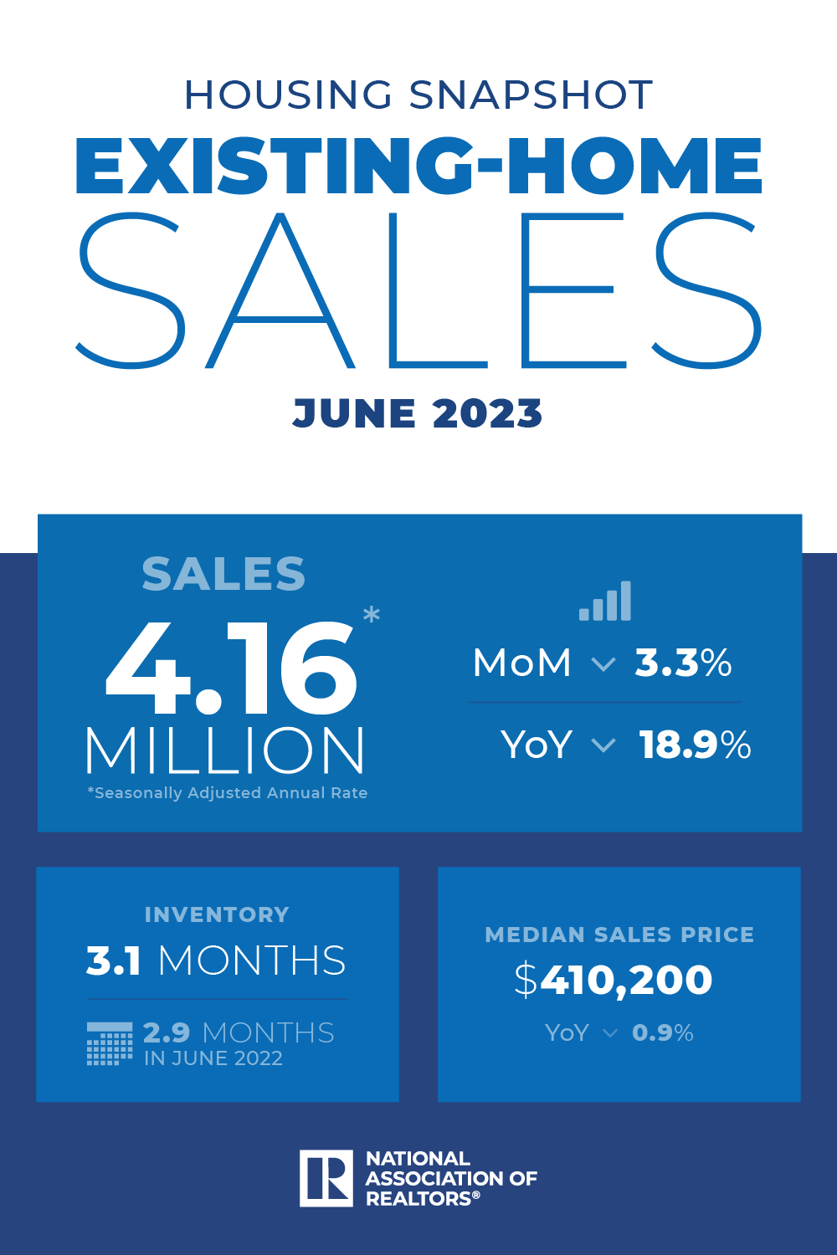
Existing-Home SALES
-3.3%
June 2023
Copyright ©2023 “Existing Home Sales.” NATIONAL ASSOCIATION OF REALTORS®. All rights reserved. Reprinted with permission. June 2023..nar.realtor/
Notes:
TALKING POINTS
June saw existing home sales decrease by over 3% - and sales are down by almost 19% from this time last year.
The median existing-home sales price rose in June – the second highest price ever recorded since January 1999 when NAR first began tracking this data.
The national absorption rate for existing homes is 3.1 months, unchanged from last month.
WHY IS THIS IMPORTANT?
Housing affordability is deteriorating, with home prices generally creeping up and interest rates again testing recent highs.
It’s important to set realistic expectations with your buyers, there are not enough homes for sale in most markets.
*Note: Existing Home Sales for July 2023 will be released 8/22/2023.

Slide 17
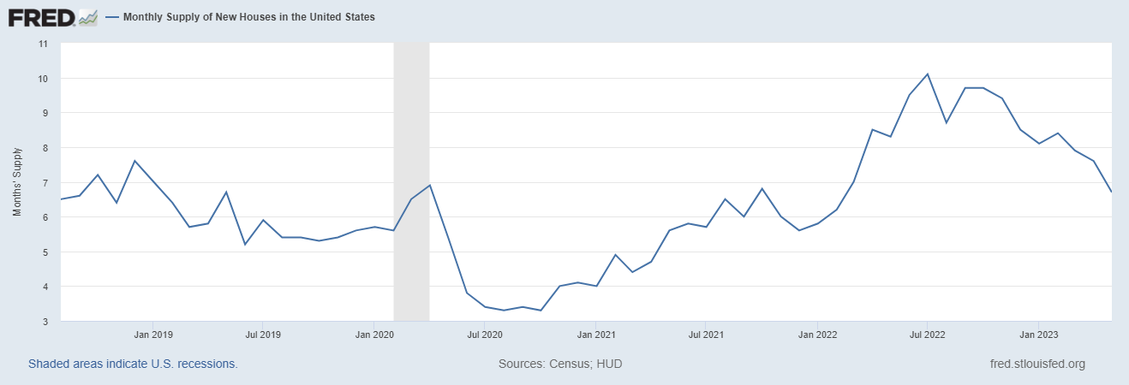
Monthly Supply of New Houses
7.4
June 2023
U.S. Census Bureau and U.S. Department of Housing and Urban Development, Monthly Supply of New Houses in the United States [MSACSR], retrieved from FRED, Federal Reserve Bank of St. Louis; https://fred.stlouisfed.org/series/MSACSR, August 3, 2023.
Notes:
TALKING POINTS
Is the appetite of buyers who want new construction starting to sour? The absorption rate for new houses rose to 7.4 months of supply from 6.7 months in June.
WHY IS THIS IMPORTANT?
With many markets still experiencing historically low inventory rates, more buyers are considering new construction.
You may want to scope out new developments in your market and introduce yourself to the builder or their sales staff.
Identify which builders will work with you regarding commission and what the protocol is; for example, will you need to accompany the buyer on their first visit to the development to qualify for a commission if they buy? How do you register a buyer?
Talk to your buyers about the advantages of having you represent them with new construction vs. negotiating the purchase independently. Remember, the builder’s salesperson does not represent the buyer’s interest; they represent the builder. And the builder’s sub-contractors may not always provide the highest quality of work.
When talking to sellers, let them know that their competition won’t just be existing homes for sale but also new construction and why.
*Note: This report will be updated on 8/26/2023.

Slide 18
Real Estate Trends Local Market Report
Notes:
Total number of listings currently available per MLS
Number of pendings last month per MLS
Number of closed transactions last month per MLS

Slide 19
Real Estate Trends Company Production
Notes:
Production Updates, Listings, Under Contracts, Closings (various ways to share)
Previous month vs. the same period last year
Year To Date (YTD)
Year Over Year (YOY)
Market Share

Slide 20
Real Estate Trends Company Data
Notes:
Average DOM from List to Under Contract
Average DOM from Under Contract to Close
Average / Median List Price
Average / Median Sales Price
Company’s List Price to Sales Price Ratio

Slide 21
Old Business & New Business
Notes:
Updates and follow-up to the previous meeting
“Parking Lot” items

Slide 22
Next Meeting
INSERT Date & Time
INSERT Location
INSERT Next Meeting Highlight
Notes:
TIP: Consider adding a meeting teaser, such as the learning sprint topic, below the meeting location

Slide 23
Spark Your Business
National Peanut Day
September 13th
Create gift bags with an assortment of nuts.
Image credit: Front Porch Portraits
Notes:
Select the “Spark Your Business” slide(s) you wish to share and hide the rest.

Slide 24
Spark Your Business
National Neighbor Day
September 28th
^{Meet your neighbors!}
Pop by with a CMA or branded items.
Notes:
Select the “Spark Your Business” slide(s) you wish to share and hide the rest.

Slide 25
Spark Your Business
National Coffee Day
September 29th
Surprise your SOI with specialty coffee and flavored creamers.
Image credit: Front Porch Portraits
Notes:
Select the “Spark Your Business” slide(s) you wish to share and hide the rest.

Slide 26
Spark Your Business
National VFW Day
September 29th
Raise funds for your local VFW post.
Notes:
Select the “Spark Your Business” slide(s) you wish to share and hide the rest.

