Slide 1
August Technology

Slide 2
Welcome

Slide 3
Meeting Agenda
Company Updates
Marketing Updates
Education Opportunities
Practical Learning
Real Estate Trends
Old Business
New Business
Adjourn
Notes:
NOTE: Edit the agenda as appropriate for your meeting.

Slide 4
Company Updates
Notes:
New company listings and buyer needs
Company Initiatives (company-specific updates or topics you deem appropriate)
“Parking Lot” items from previous meetings
Agent Sales Contest

Slide 5
Marketing Updates
Notes:
Company marketing initiatives
Company community service projects and events
Agent marketing opportunities that complement company/brand marketing

Slide 6
Education Opportunities

Slide 7
Practical Learning
Click the link to the video you wish to play.
PowerPoint users may also use the embedded videos on the following slides.
Gain the AI Advantage
https://sparkandlogic.com/videos/gain-the-ai-advantage/
Tech Trends: Tools for Real Estate Success
https://sparkandlogic.com/videos/tech-trends-tools-for-real-estate-success/
Cybersecurity
https://sparkandlogic.com/videos/cybersecurity/
Agent Mastermind: Business Technology
https://sparkandlogic.com/videos/agent-mastermind-business-technology/
Monthly Goal Setting
Full length: https://sparkandlogic.com/videos/monthly-goal-setting/
Short version: https://sparkandlogic.com/videos/monthly-goal-setting-short-version/
Notes:
Learning Sprint Video Instructions
PowerPoint
Option 1: Use this slide to click on the link to the video you wish to play. You must be logged into your Spark & Logic account to play the video.
Option 2: Use one of the following slides to play the embedded video.
Hide or delete the slides you do not wish to use
Google Slides or Keynote
Option 1: Use this slide to click on the link to the video you wish to play
Embedded videos will not play in Google Slides or Keynote.
Hide or delete the slides you do not wish to use

Slide 8
Embedded videos are for PowerPoint only.
Videos will NOT play in Google Slides or Keynote.
Notes:
Hide this slide if you do not wish to play this video.
Embedded videos are for PowerPoint only. Videos will NOT play in Google Slides or Keynote.

Slide 9
Embedded videos are for PowerPoint only.
Videos will NOT play in Google Slides or Keynote.
Notes:
Hide this slide if you do not wish to play this video.
Embedded videos are for PowerPoint only. Videos will NOT play in Google Slides or Keynote.

Slide 10
Embedded videos are for PowerPoint only.
Videos will NOT play in Google Slides or Keynote.
Notes:
Hide this slide if you do not wish to play this video.
Embedded videos are for PowerPoint only. Videos will NOT play in Google Slides or Keynote.

Slide 11
Embedded videos are for PowerPoint only.
Videos will NOT play in Google Slides or Keynote.
Notes:
Hide this slide if you do not wish to play this video.
Embedded videos are for PowerPoint only. Videos will NOT play in Google Slides or Keynote.

Slide 12
FULL LENGTH VIDEO (for the first time you do this activity)
Embedded videos are for PowerPoint only.
Videos will NOT play in Google Slides or Keynote.
Notes:
FULL LENGTH VERSION of Monthly Goal Setting for the first time you introduce the activity.
Hide this slide if you do not wish to play this video.
Embedded videos are for PowerPoint only. Videos will NOT play in Google Slides or Keynote.

Slide 13
SHORT VIDEO (you have done the activity in the past and only need a quick activity introduction)
Embedded videos are for PowerPoint only.
Videos will NOT play in Google Slides or Keynote.
Notes:
SHORT VERSION of Monthly Goal Setting when you have done the activity in the past and want a quick introduction to the activity.
Hide this slide if you do not wish to play this video.
Embedded videos are for PowerPoint only. Videos will NOT play in Google Slides or Keynote.

Slide 14
Guest Speaker
<INSERT SPEAKER NAME & COMPANY>
Notes:
NOTE: Delete if not using a guest speaker.

Slide 15
30-Year Fixed Mortgage Rates
6.69%
June 2023
6.71%
July 2023
Source: Macrotrends.net
Notes:
TALKING POINTS
June’s inflation fell to 3% YOY from 4% in May and from a peak of 9.1% on 6/22. The numbers are still not where the Feds want them to be.
Although the 30-year fixed rate only increased slightly in July, the bottom line is that the battle isn’t over yet.
WHY IS THIS IMPORTANT?
It’s essential to share with your sellers that although historically mortgage interest rates aren’t alarming if you compare them to what we experienced in the late 80s and again in the early 2000s, buyers are still hesitant to make offers as they are still waiting for rates to come back down. Many buyers dislike getting into a bidding war and overpaying for a home.
If buyers pay top dollar or above, plus assuming a higher interest rate, a seller’s home needs to be in top shape to edge out their competition (primarily new construction). Pay attention to the Existing Home Sales rate – since sales in all four regions of the US declined year-over-year.
Now is the time to show your buyers and sellers your market knowledge through data analysis – Absorption Rate charts can be beneficial. Another approach is tracking price per square foot and comparing it YOY and MOM – the national median house price is down 3.1% YOY to $396,100.

Slide 16
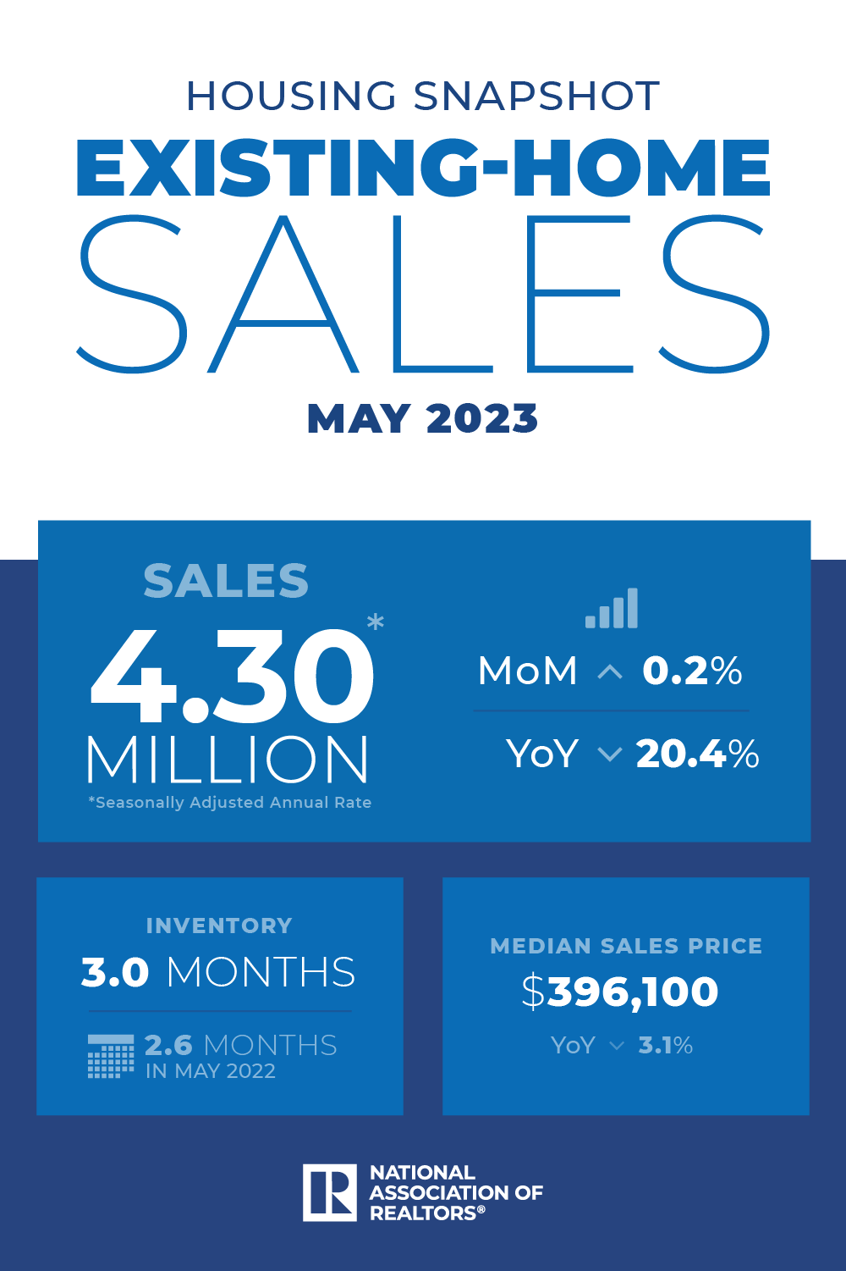
Existing-Home SALES
4.30M
May 2023
Copyright ©2023 “Existing Home Sales.” NATIONAL ASSOCIATION OF REALTORS®. All rights reserved. Reprinted with permission. May 2023..nar.realtor/
Notes:
TALKING POINTS
Existing home sales increased 0.2% in May, with gains in the South and West and declines in the Northeast and Midwest regions.
It’s crucial to keep your eye on YOY trends – existing home sales have declined over 20% since June 2022.
WHY IS THIS IMPORTANT?
Housing affordability is deteriorating, with home prices generally creeping up and interest rates again testing recent highs.
Using the median-priced home, it’s taking almost 36% of a buyer’s household income to cover the monthly mortgage payment.
Affordability is very close to the 37-year low reached in late 2022.
When talking to your sellers, listen to see if selling quickly is part of their objective because the list price will matter.

Slide 17
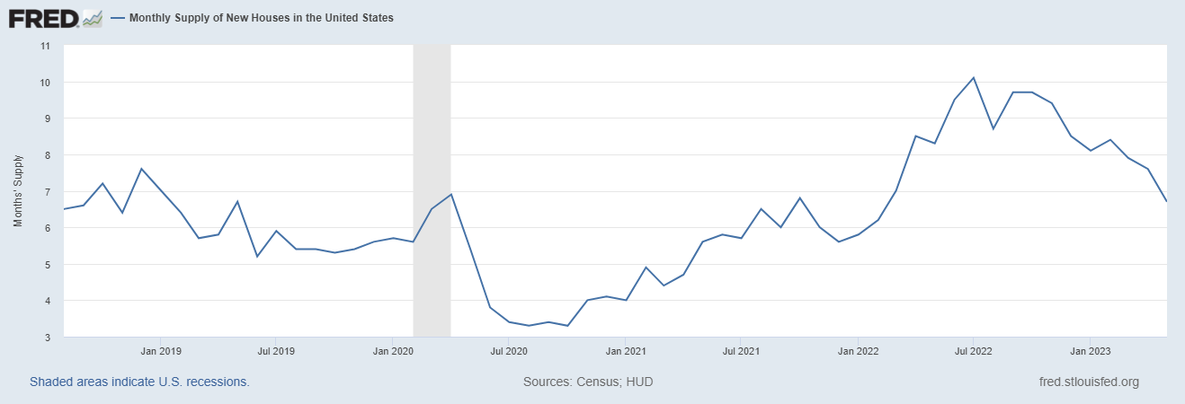
Monthly Supply of New Houses
6.7
May 2023
U.S. Census Bureau and U.S. Department of Housing and Urban Development, Monthly Supply of New Houses in the United States [MSACSR], retrieved from FRED, Federal Reserve Bank of St. Louis; https://fred.stlouisfed.org/series/MSACSR, July 17, 2023.
Notes:
TALKING POINTS
In the US, more buyers are turning to new construction to get into a home rather than face multiple offer situations on existing homes.
This has led to the absorption rate of new construction single-family homes decreasing to 6.7 months of inventory, down from 7.6 in April.
Why is this important?
With many markets still experiencing historically low inventory rates, more buyers are considering new construction.
You may want to scope out new developments in your market and introduce yourself to the builder or their sales staff.
Identify which builders will work with you regarding commission and what the protocol is; for example, will you need to accompany the buyer on their first visit to the development to qualify for a commission if they buy? How do you register a buyer?
Talk to your buyers about the advantages of having you represent them with new construction vs. negotiating the purchase independently. Remember, the builder’s salesperson does not represent the buyer’s interest; they represent the builder.
When talking to sellers, let them know that their competition won’t just be existing homes for sale but also new construction and why.

Slide 18
Real Estate Trends Local Market Report
Notes:
Total number of listings currently available per MLS
Number of pendings last month per MLS
Number of closed transactions last month per MLS

Slide 19
Real Estate Trends Company Production
Notes:
Production Updates, Listings, Under Contracts, Closings (various ways to share)
Previous month vs. the same period last year
Year To Date (YTD)
Year Over Year (YOY)
Market Share

Slide 20
Real Estate Trends Company Data
Notes:
Average DOM from List to Under Contract
Average DOM from Under Contract to Close
Average / Median List Price
Average / Median Sales Price
Company’s List Price to Sales Price Ratio

Slide 21
Old Business & New Business
Notes:
Updates and follow-up to the previous meeting
“Parking Lot” items

Slide 22
Next Meeting
INSERT Date & Time
INSERT Location
INSERT Next Meeting Highlight
Notes:
TIP: Consider adding a meeting teaser, such as the learning sprint topic, below the meeting location

Slide 23
Spark Your Business
National Beach Day
August 30th
Create gift bags with inflatable balls, sunglasses, and a beach toys.
Image credit: REdigitalassist
Notes:
Select the “Spark Your Business” slide(s) you wish to share and hide the rest.

Slide 24
Spark Your Business
National Cheese Pizza Day
September 5th
Surprise your SOI with a pizza kit
^{or pizzeria gift card!}
Image credit: mMadeDesignCo.
Notes:
Select the “Spark Your Business” slide(s) you wish to share and hide the rest.

Slide 25
Spark Your Business
Pop by with umbrellas and sunglasses!
Image credit: Tidylady Printables
Notes:
Select the “Spark Your Business” slide(s) you wish to share and hide the rest.

Slide 26
Spark Your Business
National Food Bank Day
September 1st
Organize food drive for your local food bank.
Notes:
Select the “Spark Your Business” slide(s) you wish to share and hide the rest.

