Slide 1
June Outperform Your Competition

Slide 2
Welcome

Slide 3
Meeting Agenda
Company Updates
Marketing Updates
Education Opportunities
Practical Learning
Real Estate Trends
Old Business
New Business
Adjourn
Notes:
NOTE: Edit the agenda as appropriate for your meeting.

Slide 4
Company Updates
Notes:
New company listings and buyer needs
Company Initiatives (company-specific updates or topics you deem appropriate)
“Parking Lot” items from previous meetings
Agent Sales Contest

Slide 5
Marketing Updates
Notes:
Company marketing initiatives
Company community service projects and events
Agent marketing opportunities that complement company/brand marketing

Slide 6
Education Opportunities

Slide 7
Practical Learning
Click the link to the video you wish to play.
PowerPoint users may also use the embedded videos on the following slides.
Outperform Your Competition: 6 Essential Strategies
https://sparkandlogic.com/videos/outperform-your-competition-6-essential-strategies/
3 Seconds to Make a Great First Impression
https://sparkandlogic.com/videos/3-seconds-to-make-a-great-first-impression/
Absorption Rate
https://sparkandlogic.com/videos/absorption-rate/
Be More Visible
https://sparkandlogic.com/videos/be-more-visible/
Monthly Goal Setting
Full length: https://sparkandlogic.com/videos/monthly-goal-setting/
Short version: https://sparkandlogic.com/videos/monthly-goal-setting-short-version/
Notes:
Learning Sprint Video Instructions
PowerPoint
Option 1: Use this slide to click on the link to the video you wish to play. You must be logged into your Spark & Logic account to play the video.
Option 2: Use one of the following slides to play the embedded video.
Hide or delete the slides you do not wish to use
Google Slides or Keynote
Option 1: Use this slide to click on the link to the video you wish to play
Embedded videos will not play in Google Slides or Keynote.
Hide or delete the slides you do not wish to use

Slide 8
Embedded videos are for PowerPoint only.
Videos will NOT play in Google Slides or Keynote.
Notes:
Hide this slide if you do not wish to play this video.
Embedded videos are for PowerPoint only. Videos will NOT play in Google Slides or Keynote.

Slide 9
Embedded videos are for PowerPoint only.
Videos will NOT play in Google Slides or Keynote.
Notes:
Hide this slide if you do not wish to play this video.
Embedded videos are for PowerPoint only. Videos will NOT play in Google Slides or Keynote.

Slide 10
Embedded videos are for PowerPoint only.
Videos will NOT play in Google Slides or Keynote.
Notes:
Hide this slide if you do not wish to play this video.
Embedded videos are for PowerPoint only. Videos will NOT play in Google Slides or Keynote.

Slide 11
Embedded videos are for PowerPoint only.
Videos will NOT play in Google Slides or Keynote.
Notes:
Hide this slide if you do not wish to play this video.
Embedded videos are for PowerPoint only. Videos will NOT play in Google Slides or Keynote.

Slide 12
FULL LENGTH VIDEO (for the first time you do this activity)
Embedded videos are for PowerPoint only.
Videos will NOT play in Google Slides or Keynote.
Notes:
FULL LENGTH VERSION of Monthly Goal Setting for the first time you introduce the activity.
Hide this slide if you do not wish to play this video.
Embedded videos are for PowerPoint only. Videos will NOT play in Google Slides or Keynote.

Slide 13
SHORT VIDEO (you have done the activity in the past and only need a quick activity introduction)
Embedded videos are for PowerPoint only.
Videos will NOT play in Google Slides or Keynote.
Notes:
SHORT VERSION of Monthly Goal Setting when you have done the activity in the past and want a quick introduction to the activity.
Hide this slide if you do not wish to play this video.
Embedded videos are for PowerPoint only. Videos will NOT play in Google Slides or Keynote.

Slide 14
Guest Speaker
<INSERT SPEAKER NAME & COMPANY>
Notes:
NOTE: Delete if not using a guest speaker.

Slide 15
30-Year Fixed Mortgage Rates
6.32
March 2023
6.43
April 2023
Source: Macrotrends.net
Notes:
TALKING POINTS
Many experts predict that 30-year fixed rates will hover around 6% this year.
The Feds raised interest rates again on May 3rd; economists feel this might be the central bank’s last rate hike for a while because the announcement dropped a line used previously about the “likely need for additional rate increases.”

Slide 16
Existing Home Sale Rate
-2.4%
Copyright ©2023 “February Existing Home Sales.” NATIONAL ASSOCIATION OF REALTORS®. All rights reserved. Reprinted with permission. May 15, 2023, https://www.nar.realtor/research-and-statistics/housing-statistics/existing-home-sales
Notes:
TALKING POINTS
Existing home sales fell 2.4% in March, with month-over-month sales remaining steady in the Northeast but declining in the other three regions of the U.S.
The median existing-home sales price slipped 0.9% from last year to $375,700.
Good news for buyers is that the inventory of unsold existing homes rose 1.0% from March. This is the equivalent of a 2.6 months supply at the current monthly sales pace.

Slide 17
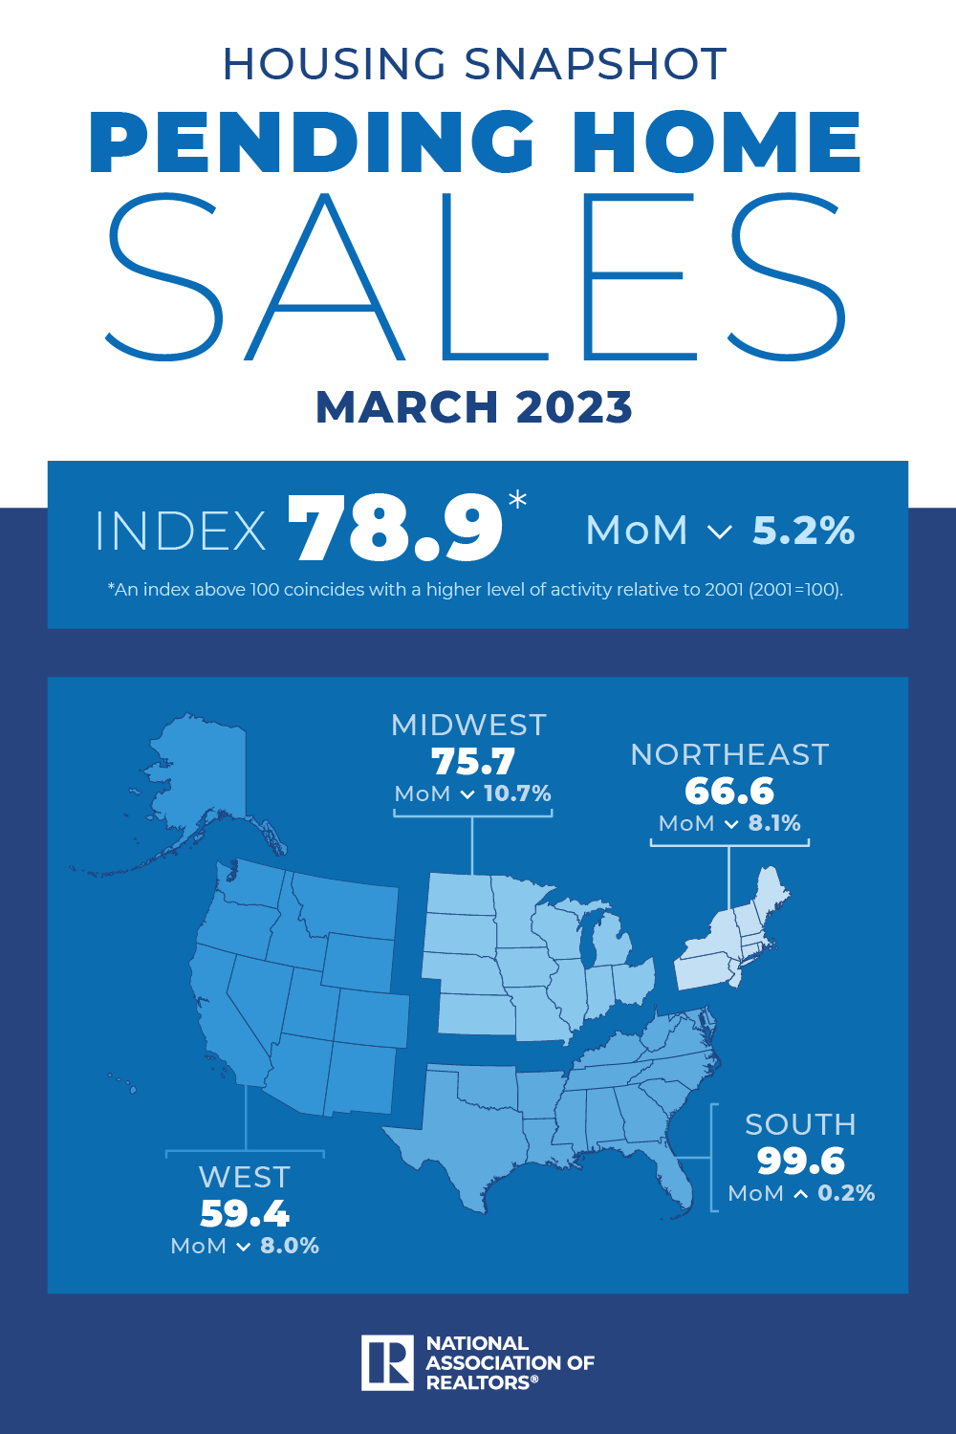
Pending Home Sales decreased slightly by -5.2% in March.
78.9
March 2023
Copyright ©2023 “Pending Home Sales Up 0.8% in February.” NATIONAL ASSOCIATION OF REALTORS®. All rights reserved. Reprinted with permission. May 15, 2023. https://www.nar.realtor/newsroom/pending-home-sales-grew-for-third-straight-month-up-0-8-in-february://www.nar.realtor/
Notes:
TALKING POINTS
Homes under contract in March were down 5.2% compared to February.
One bright spot was in the South, where pending home sales increased slightly over March’s figure.
Year-over-year, pending home sales decreased in all four US regions.

Slide 18
Monthly Supply of New Houses
7.6
March 2023
U.S. Census Bureau and U.S. Department of Housing and Urban Development, Monthly Supply of New Houses in the United States [MSACSR], retrieved from FRED, Federal Reserve Bank of St. Louis; https://fred.stlouisfed.org/series/MSACSR, May 15, 2023.
Notes:
TALKING POINTS
This percentage represents the ratio of new houses for sale to new houses sold. It’s the absorption rate for new construction.
Although builders are keeping a close eye on material costs, many home builders are generally optimistic for 2023.
The top concern for home builders is labor availability.

Slide 19
Real Estate Trends Local Market Report
Notes:
Total number of listings currently available per MLS
Number of pendings last month per MLS
Number of closed transactions last month per MLS

Slide 20
Real Estate Trends Company Production
Notes:
Production Updates, Listings, Under Contracts, Closings (various ways to share)
Previous month vs. the same period last year
Year To Date (YTD)
Year Over Year (YOY)
Market Share

Slide 21
Real Estate Trends Company Data
Notes:
Average DOM from List to Under Contract
Average DOM from Under Contract to Close
Average / Median List Price
Average / Median Sales Price
Company’s List Price to Sales Price Ratio

Slide 22
Old Business & New Business
Notes:
Updates and follow-up to the previous meeting
“Parking Lot” items

Slide 23
Next Meeting
INSERT Date & Time
INSERT Location
INSERT Next Meeting Highlight
Notes:
TIP: Consider adding a meeting teaser, such as the learning sprint topic, below the meeting location

Slide 24
Spark Your Business
Name Your Poison Day
June 8th
Invite a past client to share the
^{“poison” of their choice.}
Notes:
Select the “Spark Your Business” slide(s) you wish to share and hide the rest.

Slide 25
Spark Your Business
National Ballpoint Pen Day
June 10th
Pop by with a gift bag filled with branded pens!
Image Credit: Front Porch Portraits
Notes:
Select the “Spark Your Business” slide(s) you wish to share and hide the rest.

Slide 26
Spark Your Business
Father’s Day
June 18th
Pop by with fun or unique socks!
Image Credit: REdigitalassist
Notes:
Select the “Spark Your Business” slide(s) you wish to share and hide the rest.

Slide 27
Spark Your Business
National Smoothie Day
June 21st
^{Invite a past client to}
^{join you for a smoothie.}
Image Credit: BigTopCreations
Notes:
Select the “Spark Your Business” slide(s) you wish to share and hide the rest.

Slide 28
Spark Your Business
Birthdays & Anniversaries
Mail cards to your SOI on special dates.
Notes:
Select the “Spark Your Business” slide(s) you wish to share and hide the rest.

