Slide 1
Welcome

Slide 2
Good News!
Notes:
Let’s start the meeting on a positive note by sharing some good news. Reflect on something positive that happened and share it with the group. It could be a personal milestone, a professional accomplishment, or a simple joy that has brought a smile to your face.

Slide 3
Meeting Agenda
Company Updates
Marketing Updates
Real Estate Wants & Needs
Education Opportunities
Practical Learning
Real Estate Trends
Old Business
New Business
Adjourn
Notes:
NOTE: Edit the agenda as appropriate for your meeting.

Slide 4
Company Updates
Notes:
New company listings and buyer needs
Company Initiatives (company-specific updates or topics you deem appropriate)
“Parking Lot” items from previous meetings
Agent Sales Contest

Slide 5
Marketing Updates
Notes:
Company marketing initiatives
Company community service projects and events
Agent marketing opportunities that complement company/brand marketing

Slide 6
Wants & Needs

Slide 7
Education Opportunities

Slide 13
Guest Speaker
<INSERT SPEAKER NAME & COMPANY>
Notes:
NOTE: Delete if not using a guest speaker.

Slide 14
30-Year Fixed Mortgage Rates
7.17%
April 2024
7.03% May 2024
Source: Macrotrends.net
Notes:
TALKING POINTS
The 30-year fixed-rate decreased slightly to 7.03% at the end of May.
WHY IS THIS IMPORTANT?
Mortgage rates decreased in May as the labor market and housing data continue to point to a slowdown ahead. Rates are expected to decline gradually in 2024, but most economists don’t expect the 30 year fixed rate to fall below 6% until 2025.

Slide 15
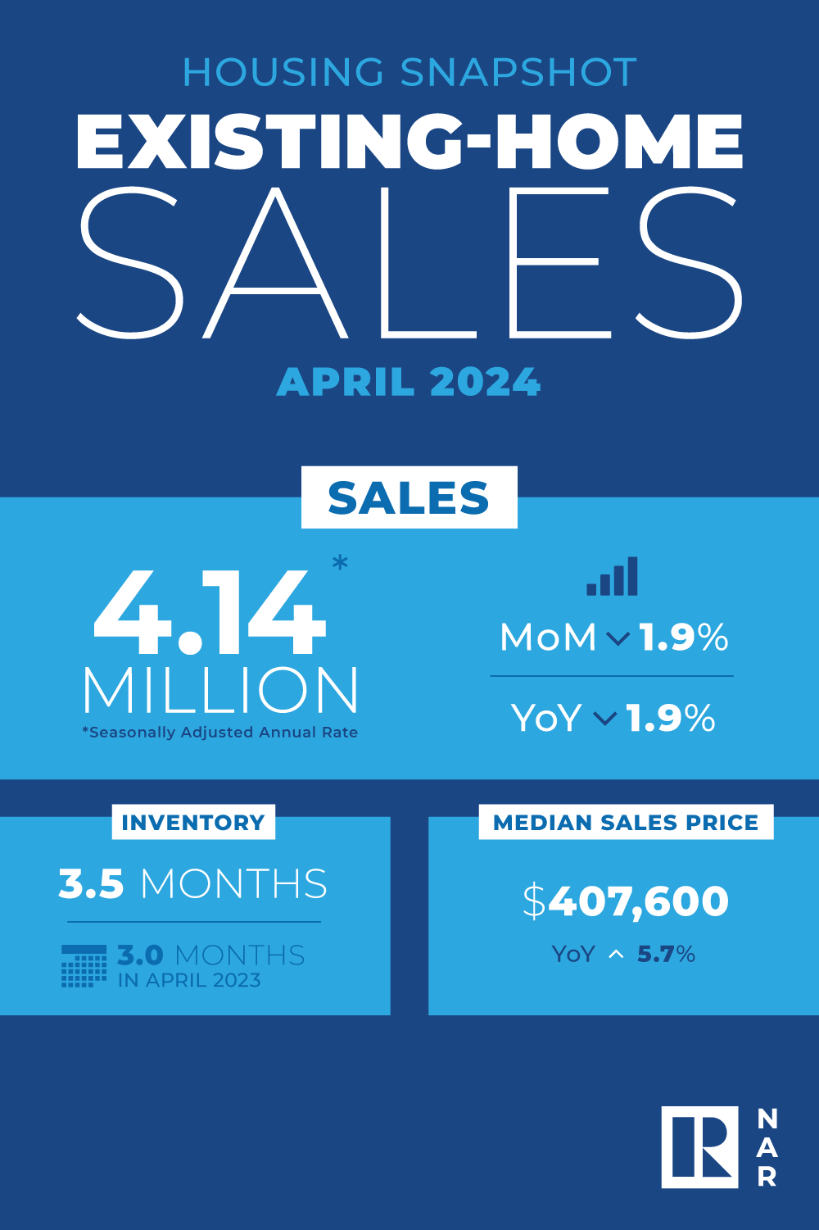
Existing-Home SALES
3.5
Months of Inventory
April 2024
Copyright ©2024 “Existing Home Sales.” NATIONAL ASSOCIATION OF REALTORS®. All rights reserved. Reprinted with permission. March 2024..nar.realtor/
Notes:
TALKING POINTS
April brought a median sales price of $407,600 and 3.5 months of inventory nationally.
WHY IS THIS IMPORTANT?
Keep your clients up-to-date on the absorption rate in your market. Nationally, the inventory of unsold existing homes grew 0.5% from last month equaling 3.5 months’ supply at the current monthly sales pace. Let your sellers know how important it is to price their homes competitively with more sellers competing for fewer buyers.

Slide 16
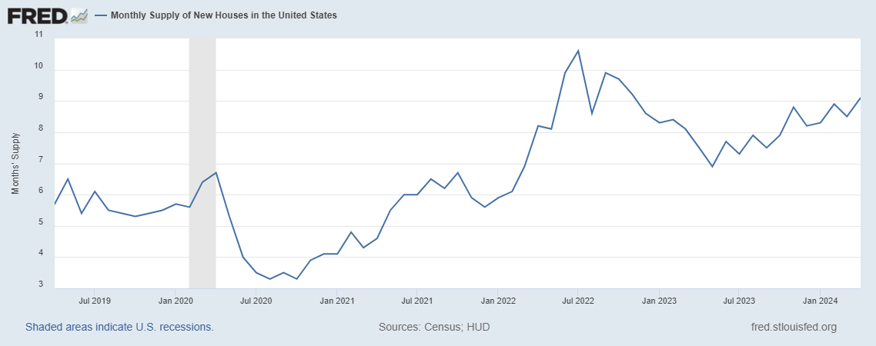
Monthly Supply of New Houses
9.1
April 2024
U.S. Census Bureau and U.S. Department of Housing and Urban Development, Monthly Supply of New Houses in the United States [MSACSR], retrieved from FRED, Federal Reserve Bank of St. Louis; https://fred.stlouisfed.org/series/MSACSR.
Notes:
TALKING POINTS
The monthly absorption rate of new construction homes increased to 9.1 months of inventory in April.
WHY IS THIS IMPORTANT?
When working with buyers, make sure you let them know that for you to represent them in a new construction transaction, you most likely will need to be present when they visit the models.
When working with sellers, include information about new subdivisions competing for the same buyer pool.

Slide 17
Real Estate Trends Local Market Report
Notes:
Total number of listings currently available per MLS
Number of pendings last month per MLS
Number of closed transactions last month per MLS

Slide 18
Real Estate Trends Company Production
Notes:
Production Updates, Listings, Under Contracts, Closings (various ways to share)
Previous month vs. the same period last year
Year To Date (YTD)
Year Over Year (YOY)
Market Share

Slide 19
Real Estate Trends Company Data
Notes:
Average DOM from List to Under Contract
Average DOM from Under Contract to Close
Average / Median List Price
Average / Median Sales Price
Company’s List Price to Sales Price Ratio

Slide 20
Old Business & New Business
Notes:
Updates and follow-up to the previous meeting
“Parking Lot” items

Slide 21
Next Meeting
INSERT Date & Time
INSERT Location
INSERT Next Meeting Highlight
Notes:
TIP: Consider adding a meeting teaser, such as the learning sprint topic, below the meeting location

Slide 22
Spark Your Business
National Watermelon Day
August 3, 2024
Drop by with a mouth-watering watermelon. Attach a clever tag and business cards.
Image Courtesy of Etsy Seller Systems and Solutions
Notes:
As we conclude today’s sales meeting, we want to leave you with one idea to help Spark Your Business and keep your pipeline full.
Staying top-of-mind can be a fun marketing activity. National Watermelon Day is August 3rd. Consider purchasing several small watermelons at your local Farmers’ Market. Tape a clever tag to the melon like this one from Etsy seller Systems and Solutions. You can edit the tag to include your name and contact information or attach a small envelope with 3 to 4 of your business cards. Identify past clients and SOI connections nearby and drop them off during the last week of July. Repeat and referral business is often your best return on investment when it comes to marketing.

Slide 23
Spark Your Business
National Spoil Your Dog Day
^{August 10, 2024}
Delight dog owners with a surprise goodie bag for their furry friends!
Image Courtesy of Etsy Seller RookieREAgent
Notes:
As we conclude today’s sales meeting, we want to leave you with one idea to help Spark Your Business and keep your pipeline full.
Identify past clients and SOI connections who are dog owners. Fill a small gift bag with dog treats, a squeaky toy, and a tennis ball. Attach a clever tag like the one shown by Etsy seller RookieREAgent, and include a couple of your business cards in the bag. Drop by to reconnect in person and leave them with this special treat for their fur baby! Connecting with people on a more personal basis will help to keep you to-of-mind when they’re asked for a real estate agent referral.

Slide 24
Spark Your Business
Newsletter
^{Summer Trends in Real Estate}
Create a newsletter focusing on summer real estate trends buyers and sellers need to know.
Notes:
As we conclude today’s sales meeting, we want to leave you with one idea to help Spark Your Business and keep your pipeline full.
Create a newsletter, electronic or print, that focuses on what buyers and sellers need to know about the summer market. Articles may include information on the types of properties in demand, tips for selling your home in the late-summer market, and the benefits of buying a home before the school year starts. Add photos where possible to make the newsletter visually appealing. This type of marketing has a long shelf life, and recipients may share it with their family, friends, and neighbors. Programs like Canva, Google Docs, and Adobe offer free templates that will help you create a professional-looking newsletter.

Slide 25
Spark Your Business
Social Media Posts
Summer Trends in Real Estate
Notes:
As we conclude today’s sales meeting, we want to leave you with one idea to help Spark Your Business and keep your pipeline full.
Create social media posts that focus on summer real estate trends, such as what buyers and sellers need to know. Articles may include current trends, such as types of properties in demand and average selling prices, tips for selling your home in the late summer market, and the benefits of buying a home before the school year starts. There are many websites that offer high-quality free stock photos, such as Adobe Stock Images and Unsplash that will make your post standout!

Slide 26
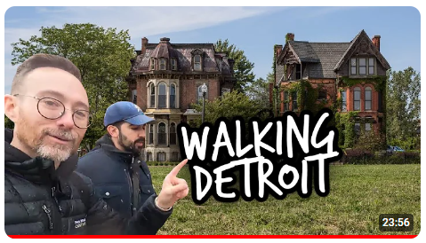
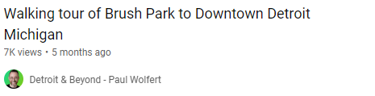
Spark Your
Business
Social Media
Virtual Neighborhood Tours
Image Courtesy of Paul Wolfert,Top 100 Agents in Michigan
Notes:
As we conclude today’s sales meeting, we want to leave you with one idea to help Spark Your Business and keep your pipeline full.
Create engaging virtual tours of neighborhoods where you have listings, where you specialize, or a neighborhood you farm. Highlight not just the homes for sale but also local amenities, schools, parks, and community events. You can conduct these tours live on social media platforms like Facebook or Instagram, allowing viewers to ask questions in real time and interact with you. Promote these tours through targeted social media advertising and email campaigns to attract potential buyers and sellers interested in those areas.
This not only showcases your knowledge of the local market but also positions you as a valuable resource for anyone looking to buy or sell in those neighborhoods. The best part of a live video is that it remains available to view even after the livestream has concluded.

