Slide 1
December Risk Management

Slide 2
Welcome

Slide 3
Meeting Agenda
Company Updates
Marketing Updates
Real Estate Wants & Needs
Education Opportunities
Practical Learning
Real Estate Trends
Old Business
New Business
Adjourn
Notes:
NOTE: Edit the agenda as appropriate for your meeting.

Slide 4
Company Updates
Notes:
New company listings and buyer needs
Company Initiatives (company-specific updates or topics you deem appropriate)
“Parking Lot” items from previous meetings
Agent Sales Contest

Slide 5
Marketing Updates
Notes:
Company marketing initiatives
Company community service projects and events
Agent marketing opportunities that complement company/brand marketing

Slide 6
Wants & Needs

Slide 7
Education Opportunities

Slide 8
Embedded videos are for PowerPoint only.
Videos will NOT play in Google Slides or Keynote.
Notes:
Hide this slide if you do not wish to play this video.
Embedded videos are for PowerPoint only. Videos will NOT play in Google Slides or Keynote.

Slide 9
Embedded videos are for PowerPoint only.
Videos will NOT play in Google Slides or Keynote.
Notes:
Hide this slide if you do not wish to play this video.
Embedded videos are for PowerPoint only. Videos will NOT play in Google Slides or Keynote.

Slide 10
Embedded videos are for PowerPoint only.
Videos will NOT play in Google Slides or Keynote.
Notes:
Hide this slide if you do not wish to play this video.
Embedded videos are for PowerPoint only. Videos will NOT play in Google Slides or Keynote.

Slide 11
Embedded videos are for PowerPoint only.
Videos will NOT play in Google Slides or Keynote.

Slide 12
FULL LENGTH VIDEO (for the first time you do this activity)
Embedded videos are for PowerPoint only.
Videos will NOT play in Google Slides or Keynote.
Notes:
FULL LENGTH VERSION of Monthly Goal Setting for the first time you introduce the activity.
Hide this slide if you do not wish to play this video.
Embedded videos are for PowerPoint only. Videos will NOT play in Google Slides or Keynote.

Slide 13
SHORT VIDEO (you have done the activity in the past and only need a quick activity introduction)
Embedded videos are for PowerPoint only.
Videos will NOT play in Google Slides or Keynote.
Notes:
SHORT VERSION of Monthly Goal Setting when you have done the activity in the past and want a quick introduction to the activity.
Hide this slide if you do not wish to play this video.
Embedded videos are for PowerPoint only. Videos will NOT play in Google Slides or Keynote.

Slide 14
Guest Speaker
<INSERT SPEAKER NAME & COMPANY>
Notes:
NOTE: Delete if not using a guest speaker.

Slide 15
30-Year Fixed Mortgage Rates
7.31%
September 2023
7.79%
October 2023
Source: Macrotrends.net
Notes:
TALKING POINTS
Interest rates continue to inch up slightly above the recorded average for October.
The Federal Reserve has indicated that it anticipates one more rate hike in 2023.
WHY IS THIS IMPORTANT?
If your buyer chooses a 30-year mortgage, ask them to check with their mortgage representative about the pros and cons of paying off their mortgage early. They should also ask their lender what costs are entailed with refinancing and how to know if it’s a good financial move for them.
If you’re working with a seller, brainstorm a few creative ideas to entice a buyer who will be mortgaging the purchase to choose the seller’s property, such as down payment assistance or offering to pay a certain number of months of an HOA fee.

Slide 16
Existing-Home SALES
-2.0%
September 2023
Copyright ©2023 “Existing Home Sales.” NATIONAL ASSOCIATION OF REALTORS®. All rights reserved. Reprinted with permission. September 2023..nar.realtor/
Notes:
TALKING POINTS
In September 2023, existing home sales fell by 2.0% month over month and 15.4% year over year.
The median sales price fell month-over-month from $407,100 in August.
WHY IS THIS IMPORTANT?
When talking with sellers this month, let them know that last month's median sales price decreased by 3.14%. Most markets are no longer seeing double-digit appreciation YOY.
For your listings, you’ll want to prepare a new market analysis each month it remains on the market to ensure your clients have their homes priced correctly.
If you’re preparing your market’s absorption rate monthly, look back at last year’s data to compare it to the national trend and share this information with your clients.
Prepare your sellers for the fact that homes may linger on the market slightly longer than last month. The national absorption rate increased from 3.3 months of inventory to 3.4 months. Provide them with ideas to help their home stand out from their competition, positioning their home for a quicker sale.
This is good information to include in your listing presentation to help set the correct expectations for sellers.
According to NAR, “Among the four major US regions, sales rose in the Northeast, but receded in the Midwest, South and West. All four regions registered year-over-year declines.”

Slide 17
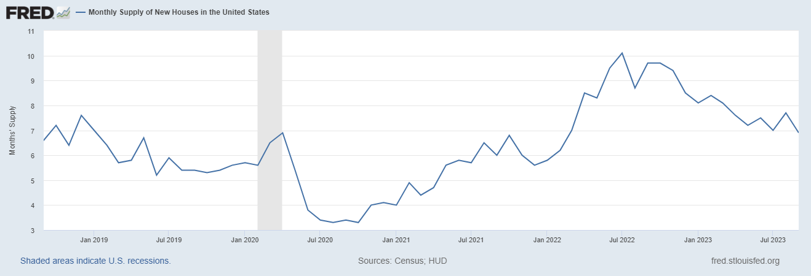
Monthly Supply of New Houses
6.9
September 2023
U.S. Census Bureau and U.S. Department of Housing and Urban Development, Monthly Supply of New Houses in the United States [MSACSR], retrieved from FRED, Federal Reserve Bank of St. Louis; https://fred.stlouisfed.org/series/MSACSR.
Notes:
TALKING POINTS
The monthly absorption rate of new construction homes fell by almost a month to 6.9 months of inventory from 7.8 months of inventory last month.
New construction sales are on the uptick.
The National Association of Home Builders estimates that “…at least 1.5 million housing units are needed to meet demand and bring the housing market into balance.”
WHY IS THIS IMPORTANT?
Now is the time to work on your buyer’s presentation – make sure you let buyers know you can represent them if they want to buy a new construction, but that it may require you to be with them on their initial visit to view the builder’s models.
Make sure you recommend to your buyers that they have a private home inspection vs. the builder’s inspector. Homes are going up quickly to take advantage of existing homes’ low inventory, and sub-contractors aren’t held accountable as they should. Even local County building departments have been known to let sub-par work slide during the inspection.
Builders, like existing home sellers, still have the upper hand in hot markets, so getting builders to throw in extras at no charge will be challenging.

Slide 18
Real Estate Trends Local Market Report
Notes:
Total number of listings currently available per MLS
Number of pendings last month per MLS
Number of closed transactions last month per MLS

Slide 19
Real Estate Trends Company Production
Notes:
Production Updates, Listings, Under Contracts, Closings (various ways to share)
Previous month vs. the same period last year
Year To Date (YTD)
Year Over Year (YOY)
Market Share

Slide 20
Real Estate Trends Company Data
Notes:
Average DOM from List to Under Contract
Average DOM from Under Contract to Close
Average / Median List Price
Average / Median Sales Price
Company’s List Price to Sales Price Ratio

Slide 21
Old Business & New Business
Notes:
Updates and follow-up to the previous meeting
“Parking Lot” items

Slide 22
Next Meeting
INSERT Date & Time
INSERT Location
INSERT Next Meeting Highlight
Notes:
TIP: Consider adding a meeting teaser, such as the learning sprint topic, below the meeting location

Slide 23
Spark Your Business
National Cocoa Day
December 13th
Give your SOI gift bags containing a mug,
hot cocoa mix, and marshmallows.
Notes:
Select the “Spark Your Business” slide(s) you wish to share and hide the rest.

Slide 24
Spark Your Business
National Cookie Exchange Day
December 22nd
Surprise your SOI with homemade or specialty cookies.
Notes:
Select the “Spark Your Business” slide(s) you wish to share and hide the rest.

Slide 25
Spark Your
Business
Show your 2023 clients that they are clients for life by helping them prepare for tax time.
Mail or email a copy of their closing statement in early January.
Include a personalized letter.
Notes:
Select the “Spark Your Business” slide(s) you wish to share and hide the rest.

Slide 26
Spark Your Business
Acts of Kindness
Donate
Volunteer
Pay it Forward
Notes:
Select the “Spark Your Business” slide(s) you wish to share and hide the rest.

